Slide 1
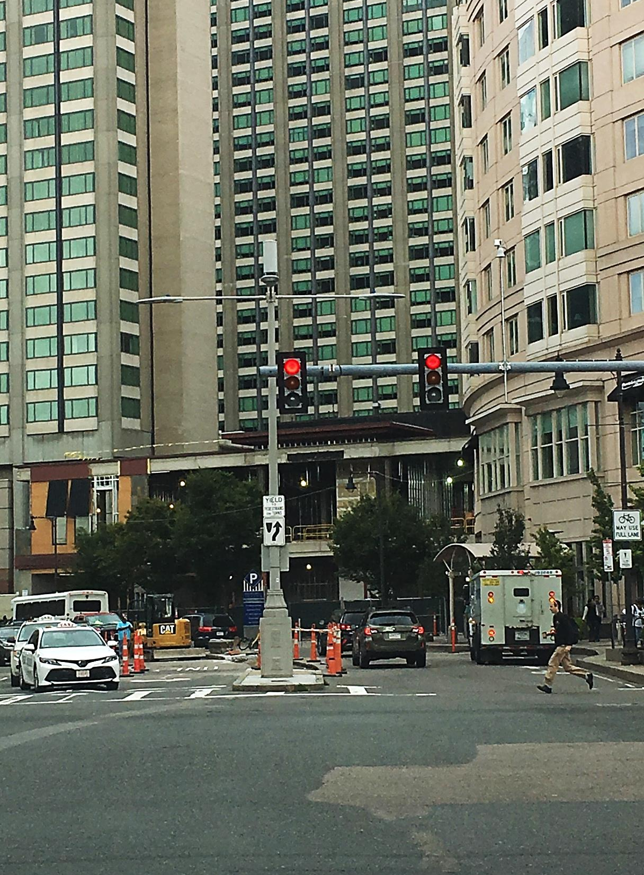
Big Changes Coming to Small Cells
Thousand Oaks
November 19, 2018 Presenter:
Dr. Jonathan L. Kramer
Partner
Telecom Law Firm, P.C.
www.TelecomLawFirm.com
Los Angeles – San Diego
Small cell: Boston, MA.

Slide 2
FCC’s 2018 Small Cell Order
broad preemption for “small cell wireless facilities” as a new regulatory classification
abrogates governmental regulatory and proprietary distinction in the small cell context
shorter shot clocks require municipalities to do more with less time – including MLA negotiations

Slide 3
FCC’s 2018 Small Cell Order
approved by FCC on September 26, 2018
effective 90 days after publication in Federal Register
January 14, 2019
appeals and requests for stay have been filed in court and at the FCC
appeals likely to take 12 to 18 months & rules are applicable during appeals unless stayed …how likely?

Slide 4
What’s a “Small Wierless Facility”? (SWF)

Slide 5
What’s a Small Cell?
Small cells are only the size of a pizza box! Yeah. A pizza box…that’s it!

Slide 6
Jonathan is a very meaty Pizza Topping The Podium is the Cheese inside the Crust

Slide 7
What does 28 cubic feet look
in the field?

Slide 8
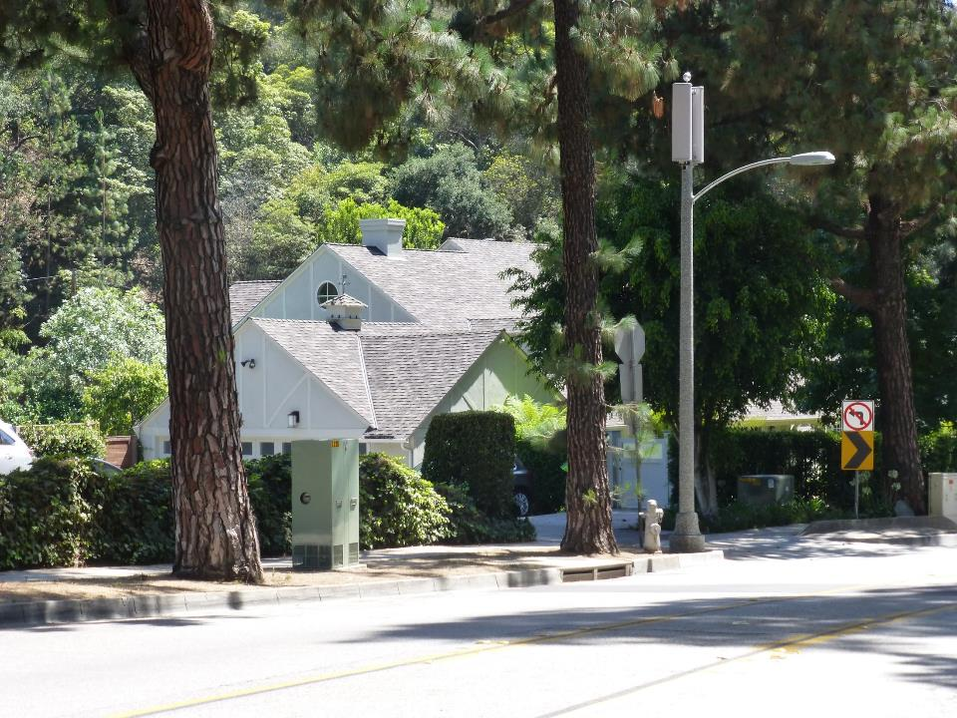

Slide 9
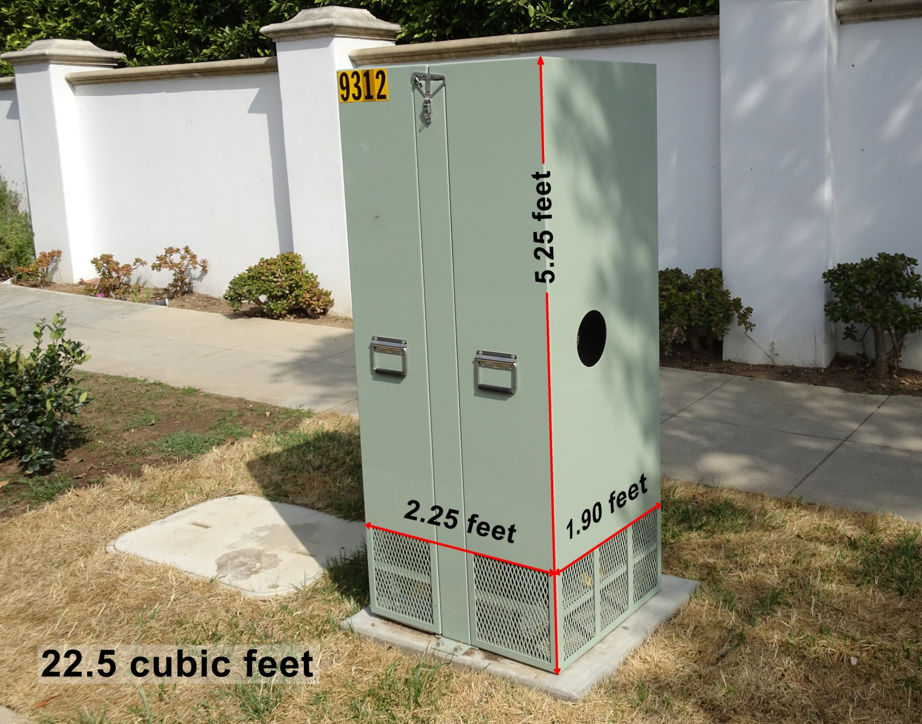
AT&T

Slide 10
Plus how many 3 cubic foot antennas?
Antennas are NOT counted in the 28 cubic foot ‘small wireless facility’ volume calculation
No limit to the number of 3 cubic foot antennas
Typical 6’ tall panel antennas are less than or equal to 3 cubic feet in volume

Slide 11
Effective Prohibitions
General Rule
a state or local requirement effectively prohibits deployment when it “materially limits or inhibits any competitor’s or potential competitor’s ability to compete in a fair and balanced legal and regulatory environment.”
Fee Requirements
must be (1) reasonably approximate to cost; (2) objectively reasonable to pass to applicant; and (3) no higher than fees charged to competitors in similar circumstances
Non-Fee Requirements (e.g. Aesthetics)
must be (1) reasonable; (2) no more burdensome than those applied to other infrastructure deployments; and (3) objective and published in advance

Slide 12
Effective Prohibitions
Law | Pre-Small Cell Order | Post-Small Cell Order
Regulatory Fees | evaluated under a liberal “totality of the circumstances” test that required the plaintiff to show an actual prohibition | limited to cost; prohibited if any higher than fees charged to a competitor; no requirement to show that fees above cost actually prohibit deployment
Proprietary Rents | insulated from preemption under “market participant” doctrine | no longer insulated; limited to cost as described above
Aesthetic Regulations | evaluated under “significant gap/least intrusive means” test adopted by 9th Circuit | invalid unless: (1) reasonable; (2) no more stringent than those applied to other infrastructure; and (3) published in advance

Slide 13
Fees Compared
 | Market Rate | Regulated Prices
Annual License Fee | $750 to $1,500* | reasonable costs; presumed reasonable at or below $270
One-Time License Execution Fee | ~ $5,000 | actual cost; no presumptively reasonable amount
One-Time Site License Processing Fee | $500 to $1,000 | actual cost; presumed reasonable at or below $100 per collocation or $1,000 per new pole
Permit Fee | reasonable cost | included in one-time processing fee

Slide 14
New & Old Shot Clock Rules
Shorter Timeframes
60 days | small wireless facility “collocations” ♣ all eligible facility requests under Section 6409♦
90 days | small wireless facilities on new structures ♣ collocations not covered as an eligible facilities request or small wireless facility֎
150 days | everything else…♣ new, freestanding non-small wireless facilities֎
♦ FCC deemed-approved if shot clock busted
֎ AB57 deemed-approved if shot clock busted
♣ Applicant must sue City

Slide 15
New Shot Clock Rules
Broader Applicability
collocations cover attachments to any existing structure
includes pre-application meetings, license negotiations for pole attachments, permit review, appeals and (maybe) all ministerial permits
Batched Applications
may not prohibit batched applications
the longest shot clock in the batch governs
not much further guidance

Slide 16
New Shot Clock Rules
The New ‘One-Time’ Reset Button
shot clock goes back to zero when:
application is materially incomplete at 1st submittal
incomplete notice goes out w/in first 10 days
incomplete items must be publicly stated
is this a trap? (The FCC may Giveth, but the FCC also wants to Taketh Away)

Slide 17
Why so many?
Estimated: 30 to 60-ish small cell per sq. mile per carrier in the next 5-ish years, plus ~8 mi new fiber in each sq. mile
Why: Reduce latency, increase capacity by limiting coverage, in-building coverage, fixed wireless (to replace cable modems, DSL, etc.)

Slide 18
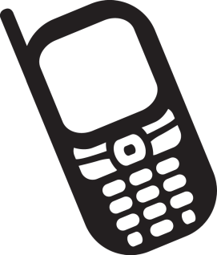
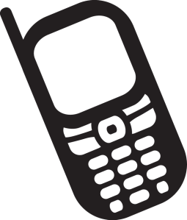
Latency
(or, ‘Closer to the Cell Site Results in Faster Data Transfer’)
(( ))
((( )))
18

Slide 19
Multiple In Multiple Out (“MIMO”)
(or, ‘Multiple Bands Bonded Results in Faster Data’)
(( ))
((( )))
19

Slide 20
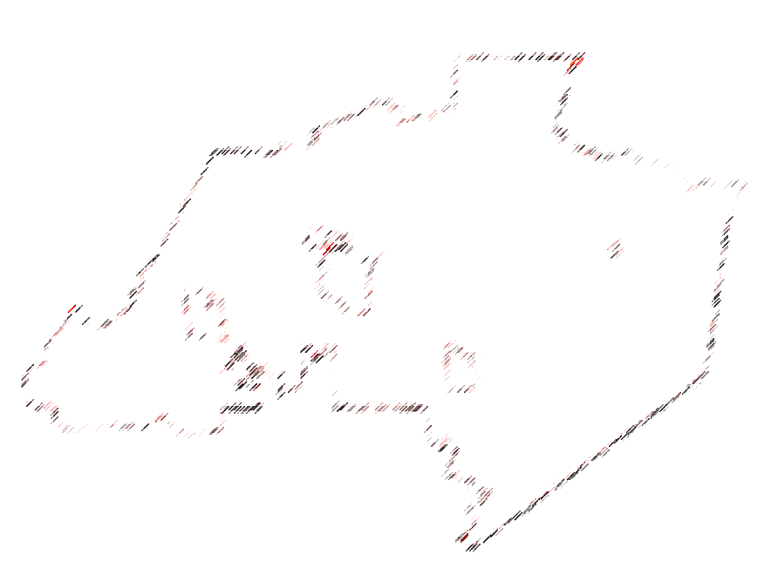
Thousand Oaks (Estimates only!)
Land area: 55.18 sq. mi (land)
and 4 national carriers (today)
…but let’s be ultra conservative:
= 25 sq mi * 4 carriers * 20 per sq mi =
~2,000 small cells/SWFs
…plus…
25 sq mi * 8 miles of fiber per sq mi =
~200 miles of new fiber optic cables

Slide 21
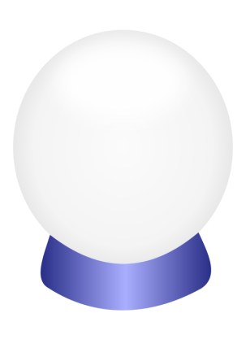
Sacramento 2019?
New wireless regulation to include all flavors of FCC shot clocks as ‘deemed approved’ (AB 57 update)?
Require even faster processing than FCC?
Allow siting in every zone?
Set local permit fees as to what’s ‘reasonable’?
Limit undergrounding and camo?
Further limit appeals

Slide 22
Some examples of existing small cells and existing sites that would qualify as SWFs…

Slide 24
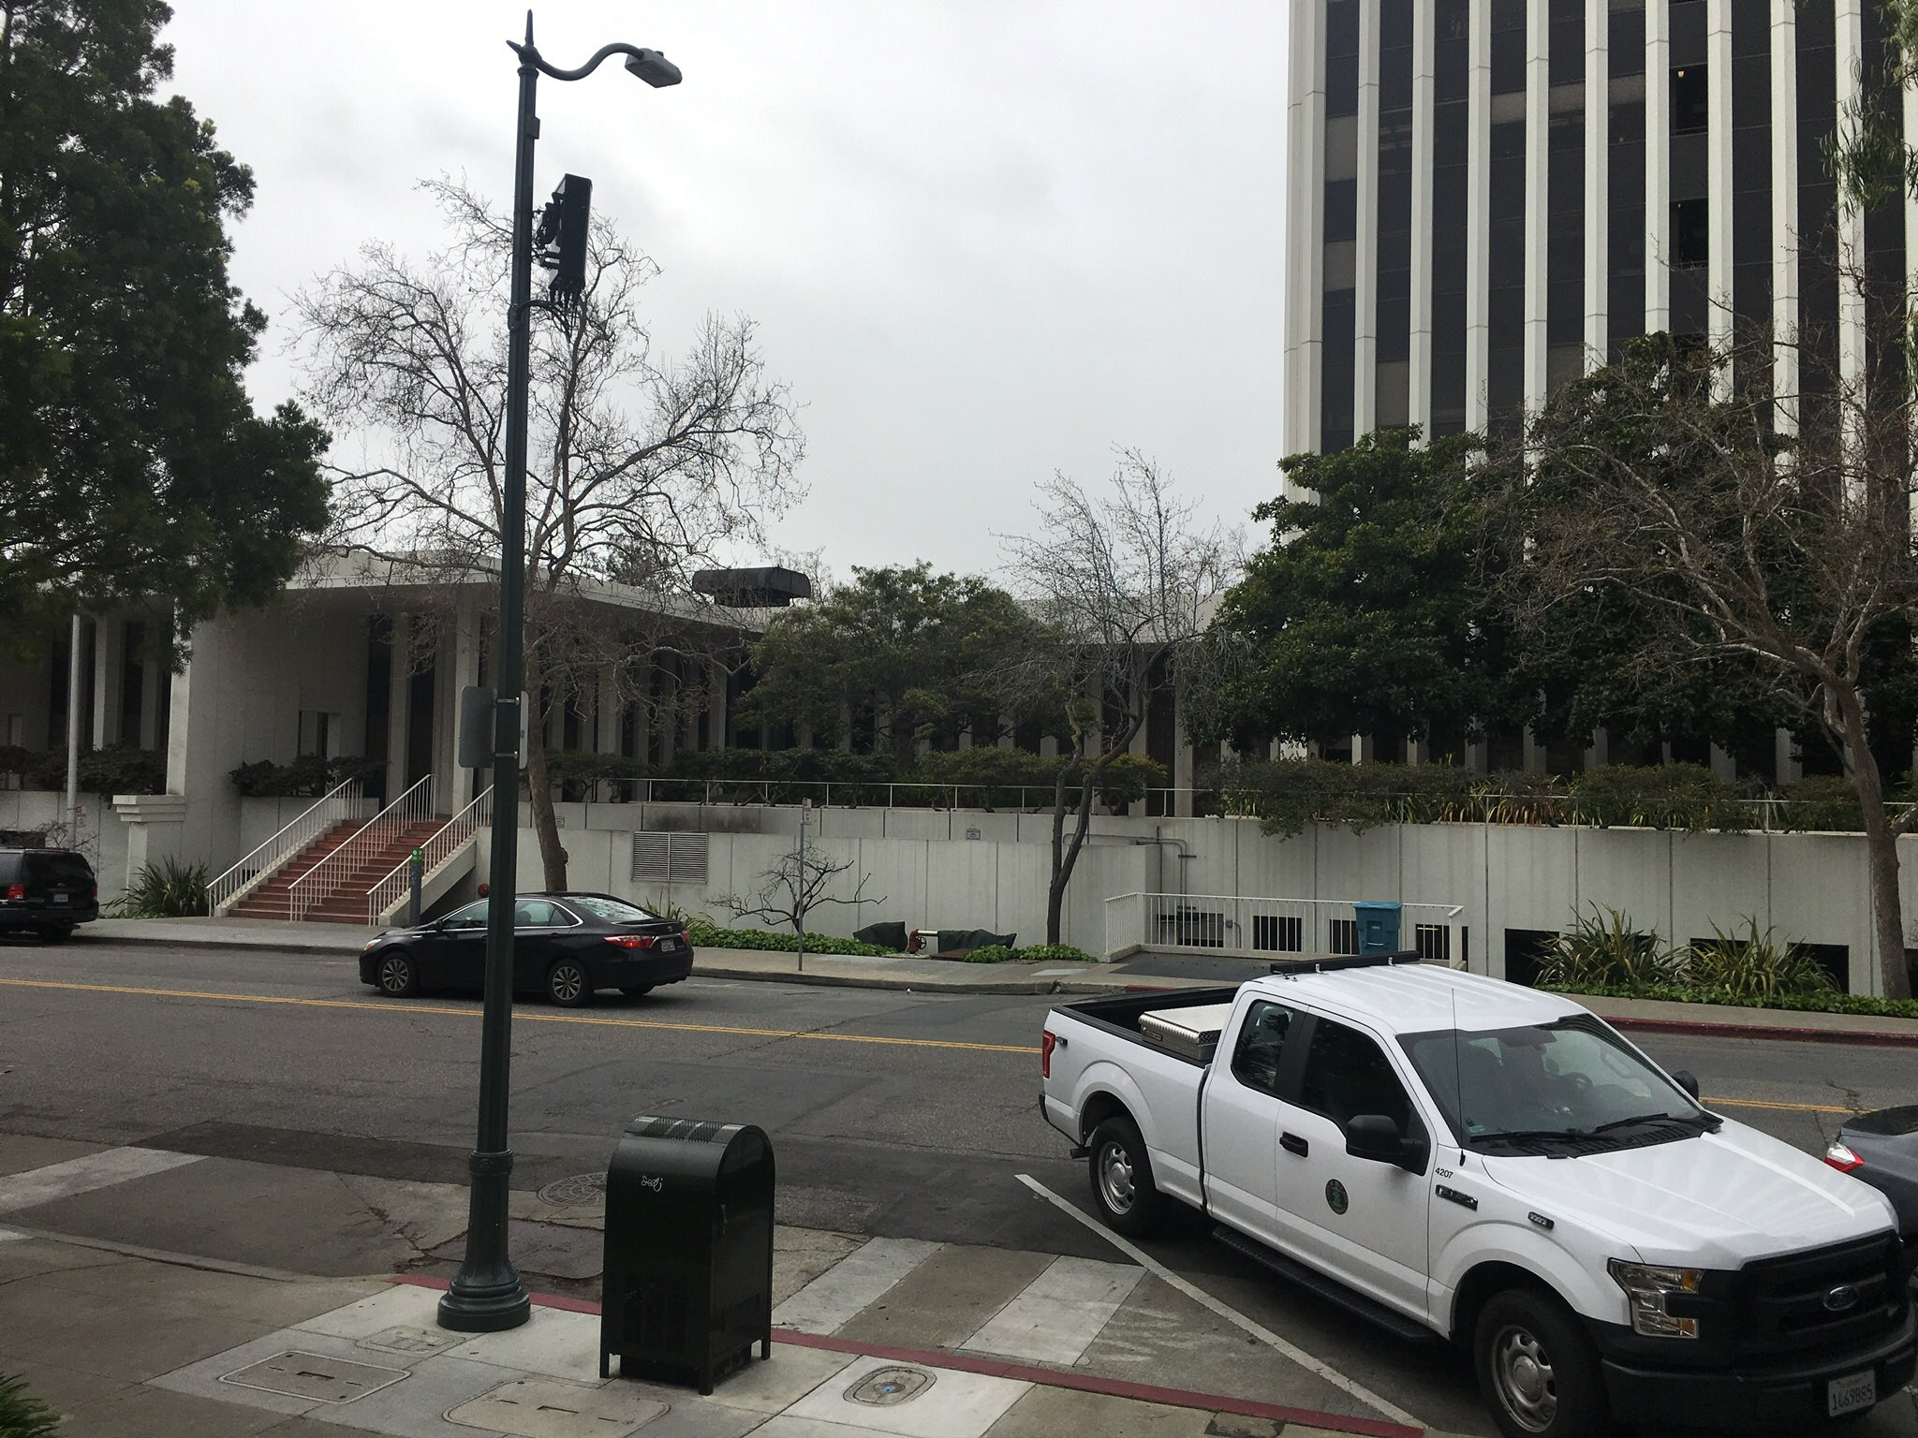
Base station equipment in
faux mailbox

Slide 25
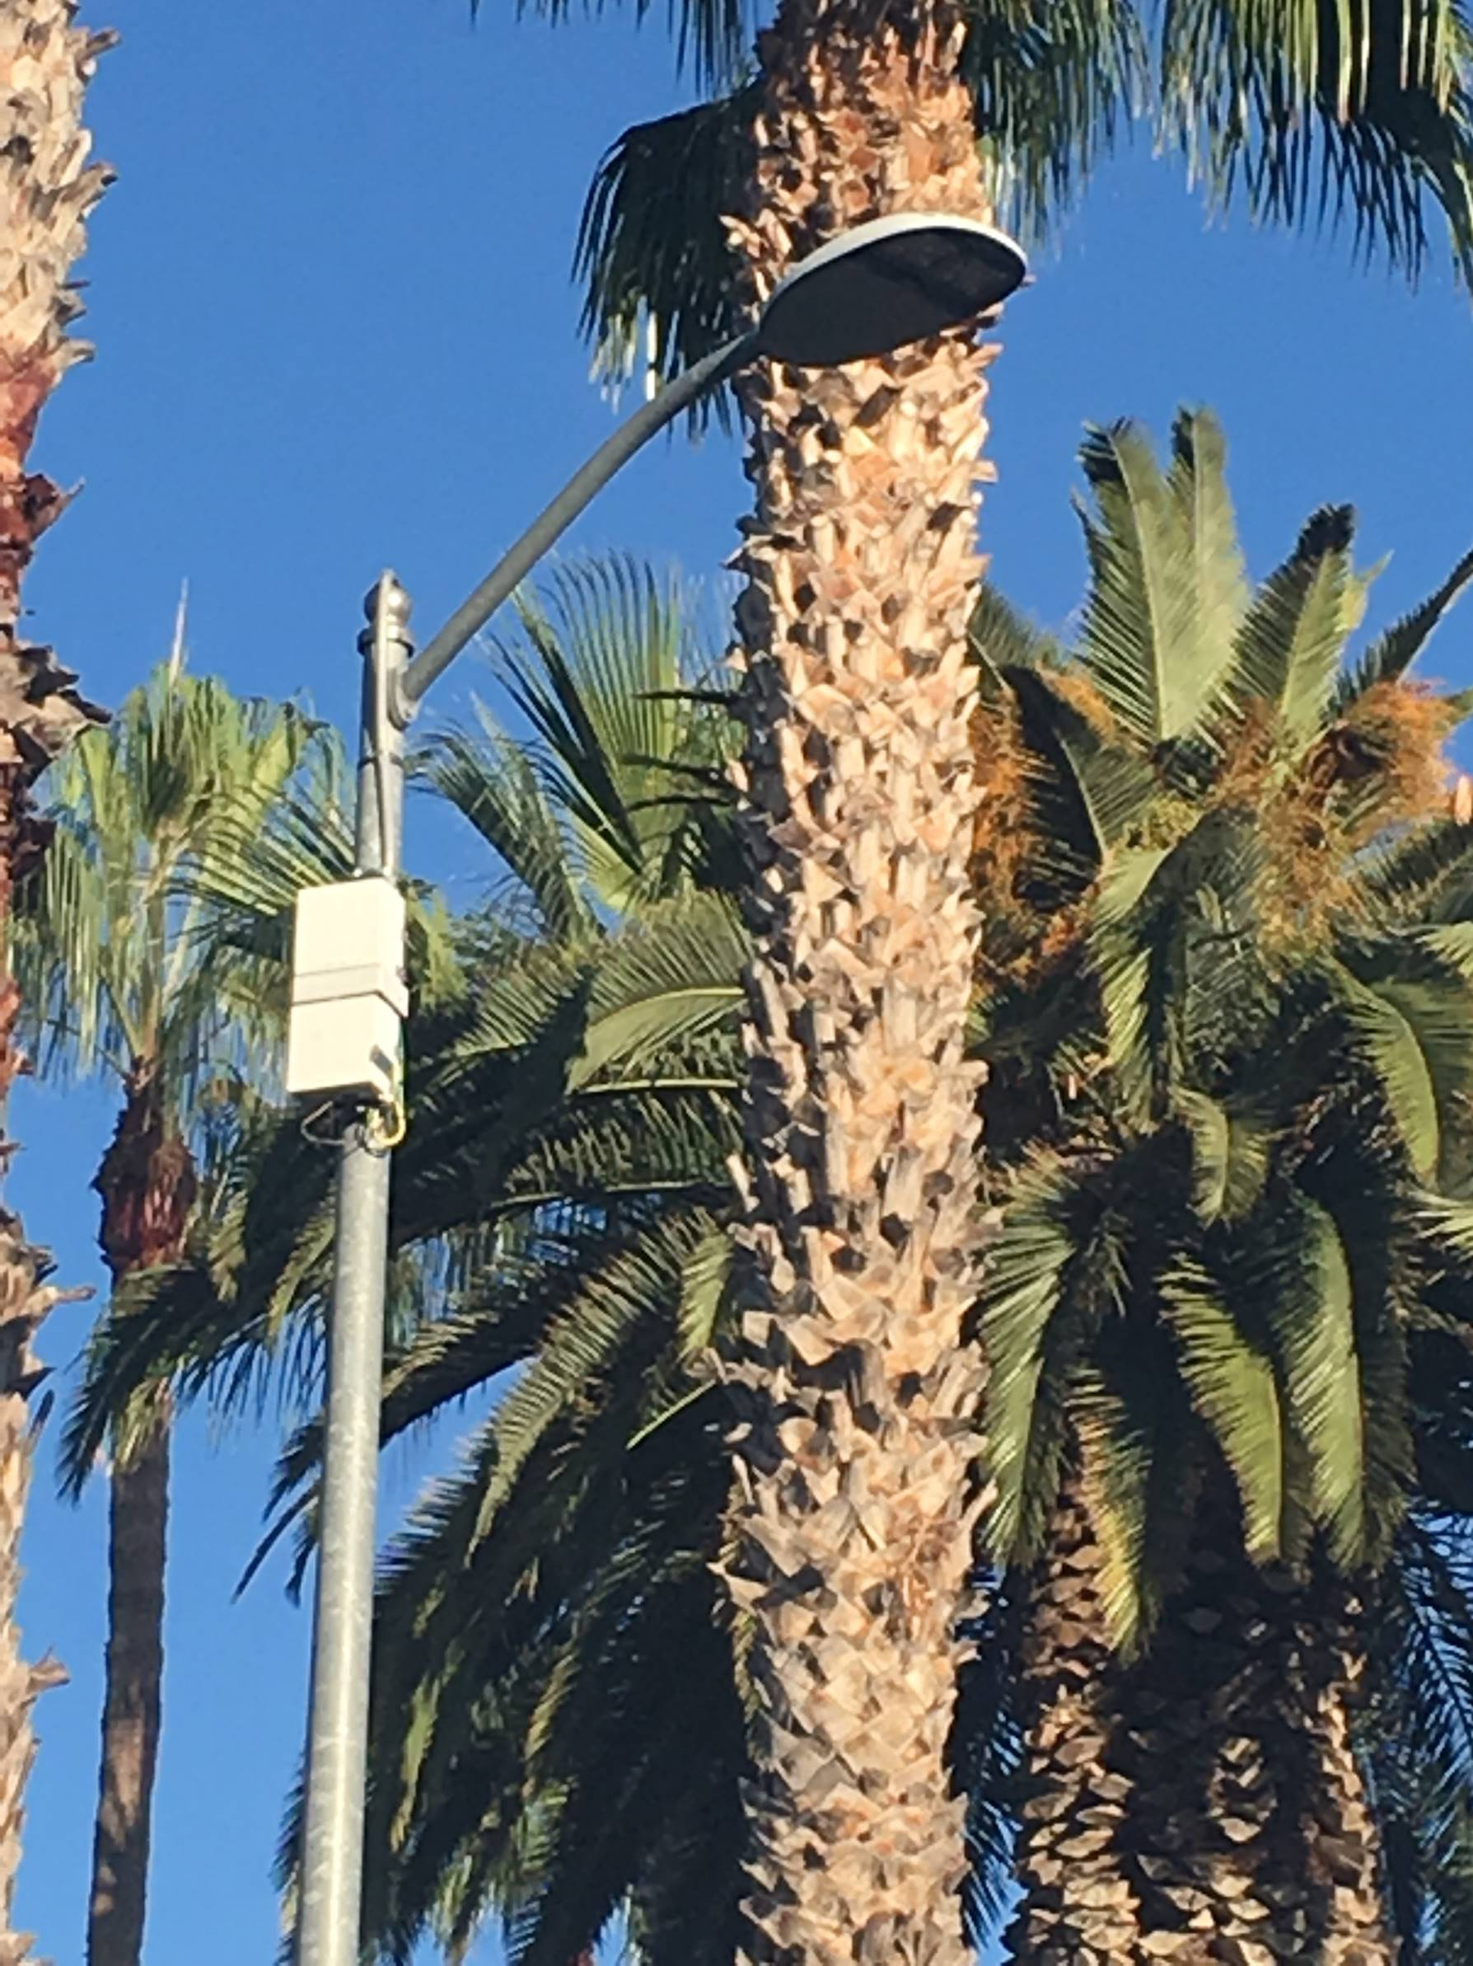
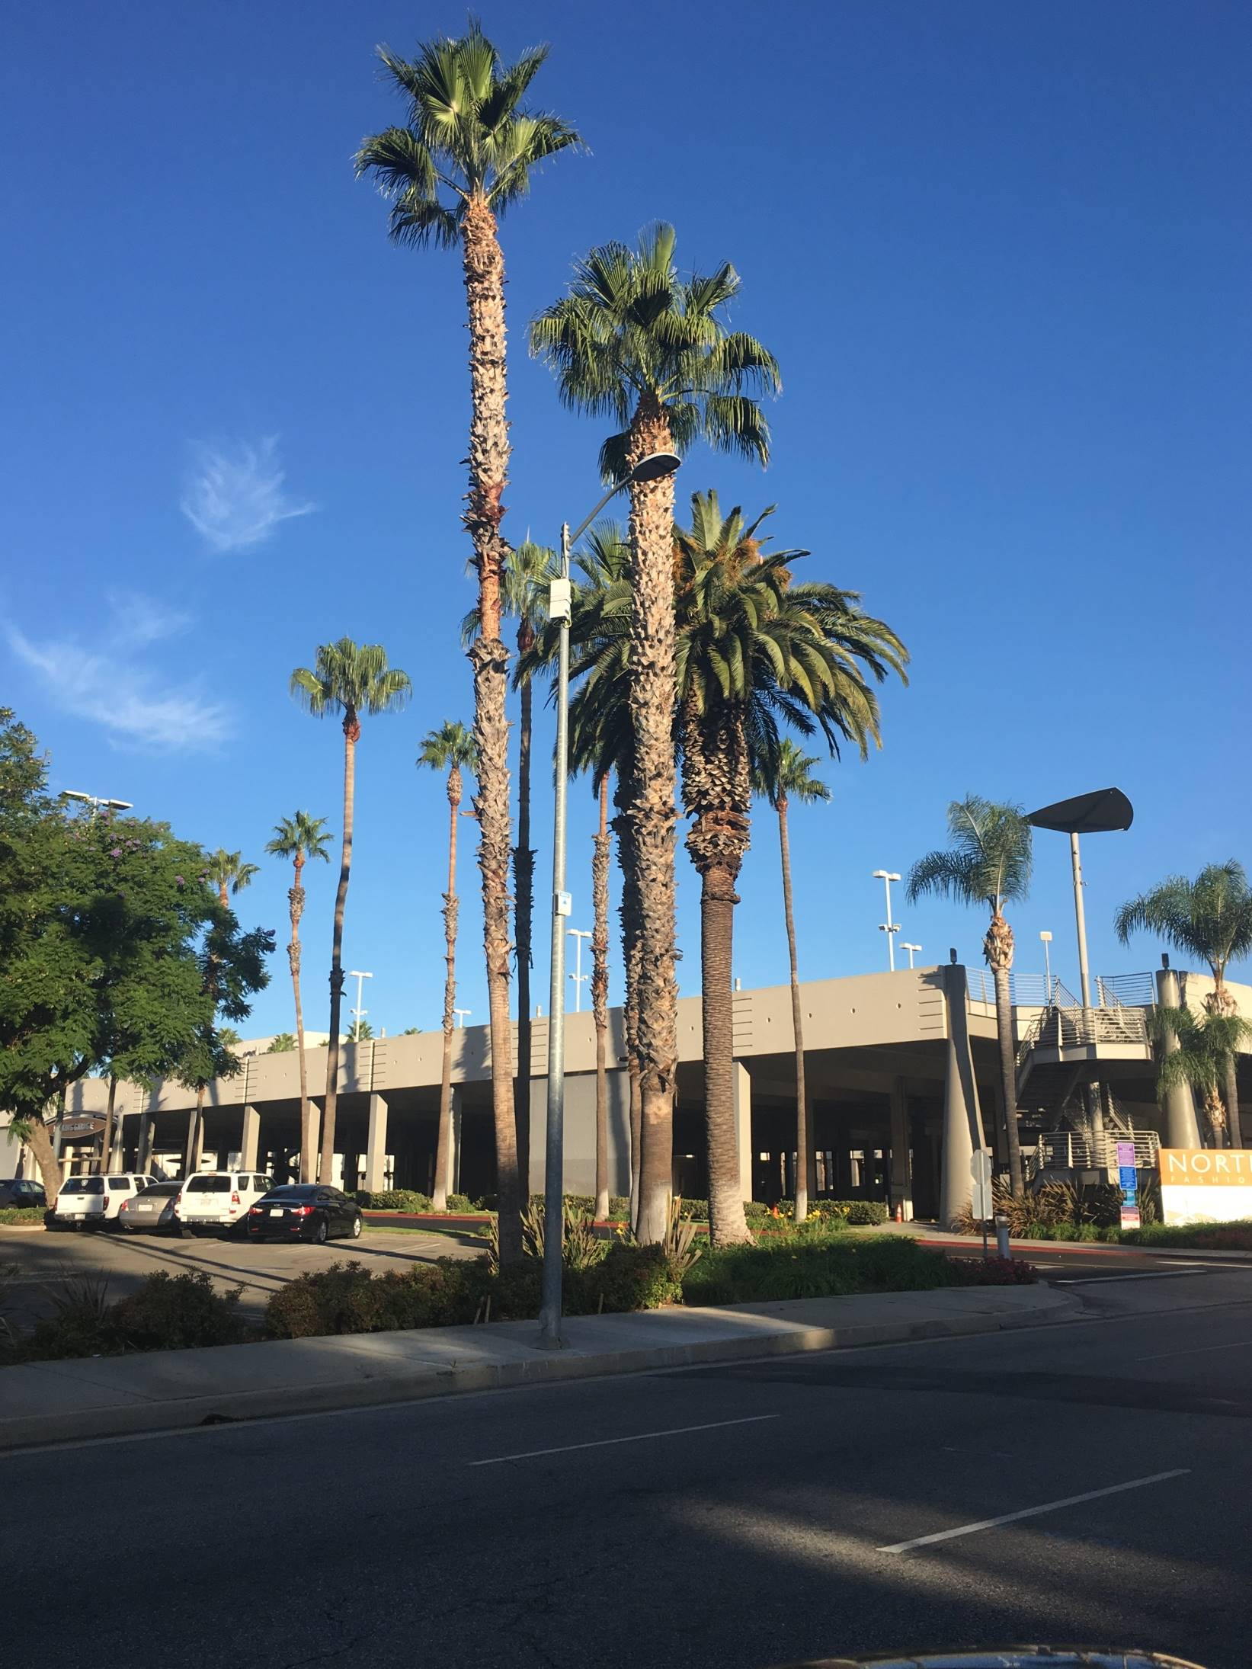
T-Mobile by Crown Castle

Slide 26
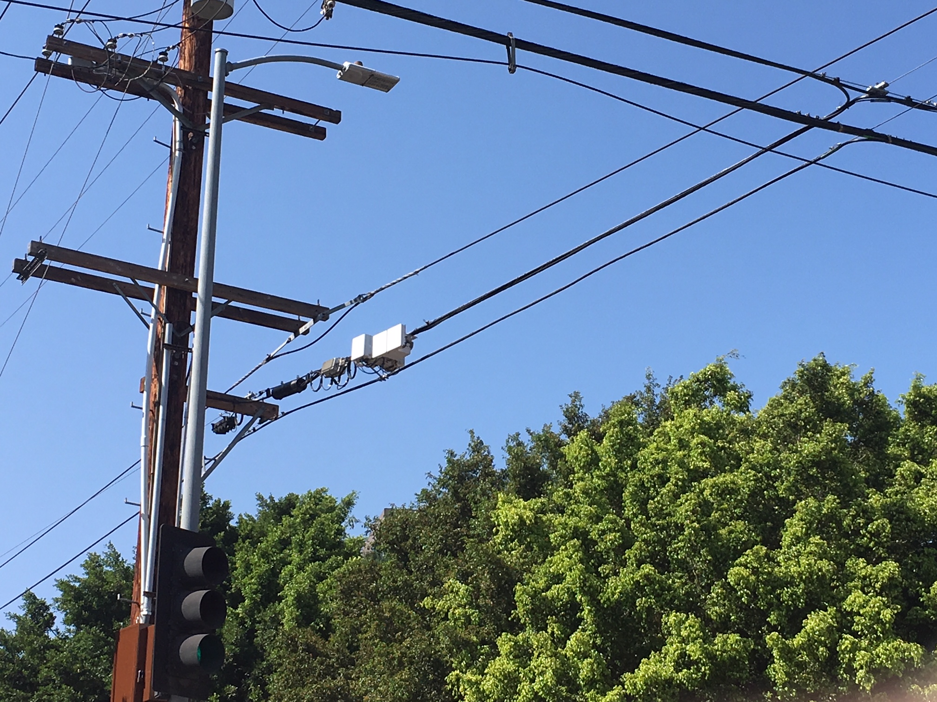
T-Mobile by Crown Castle

Slide 27
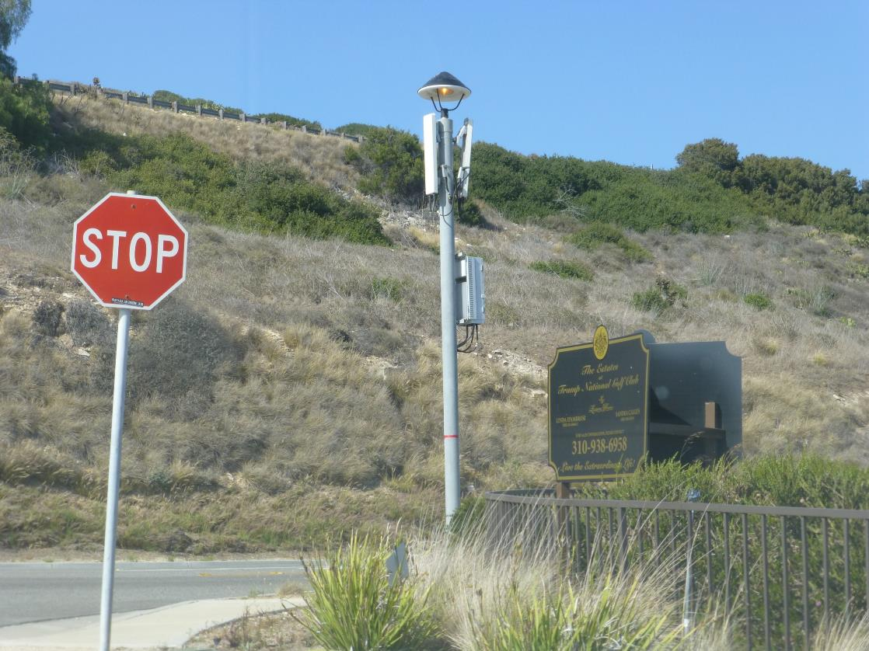

Slide 28
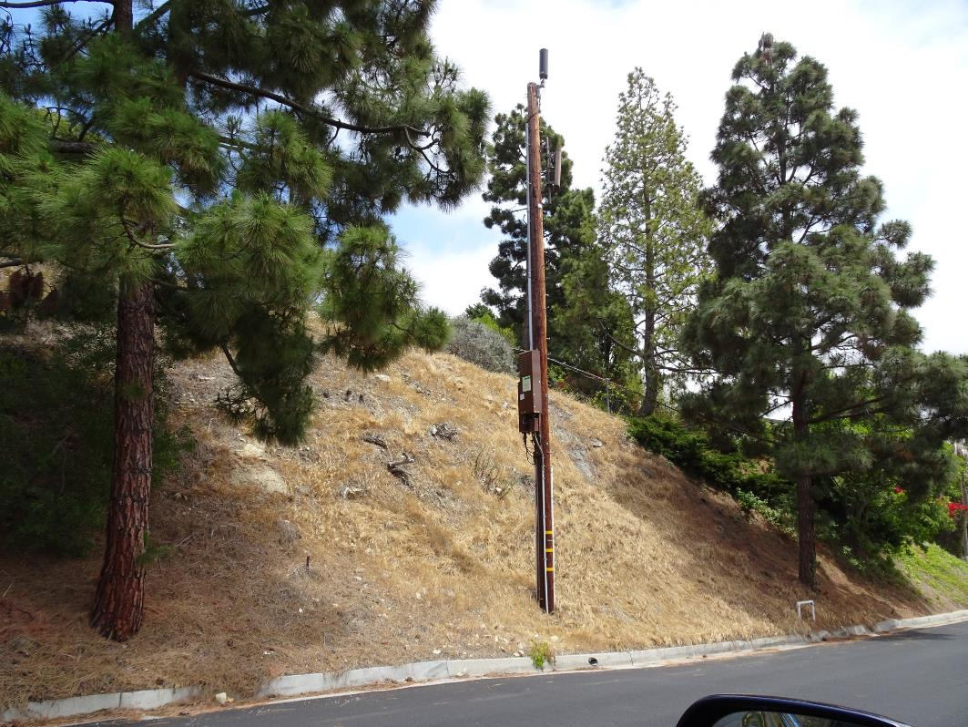
Sprint by Crown Castle

Slide 29
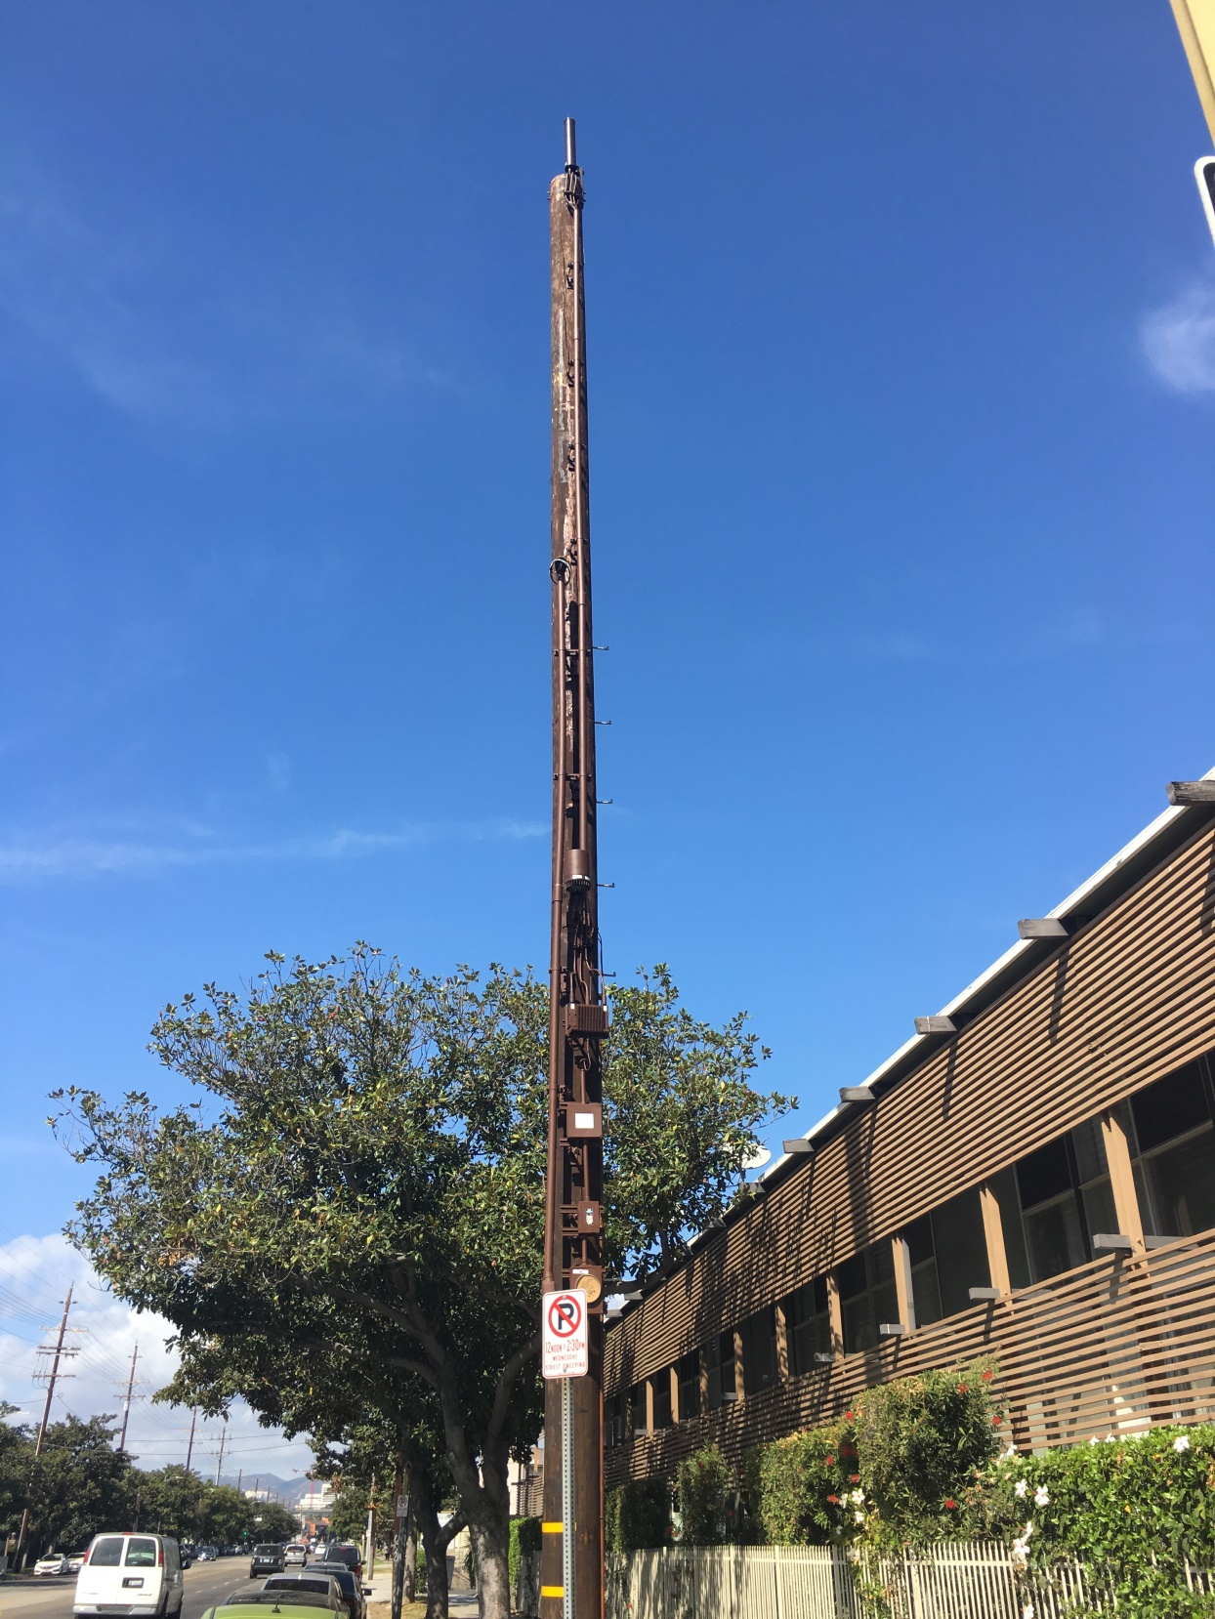
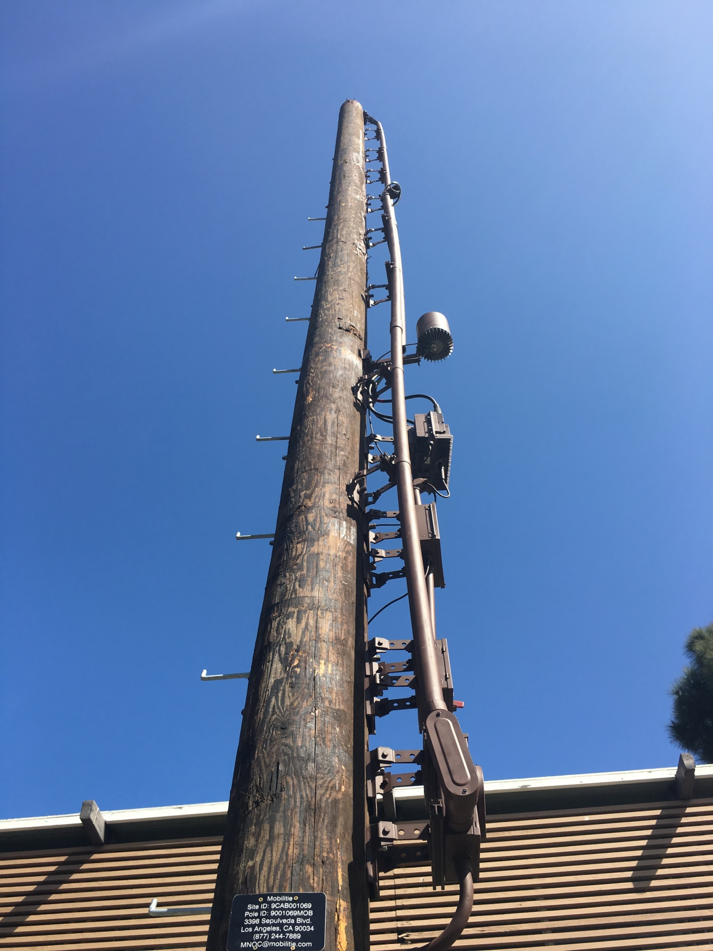
Pole put in by
Mobilitie; not
shared
Sprint by
Mobilitie

Slide 30
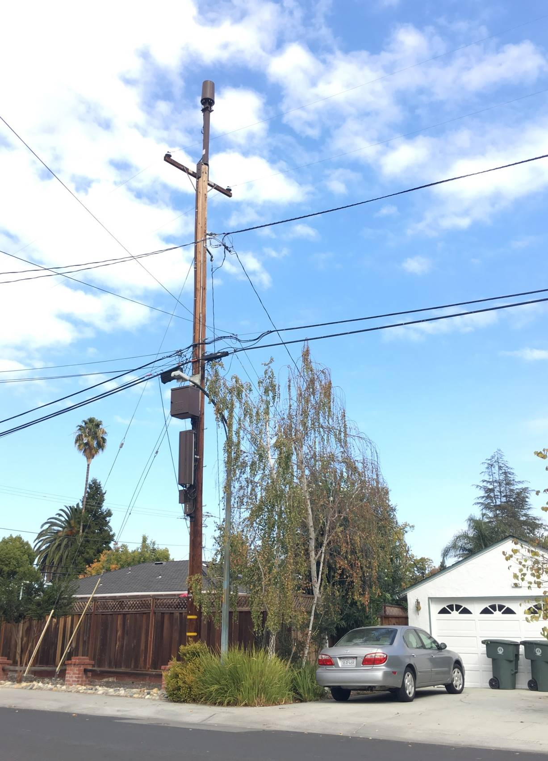
AT&T

Slide 31
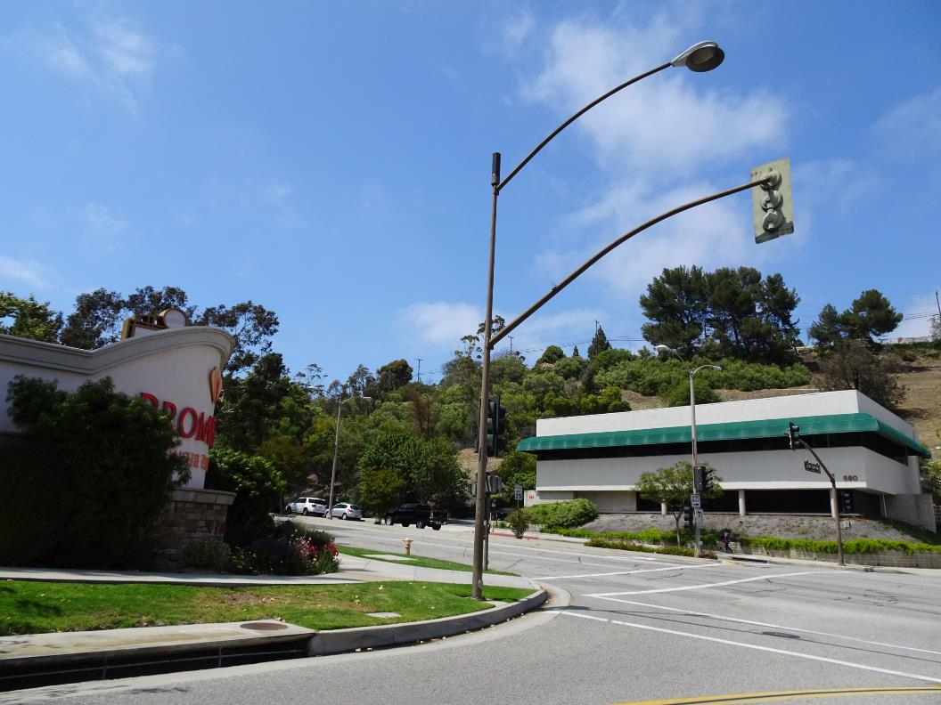
Crown Castle
Base station equipment in vault
By fire plug

Slide 32
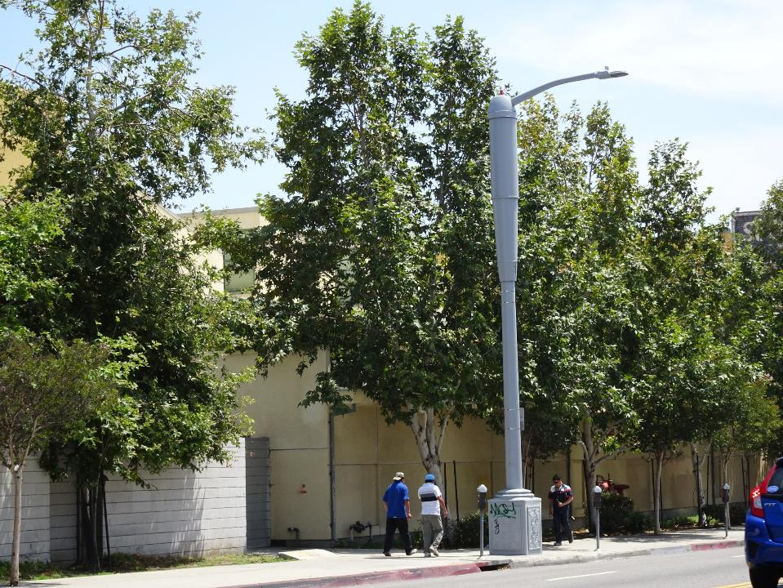
Verizon

Slide 33
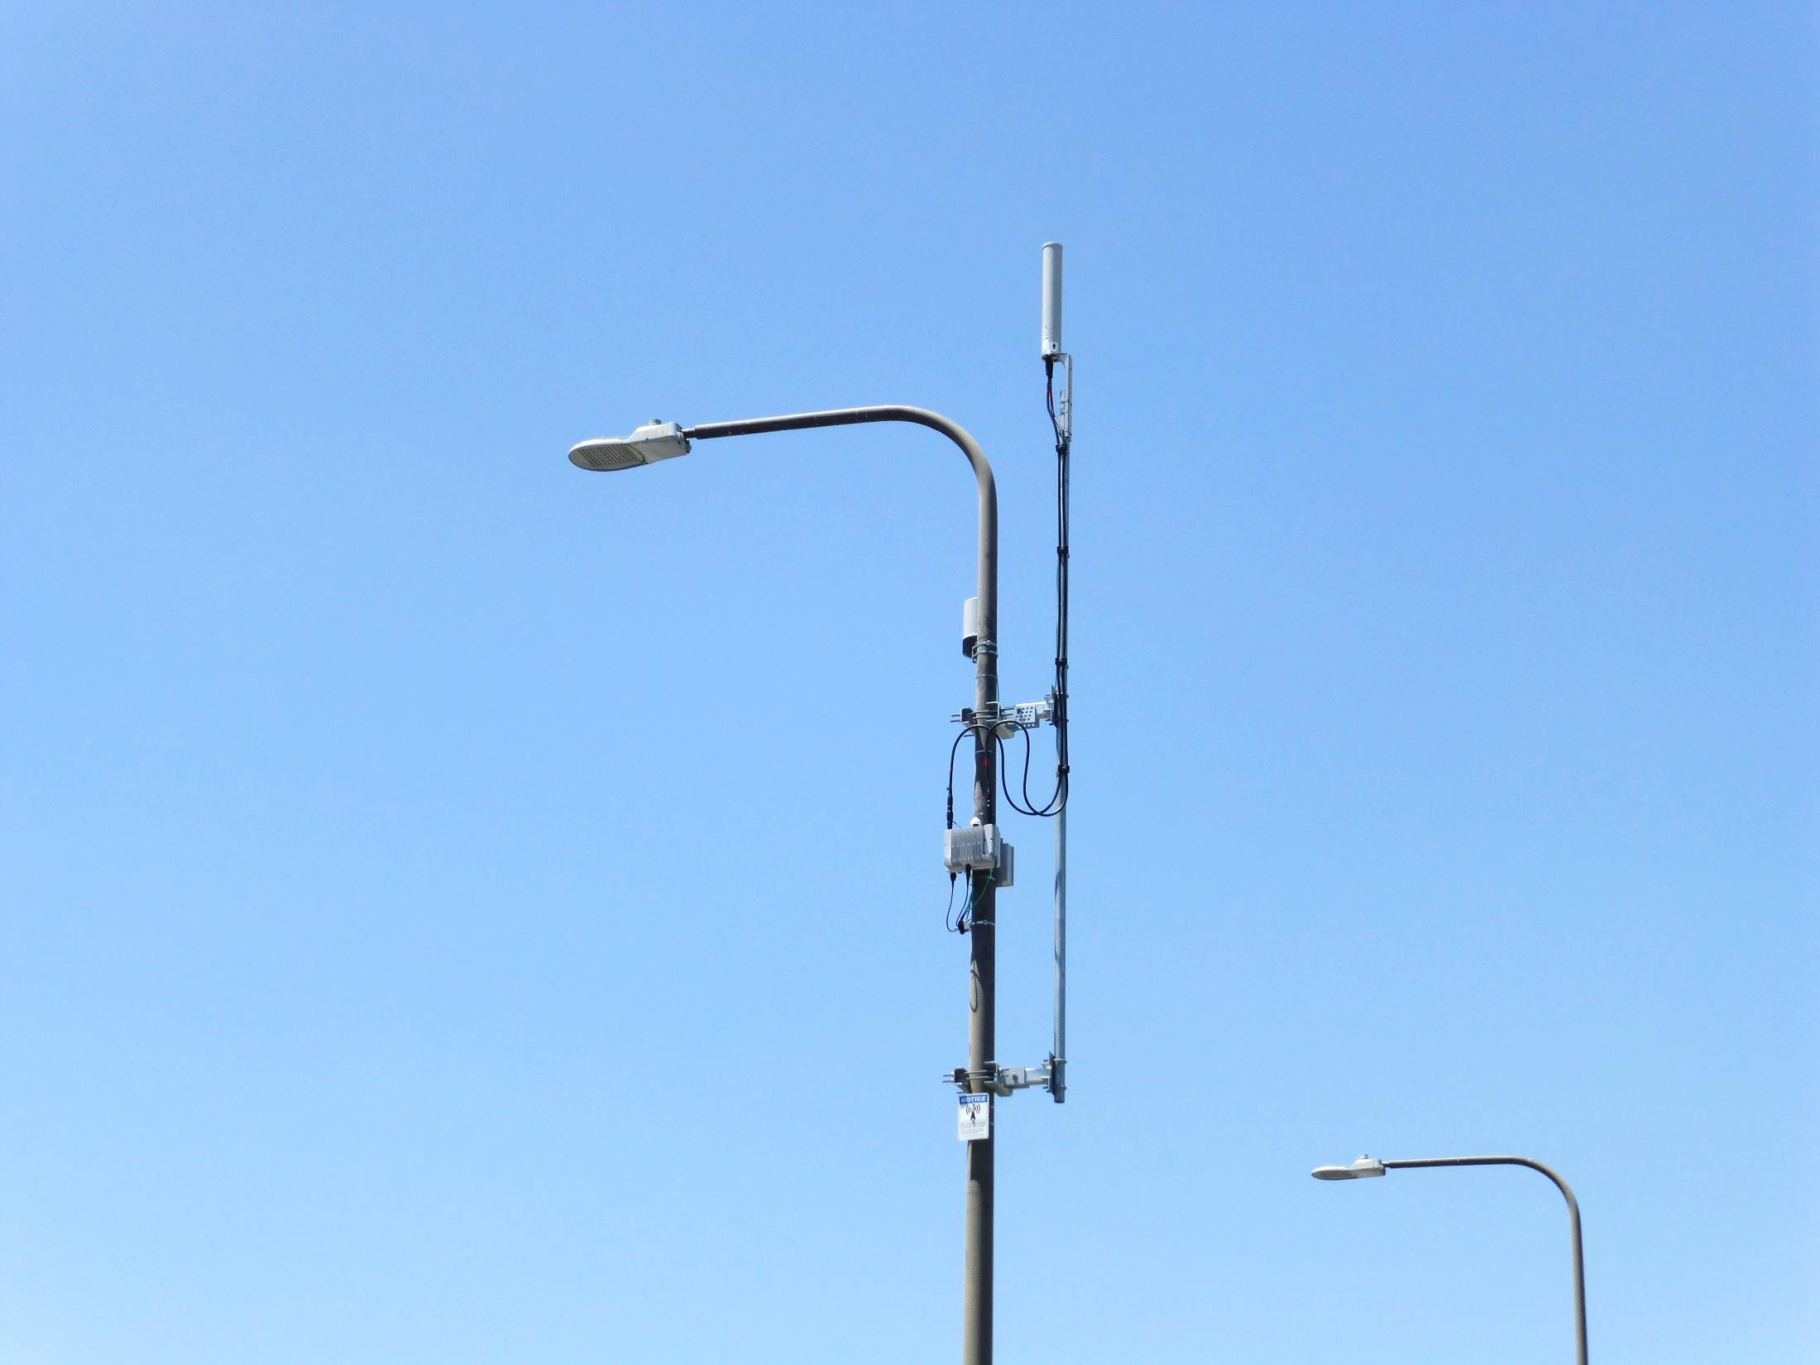

Slide 34
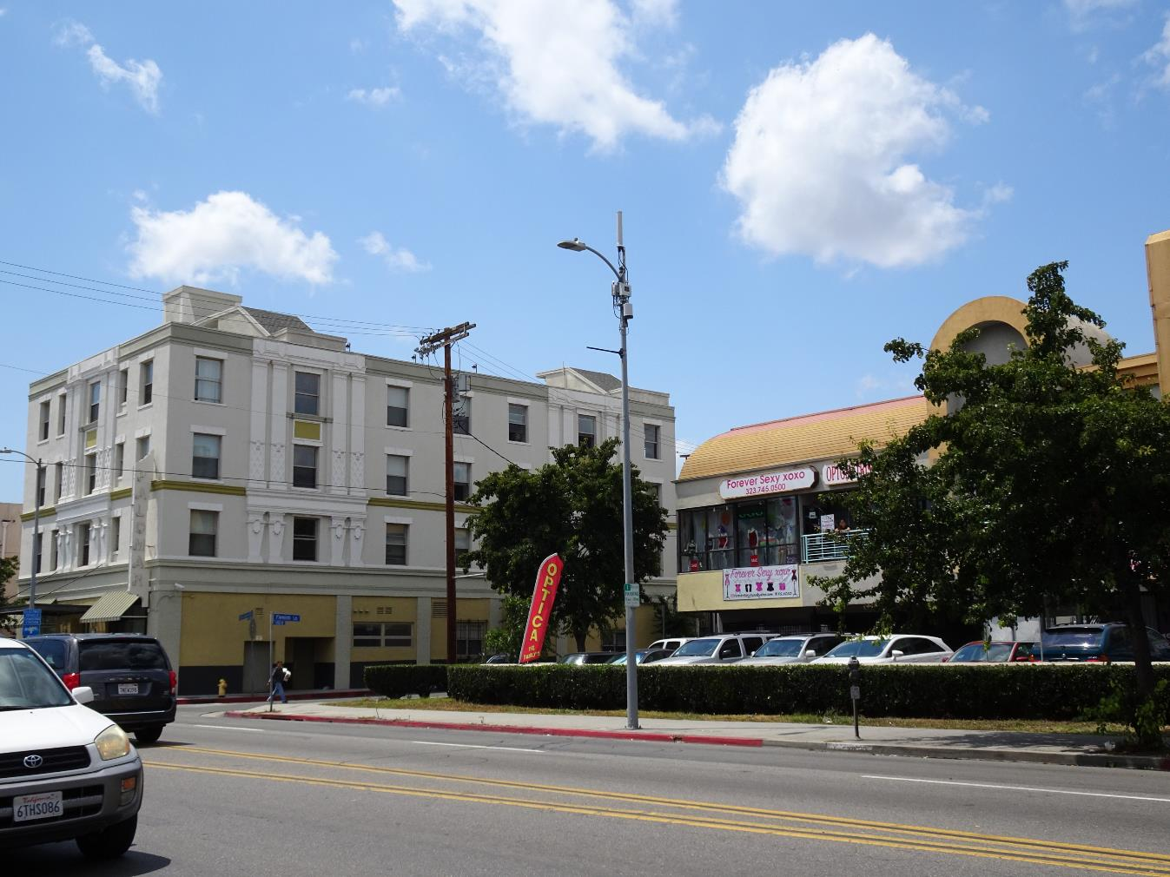
Sprint by
Mobilitie

Slide 35
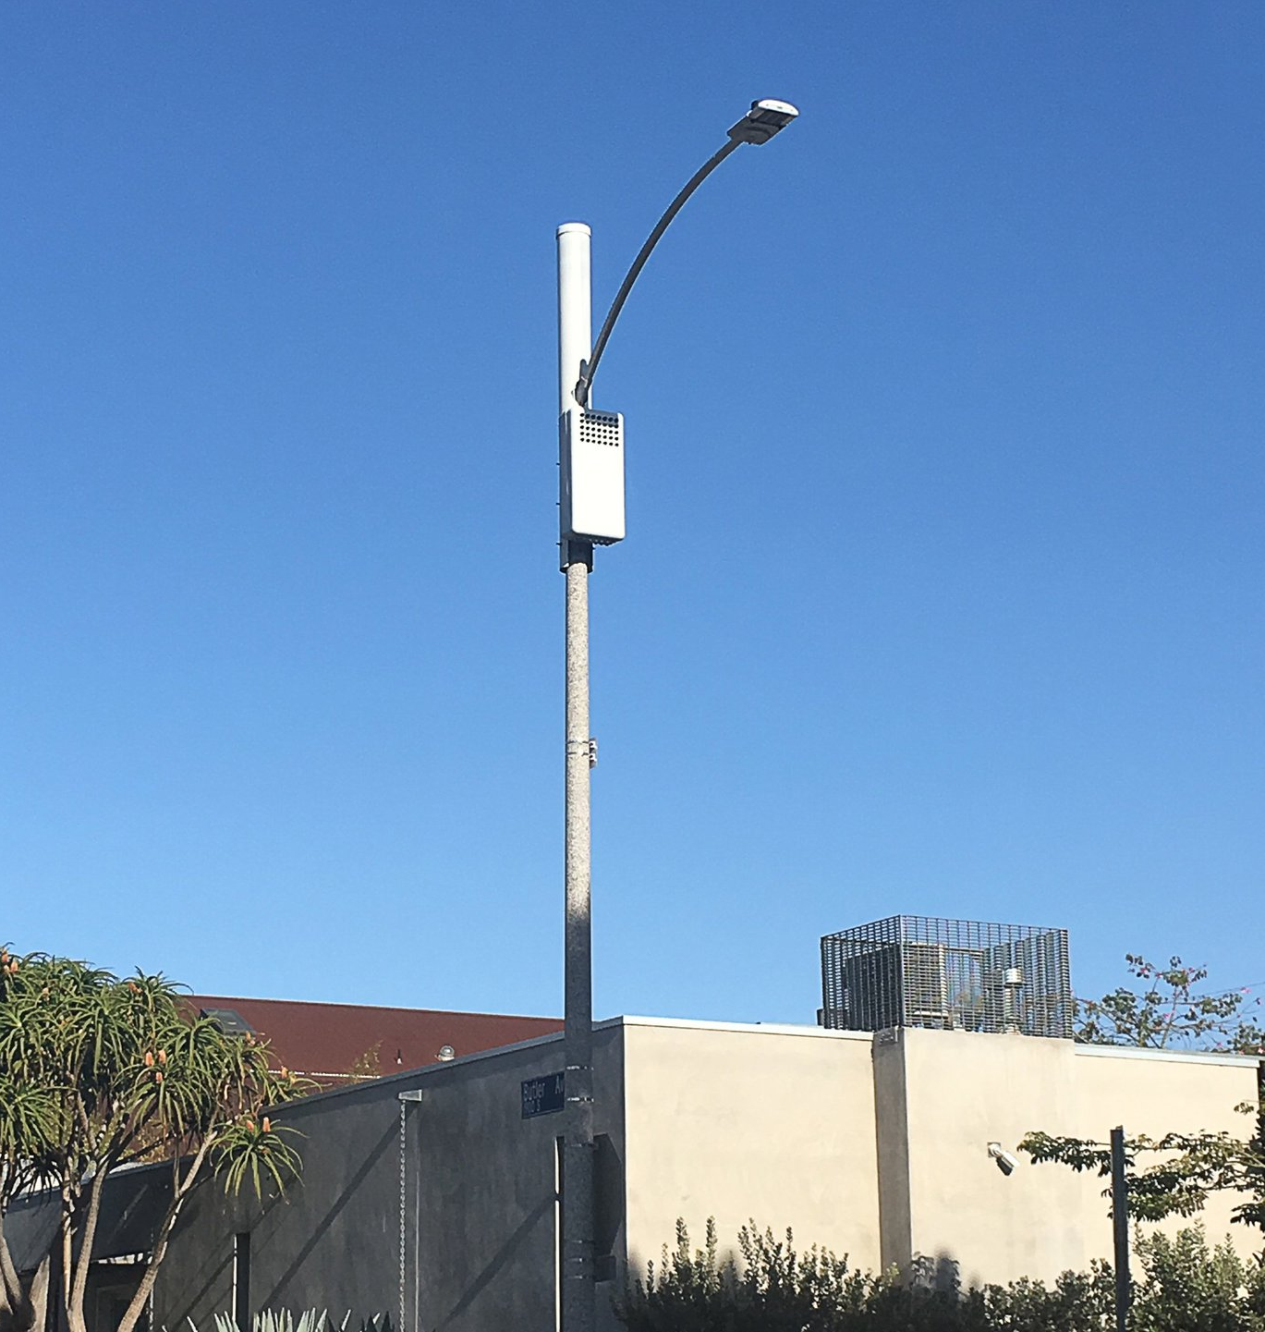
Sprint by
Mobilitie

Slide 36
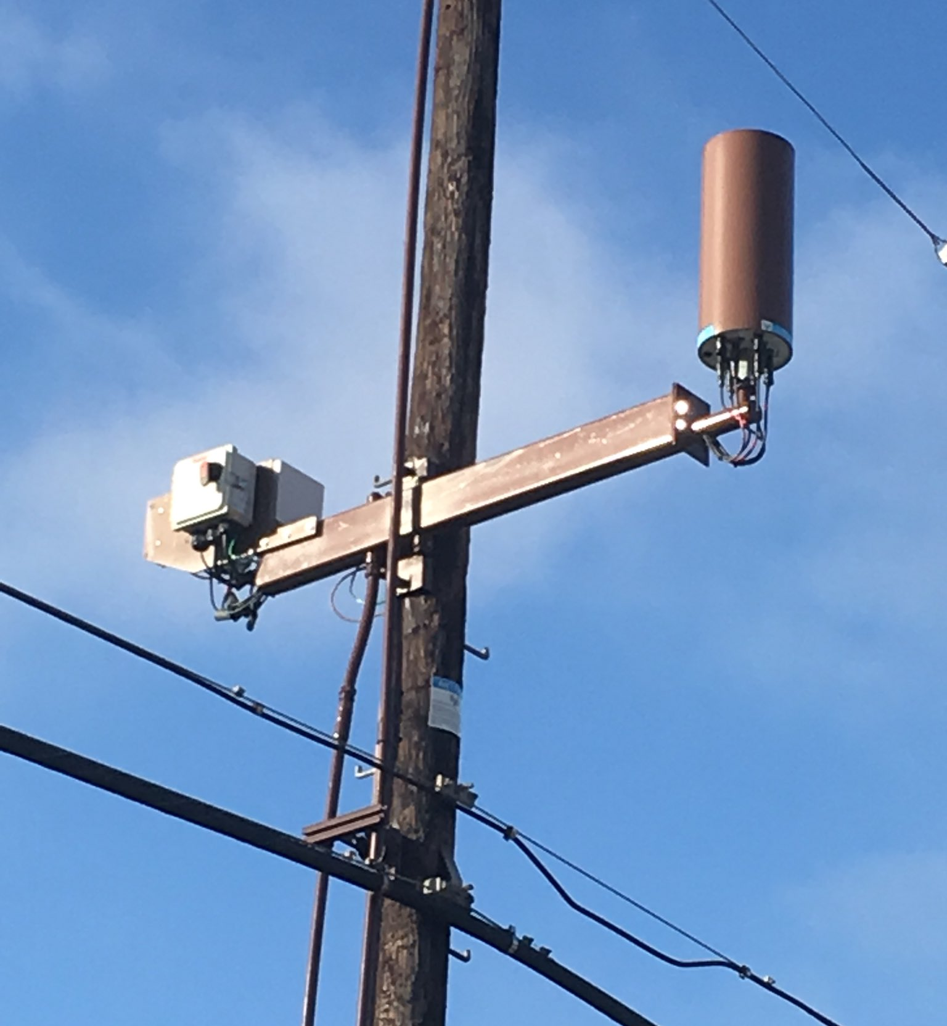
AT&T
36

Slide 37
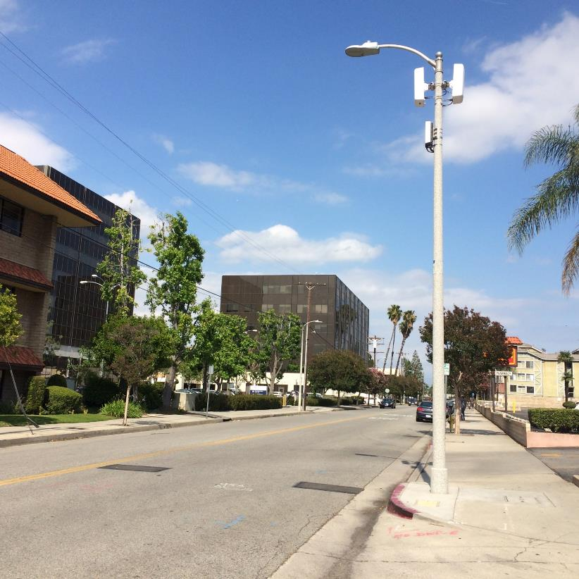
Verizon

Slide 38
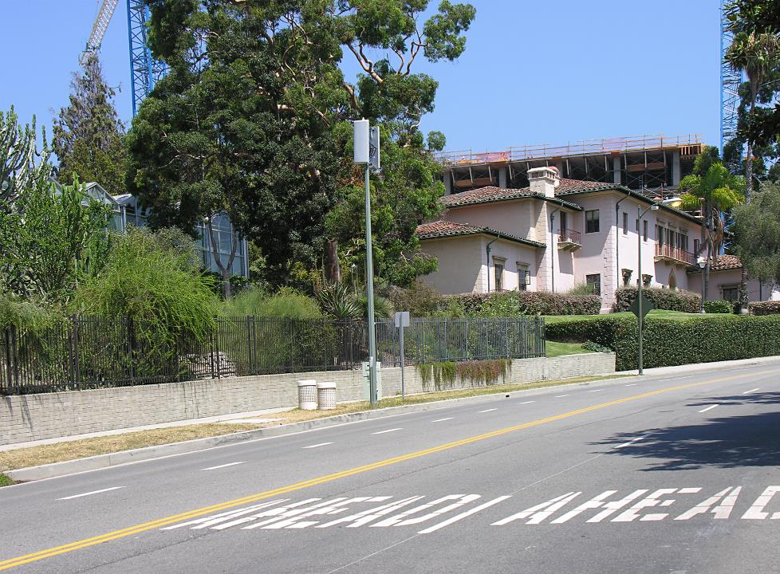
Sprint
Equipment in vault

Slide 39
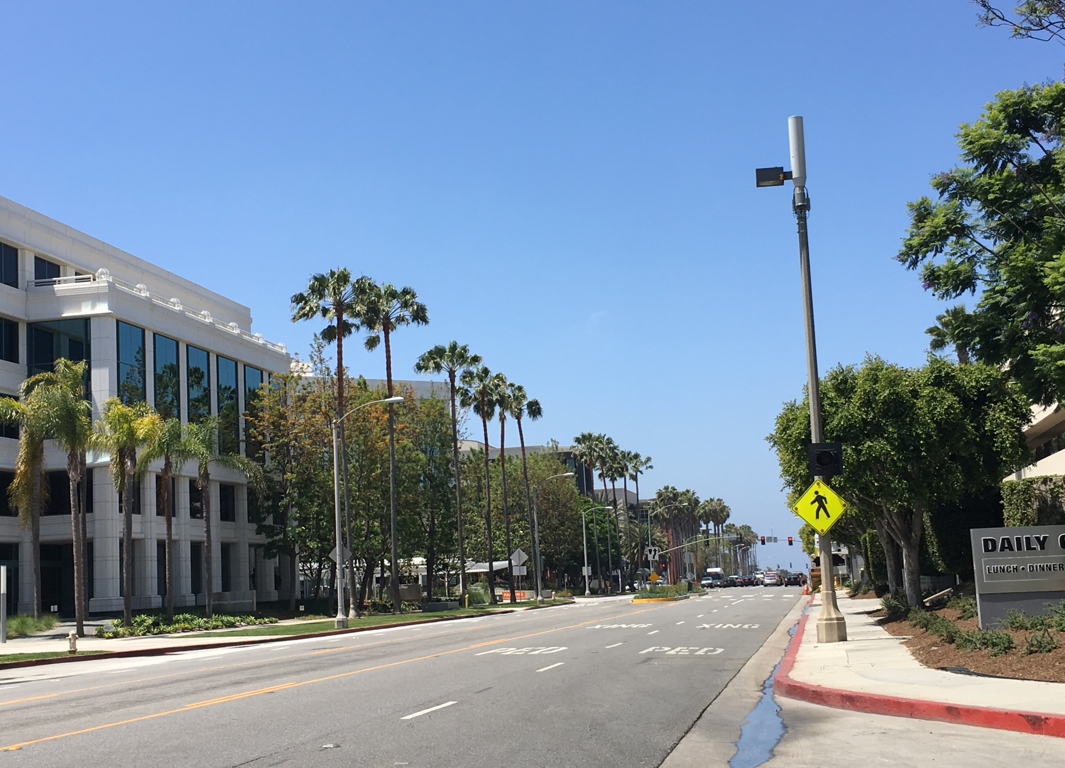
Sprint by
Mobilitie

Slide 40
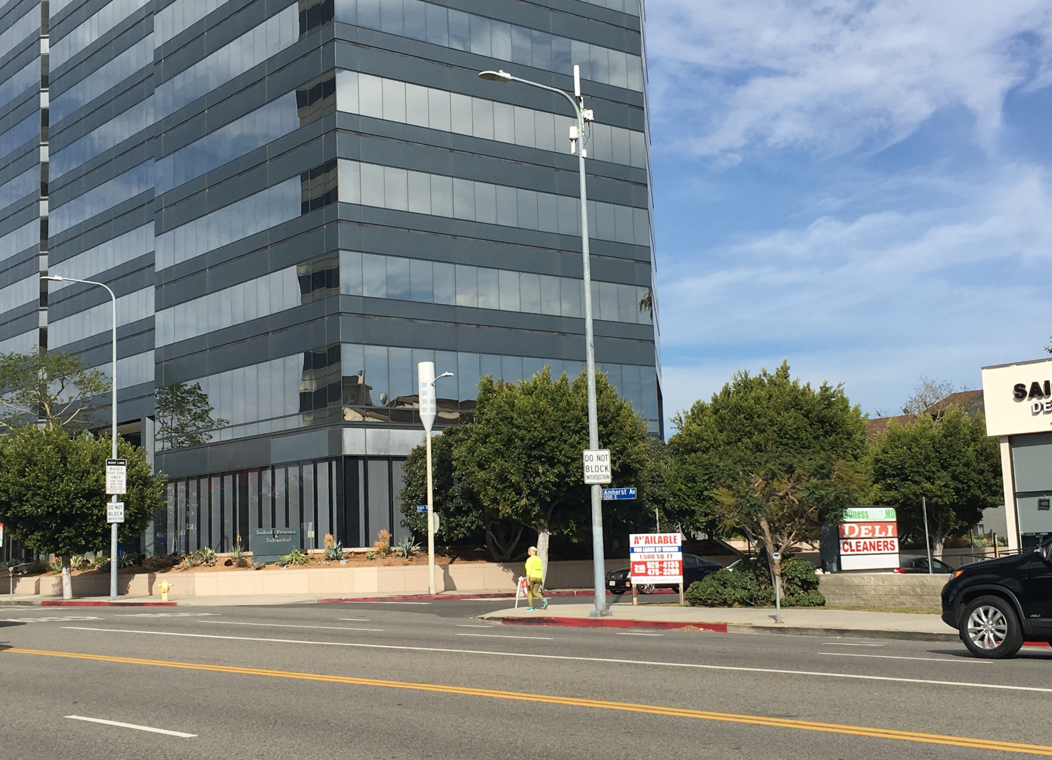
Sprint by
Mobilitie
AT&T.
Los Angeles, CA

Slide 41
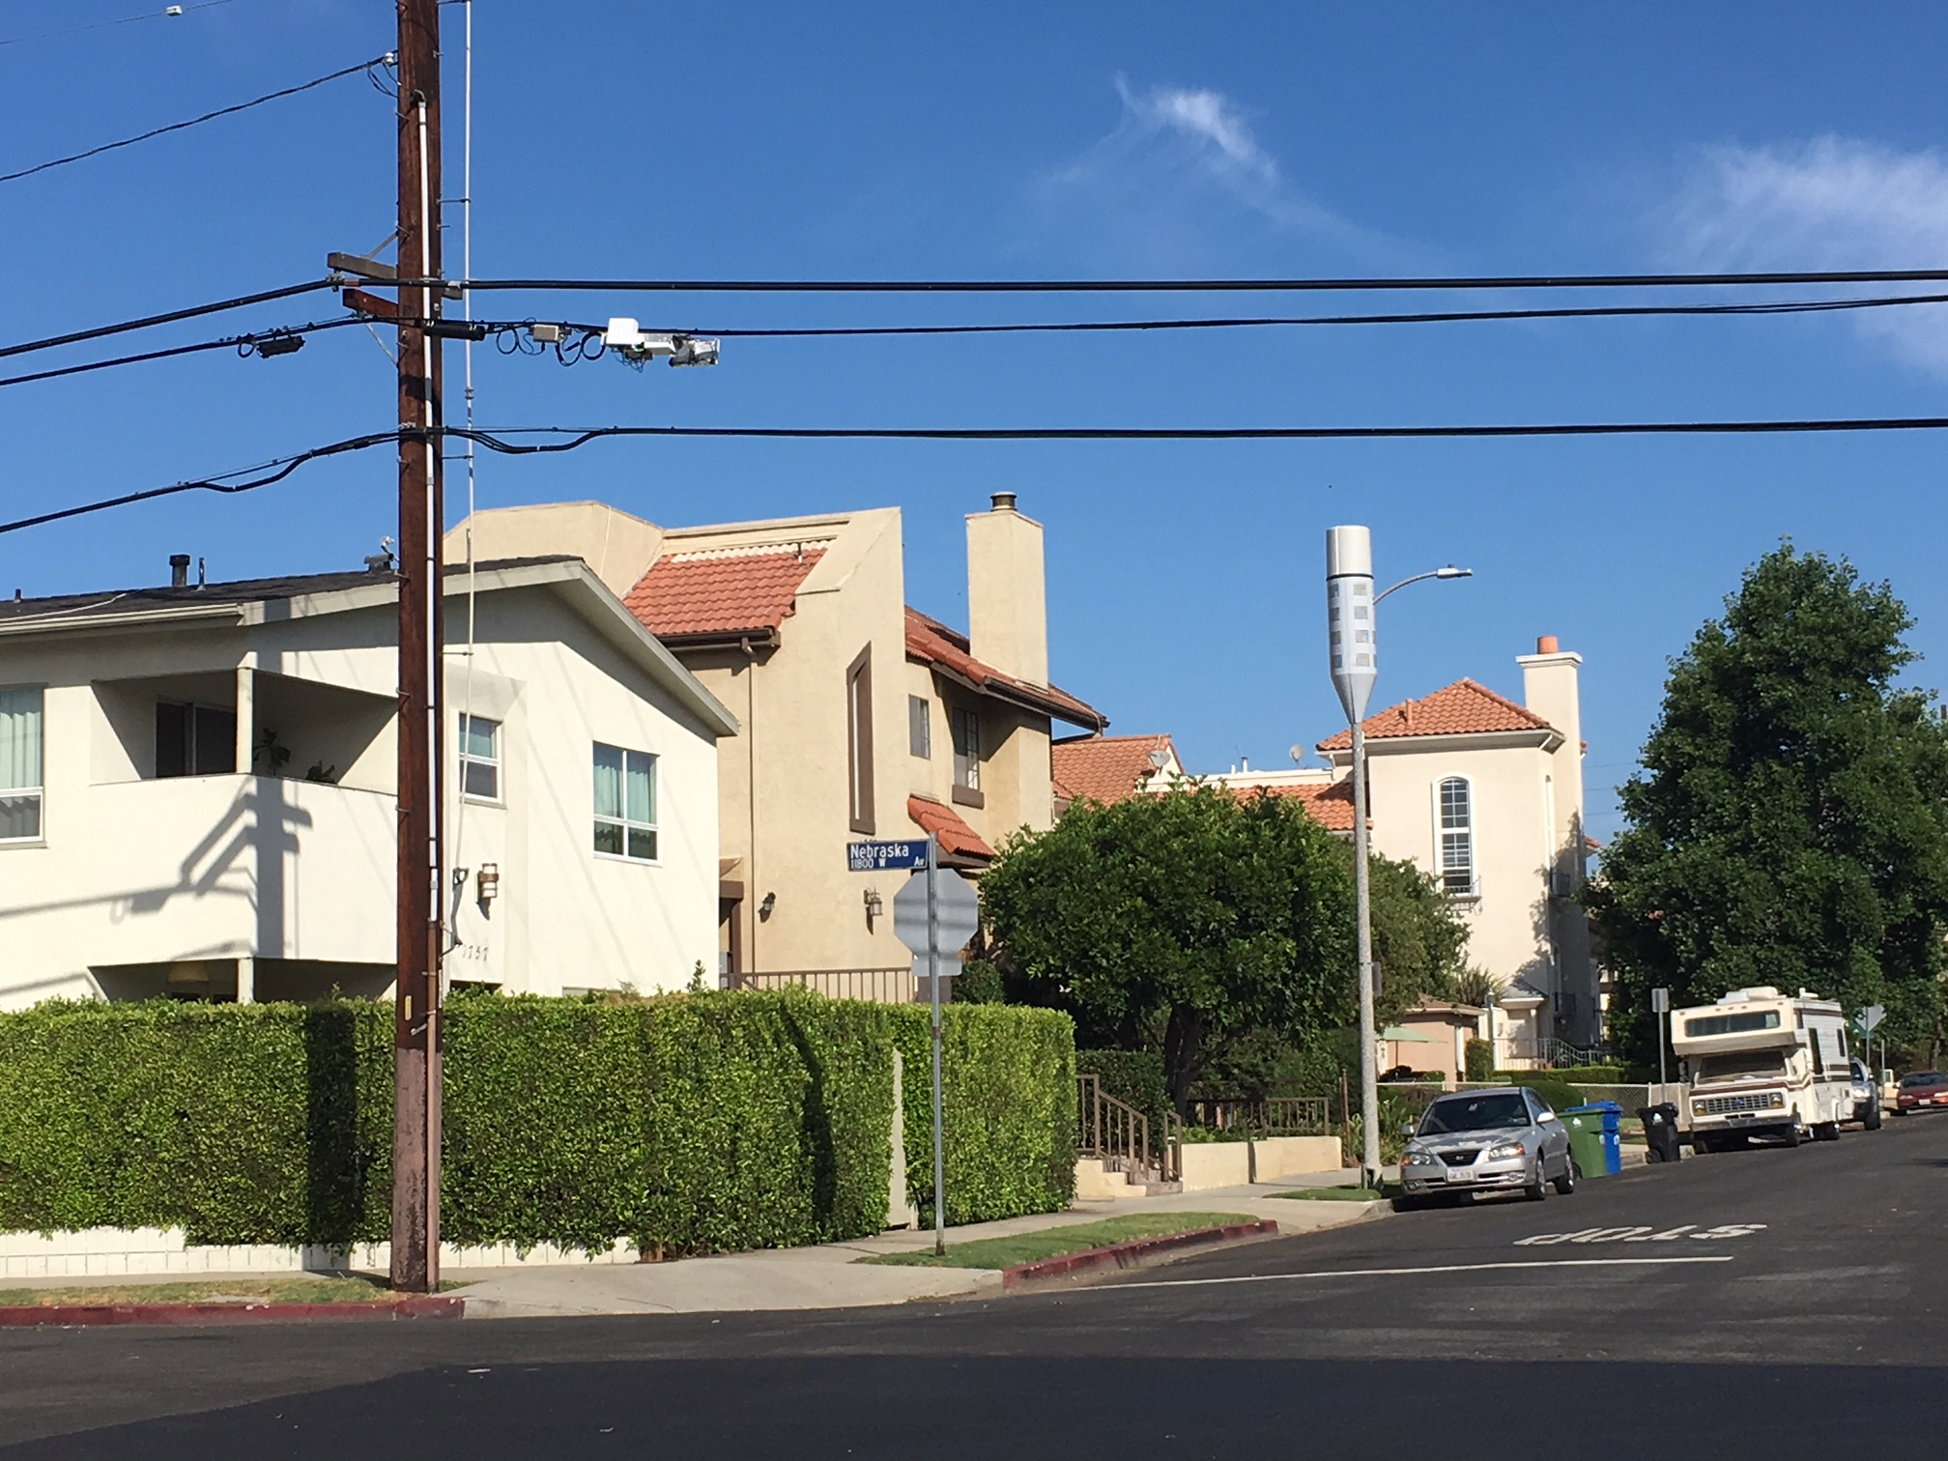
T-Mobile by Crown Castle
AT&T
Los Angeles, CA

Slide 42
Ok, but what about . . .
Undergrounding requirements?
Restrictions on deployment in residential areas?
Restrictions on attachment to decorative poles?
Residents who want public hearings/appeals?
Existing small cell agreements?
The deemed-granted remedy for shot clock violations the FCC proposed?
Moratoria?

Slide 43
Recommendations
Treat small wireless facilities as a separate class subject to specialized regulations.
Don’t repeal existing regulations (Reso 97-197) YET that serve as default rules for non-small wireless facilities.
Repeal and Replace Reso 97-197 in the near future (next week?
Evaluate how to take existing subjective aesthetic standards and convert them to objective, generally-applicable standards.
Streamline or eliminate negotiation for pole attachment agreements.
Invest in comprehensive fee studies for staff time.
Get started yesterday – rules effective Jan. 14, 2019.

Slide 44
Questions?
Yeah… me too.

