Slide 1
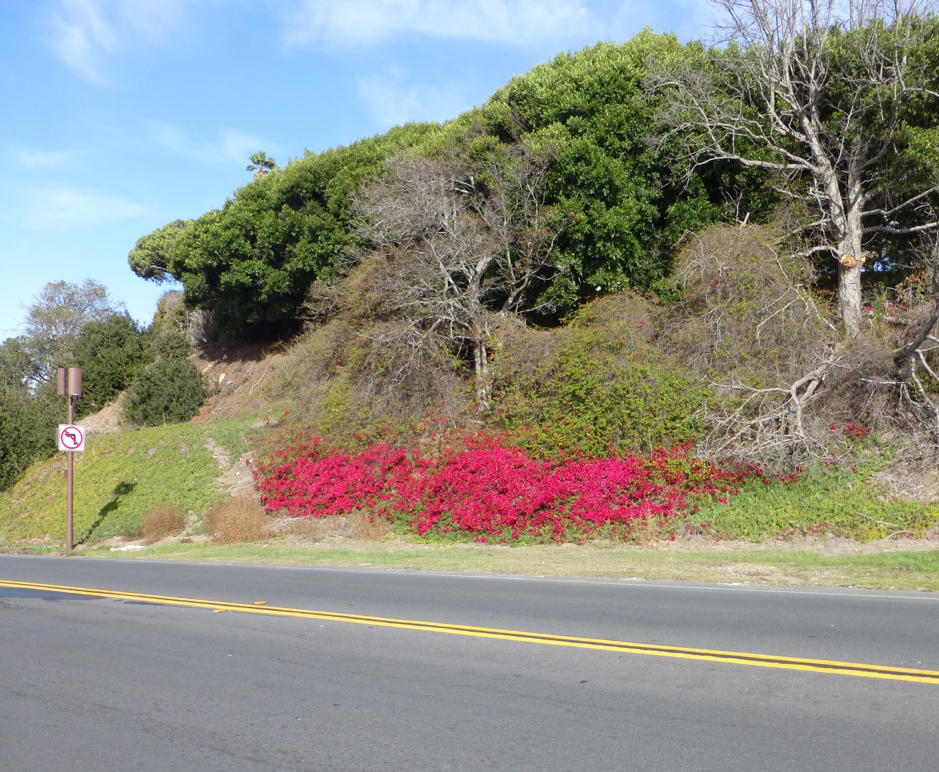
Big Changes Coming to
Small Cells
Town of Hillsborough
November 28, 2018
Presenter:
Dr. Jonathan L. Kramer
Partner
Telecom Law Firm, P.C.
www.TelecomLawFirm.com
Los Angeles – San Diego
Verizon by Crown Castle
Palos Verdes Estates

Slide 2
Status:
FCC’s 2018 Small Cell Order
  approved by FCC on September 26, 2018
    effective 90 days after publication in Federal Register:
    January 14, 2019
  appeals and requests for stay have been filed in federal court and at the FCC (10th Cir to hear, for now)
  appeals likely to take 12 to 18 months
  rules likely to be applicable during appeals
  (a stay by the FCC or a court seems unlikely)

Slide 3
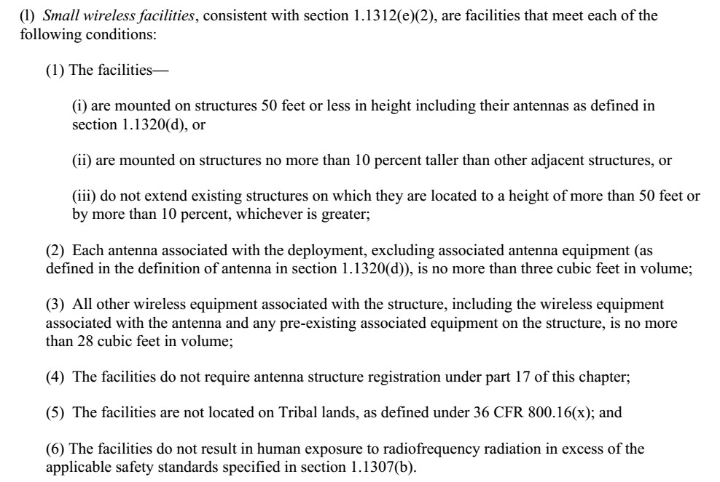
What’s a “Small Wireless Facility”? (SWF)
But we still can’t regulate RF emissions

Slide 4
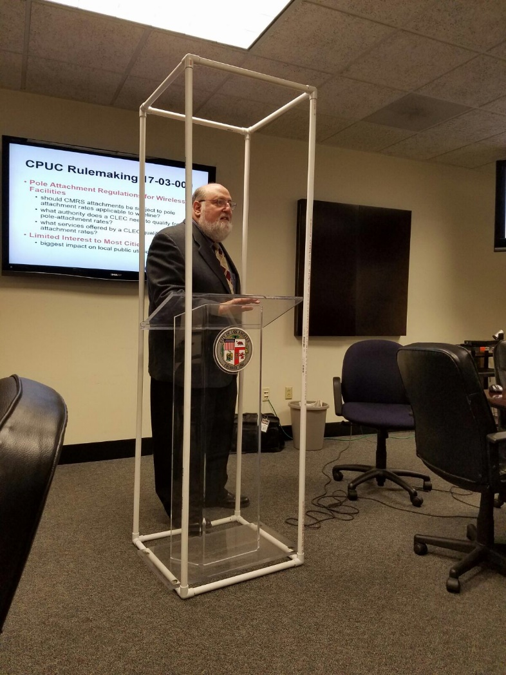
28 Cubic Feet

Slide 5
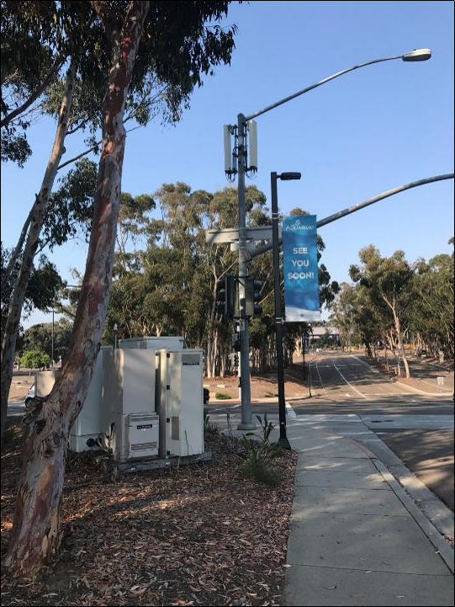
What does 28 cubic feet look
in the field?

Slide 6
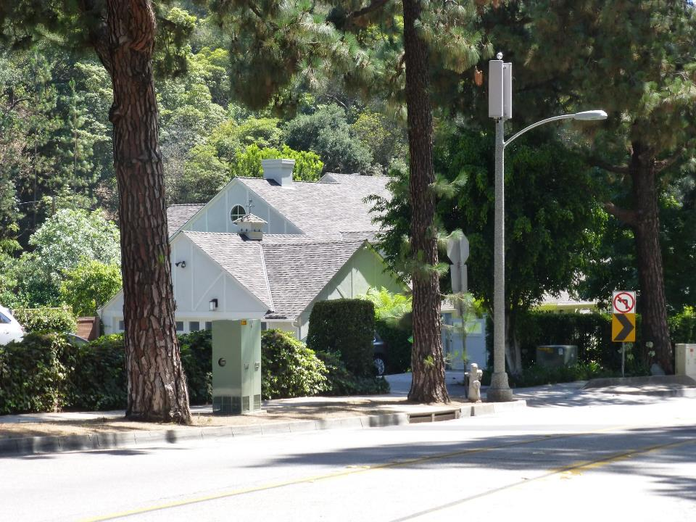
Less than
3 cubic feet
antennas
22 ½ cubic foot
cabinets

Slide 7
Plus how many 3 cubic foot antennas?
Antennas are NOT counted in the 28 cubic foot ‘small wireless facility’ volume calculation
No limit to the number of 3 cubic foot antennas
Typical 6’ tall panel antennas are less than or equal to 3 cubic feet in volume

Slide 8
New & Old Shot Clock Rules
There will be 5 separate shot clocks
Shorter Timeframes
60 days | small wireless facility “collocations” (on any existing structure) all eligible facility requests under Section 6409
90 days | small wireless facilities (on any new structures) collocations not covered as an eligible facilities request or small wireless facility
150 days | everything else…new, freestanding non-small wireless facilities
Before 1/14/19: Commonly, appeals and construction permits followed after shot clock
After 1/14/19: All appeals, shovel ready permits, must be completed within the shot clock

Slide 9

Why so many?
Estimated: 30 to 60-ish small cell per sq. mile, per carrier over the next 5-ish years, plus ~8 mi new fiber in each sq. mile
Why: Faster data transfer is the goal
Legacy: Macrocells likely to remain (umbrella)

Slide 10
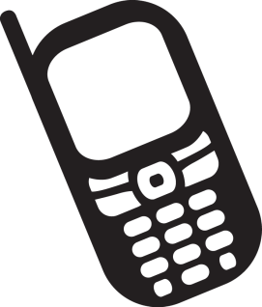
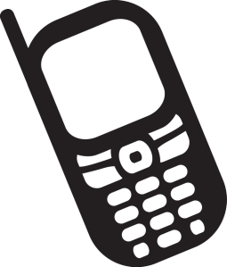
Cell Sites Closer to Users
Faster Data Transfer & Greater Building Penetration
(( ))
((( )))
10

Slide 11
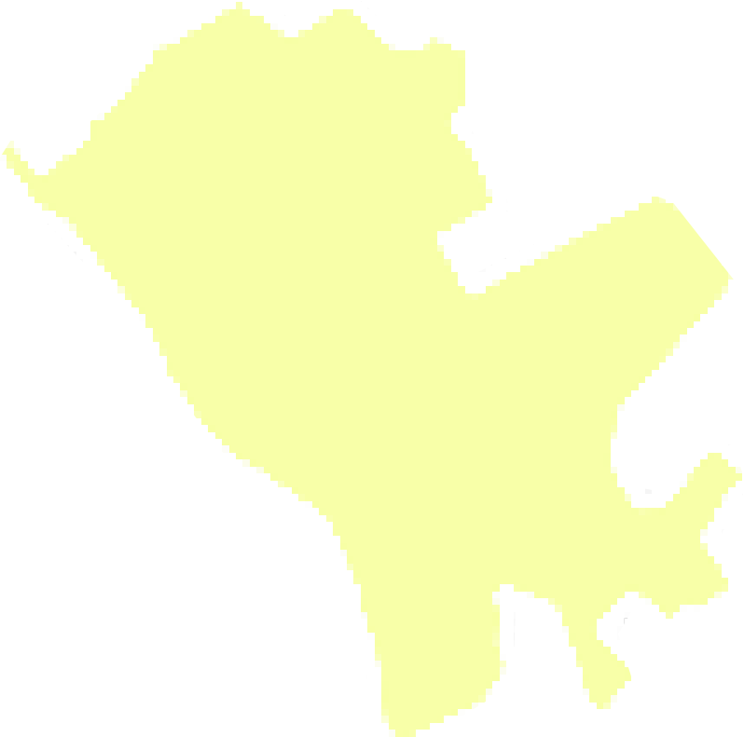
Town of Hillsborough
(Estimates only!)
Land area: ~6.25 sq. mi
4 national carriers today
…but let’s be very conservative:
= 2.5 sq mi * 4 carriers * 20 per sq mi =
~ 200 small cells/SWFs
…plus…
2.5 sq mi * 8 miles of fiber per sq mi =
~ 20 miles of new fiber optic cables

Slide 12
Wireless Siting Challenges in Hillsborough
Low population density
Challenging RF propagation environment (due to large trees; irregular terrain; many target areas at high elevation above average terrain)
Substantial residential building structures that make signal penetration challenging
Limited mounting structures available in the public right of way (few street lights, traffic signals and road signs)
(Based on information provided by Lee Afferbach)

Slide 13
Some Primary Considerations
(All are important)
Aesthetics
  Considering PUC 7901, 7901.1; FCC 9/18 Order; Court decisions (inc. Cal Sup. Ct. pending case: T-Mobile v. SF)
Safety (compliance with state, local codes)
  PUC 7901, 7901.1, 2902, GO95, GO128:
  Dealing with time, place, and manner of construction, as well as maintenance; not incommoding the use of the right of way Safety (compliance with FCC RF standards)
  FCC Rules 1.1307 et seq, Bulletin 65
Avoiding Effective Prohibitions

Slide 14
Effective Prohibitions
Out with the Gap…In with the Competition
The Existing 9th Circuit Rule (2005)
evaluated under “significant gap/least intrusive means” test adopted by 9th Circuit
The New Rule 1/14/19
  a state or local requirement effectively prohibits deployment when it “materially limits or inhibits any competitor’s or potential competitor’s ability to compete in a fair and balanced legal and regulatory environment.”
Non-Fee Requirements (e.g. Aesthetics) 1/14/19
  must be (1) reasonable; (2) no more burdensome than those applied to other infrastructure deployments; and (3) objective and published in advance

Slide 15
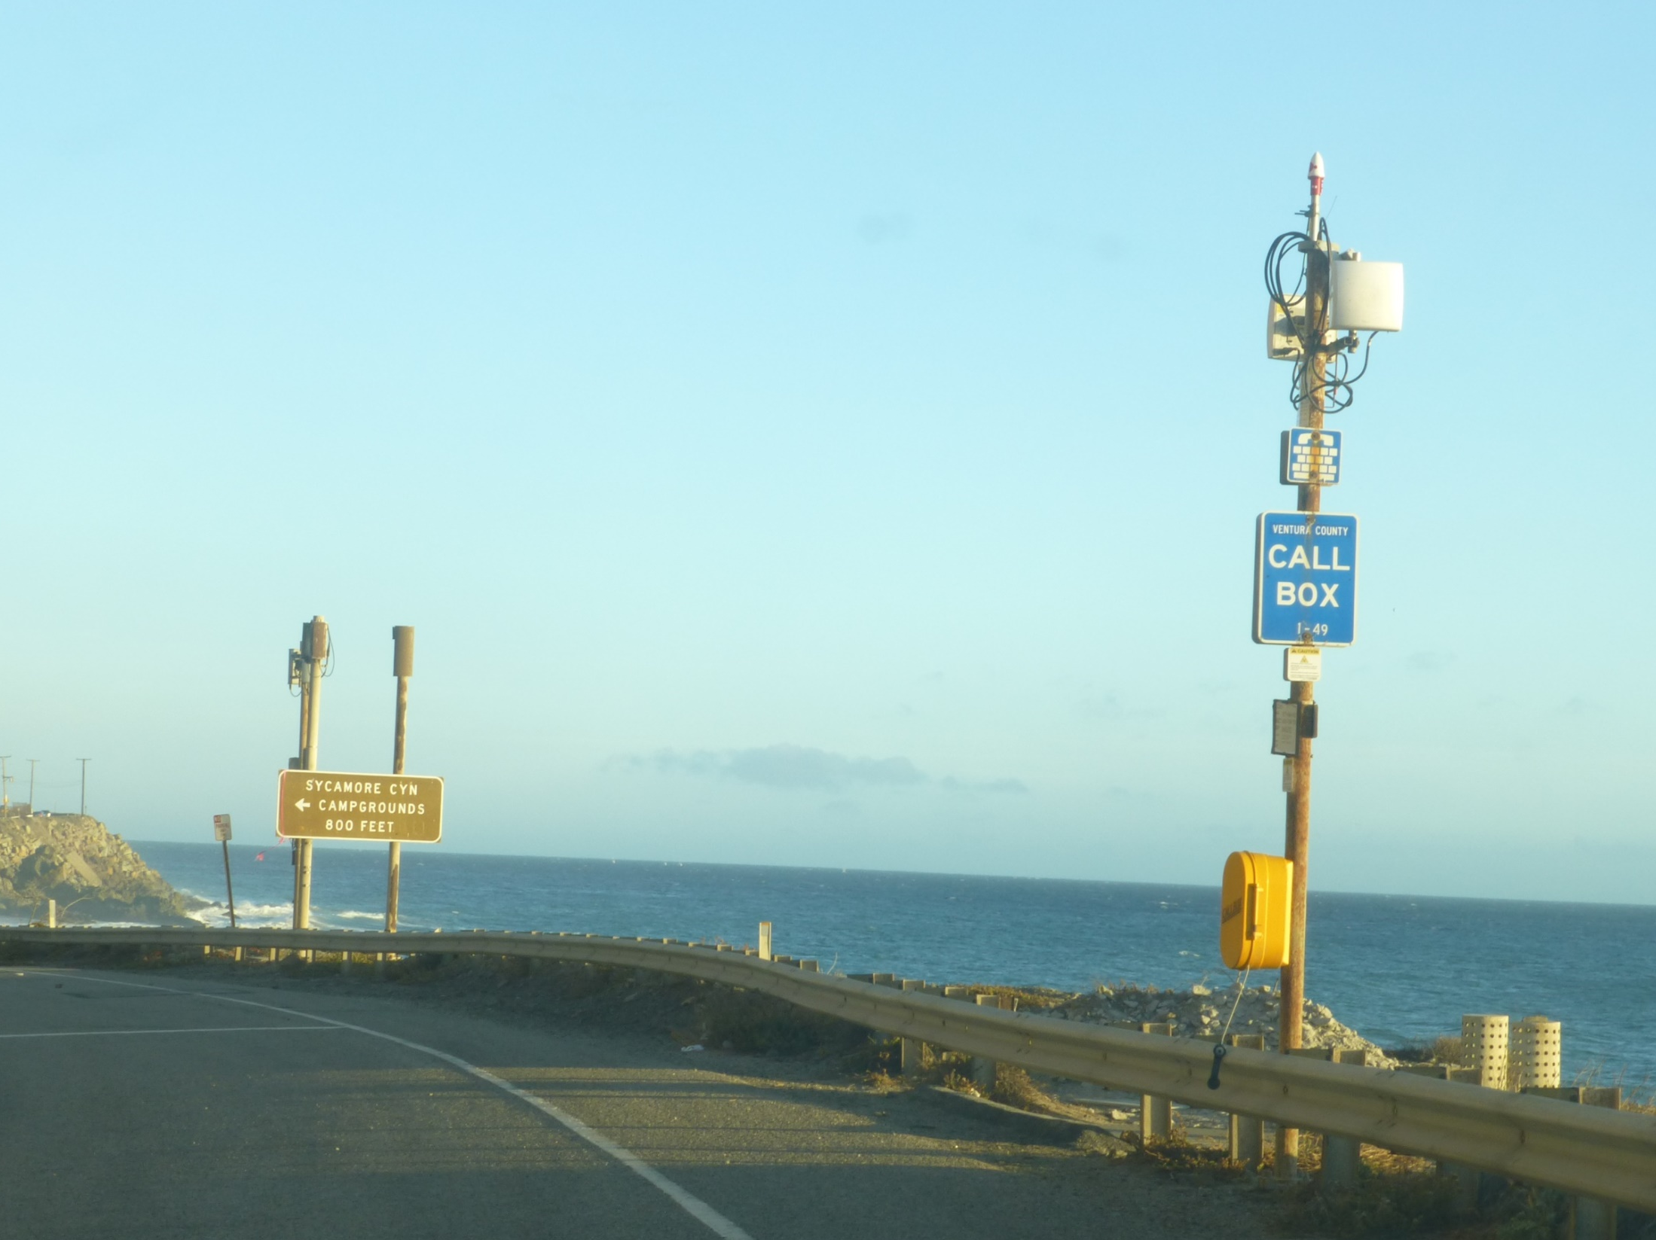
Examples of existing 3G/4G+ small cells and beyond…
…but not every design
will work in Hillsborough
Ventura County/Malibu

Slide 16
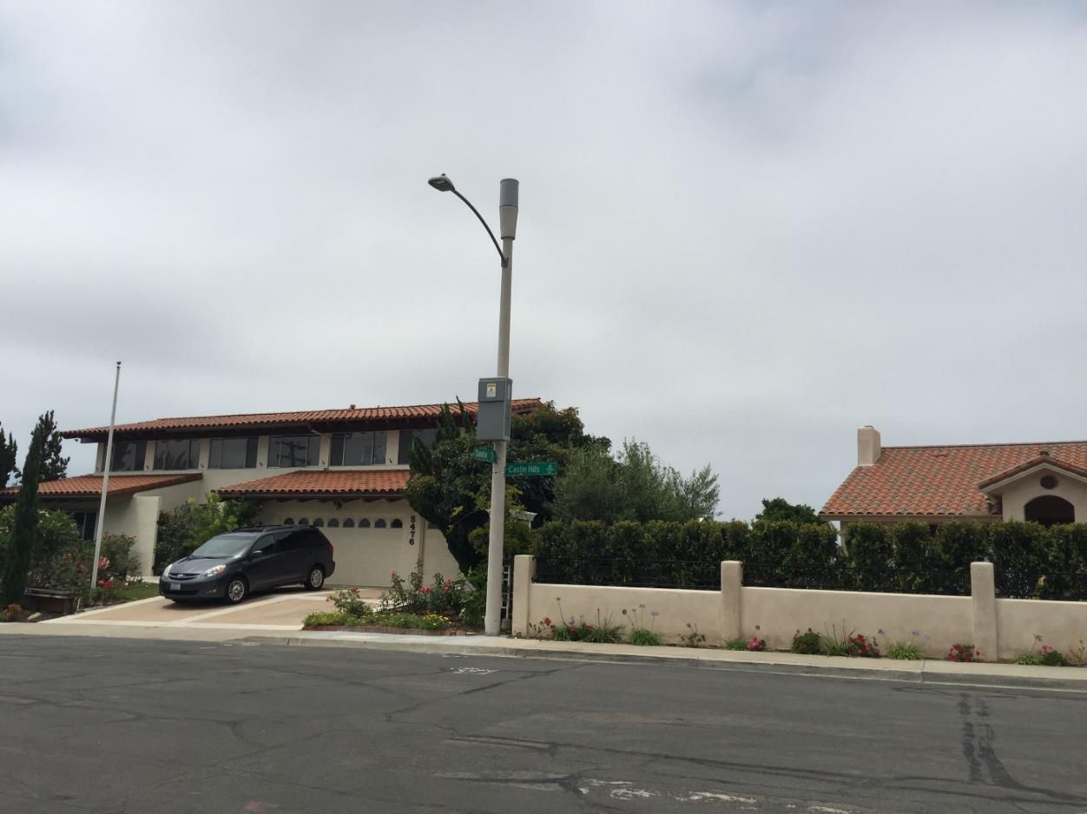
Rancho Palos Verdes

Slide 17
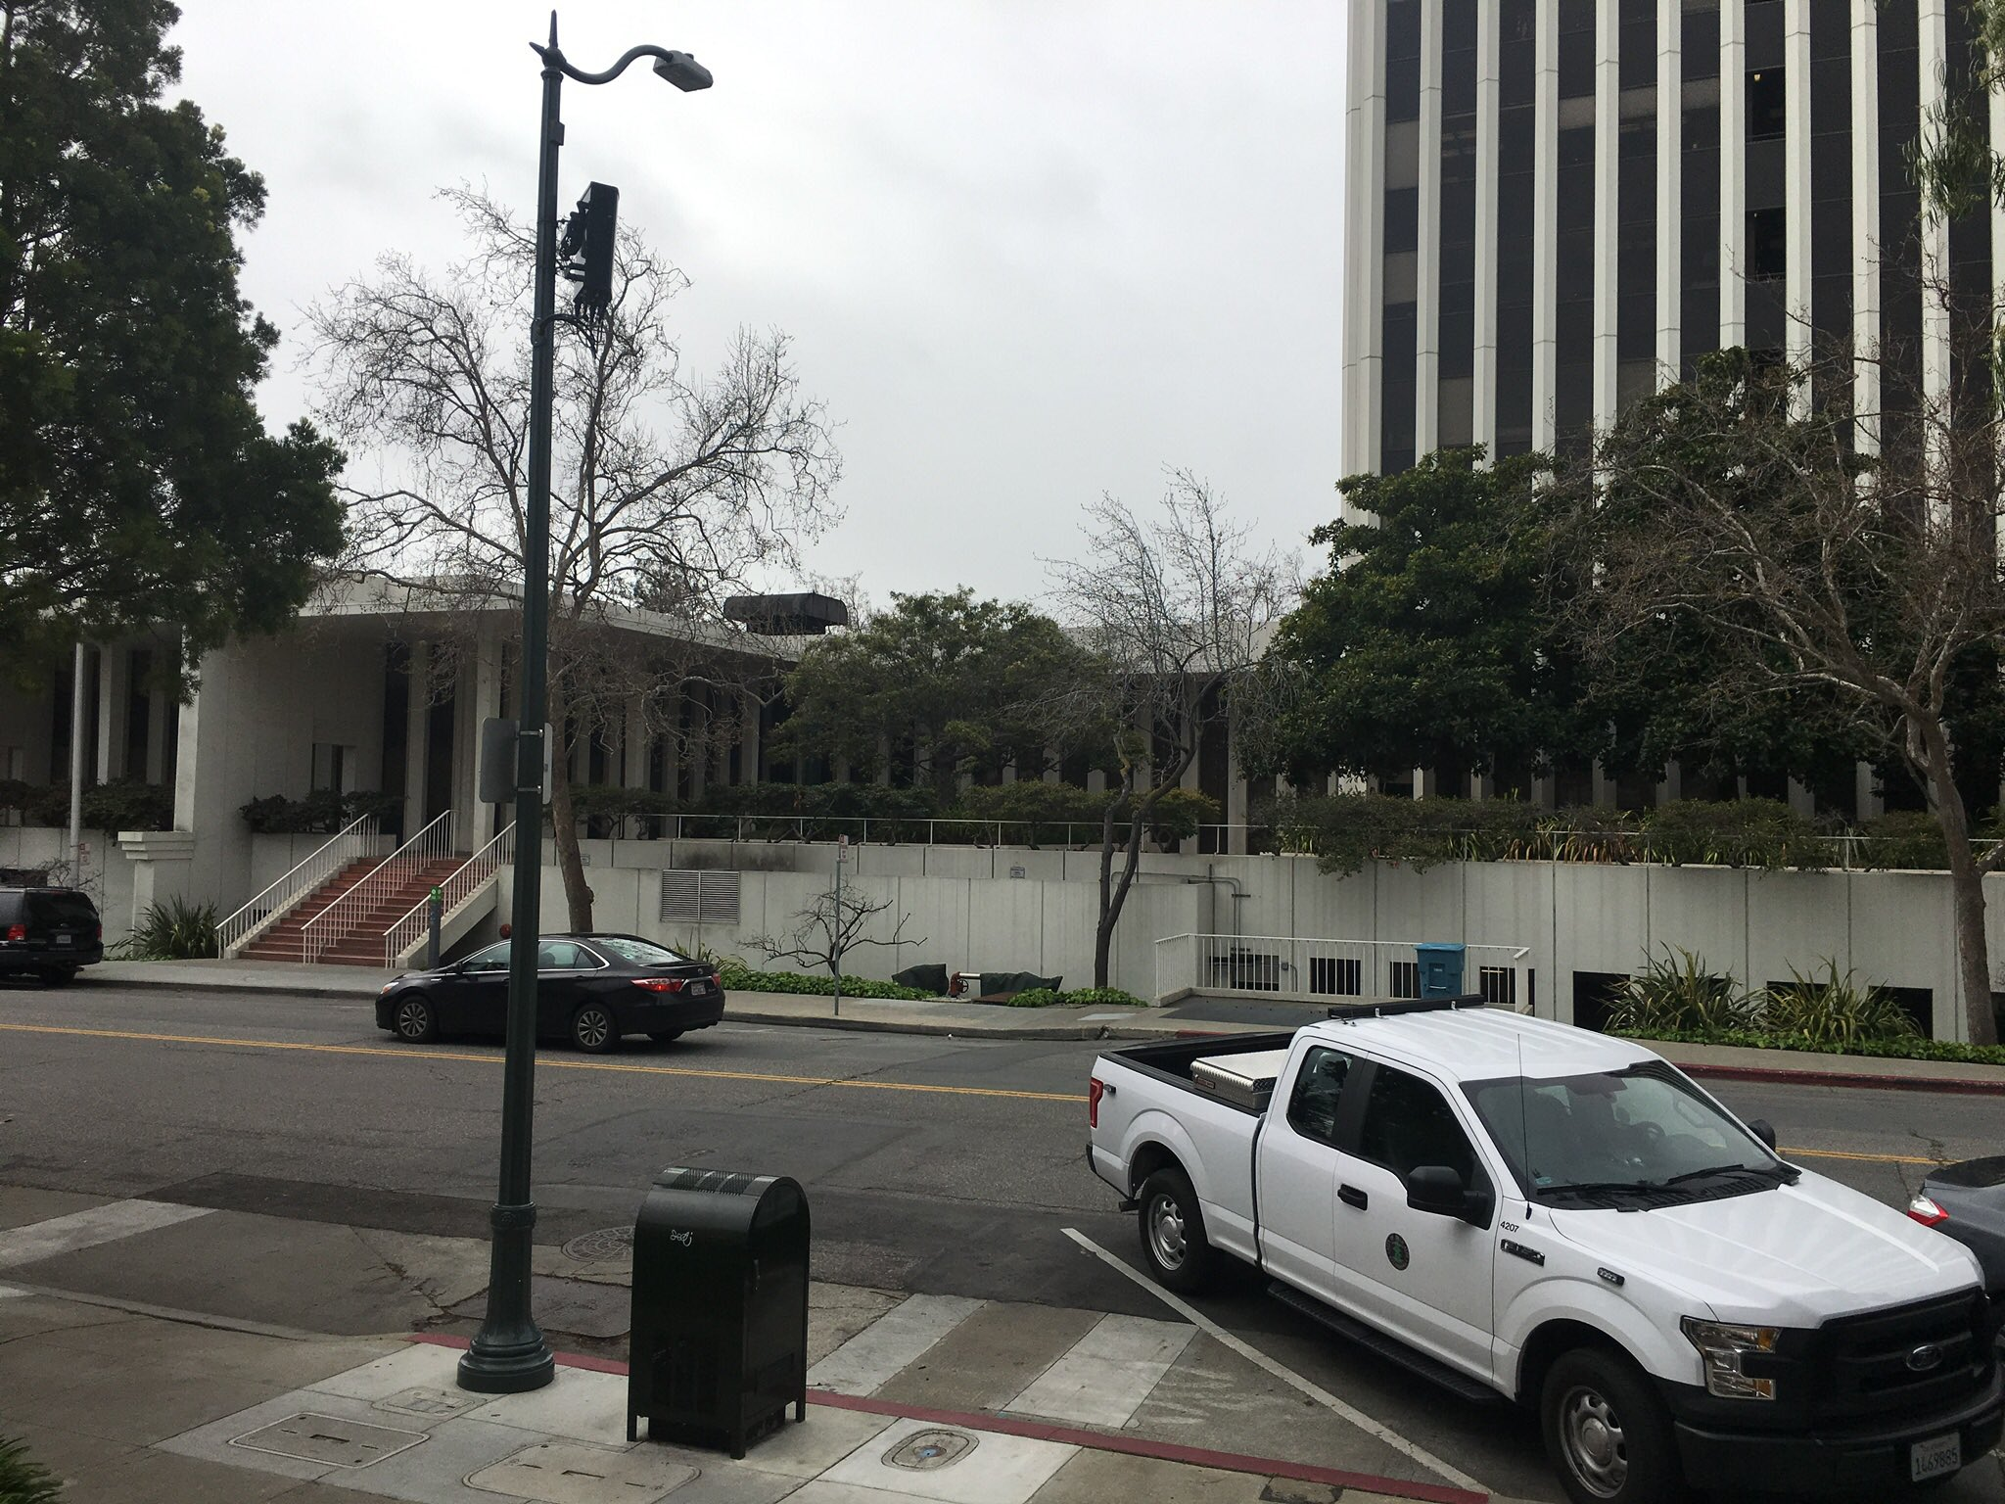
2 foot antenna
Base station equipment in
faux mailbox
Palo Alto

Slide 18
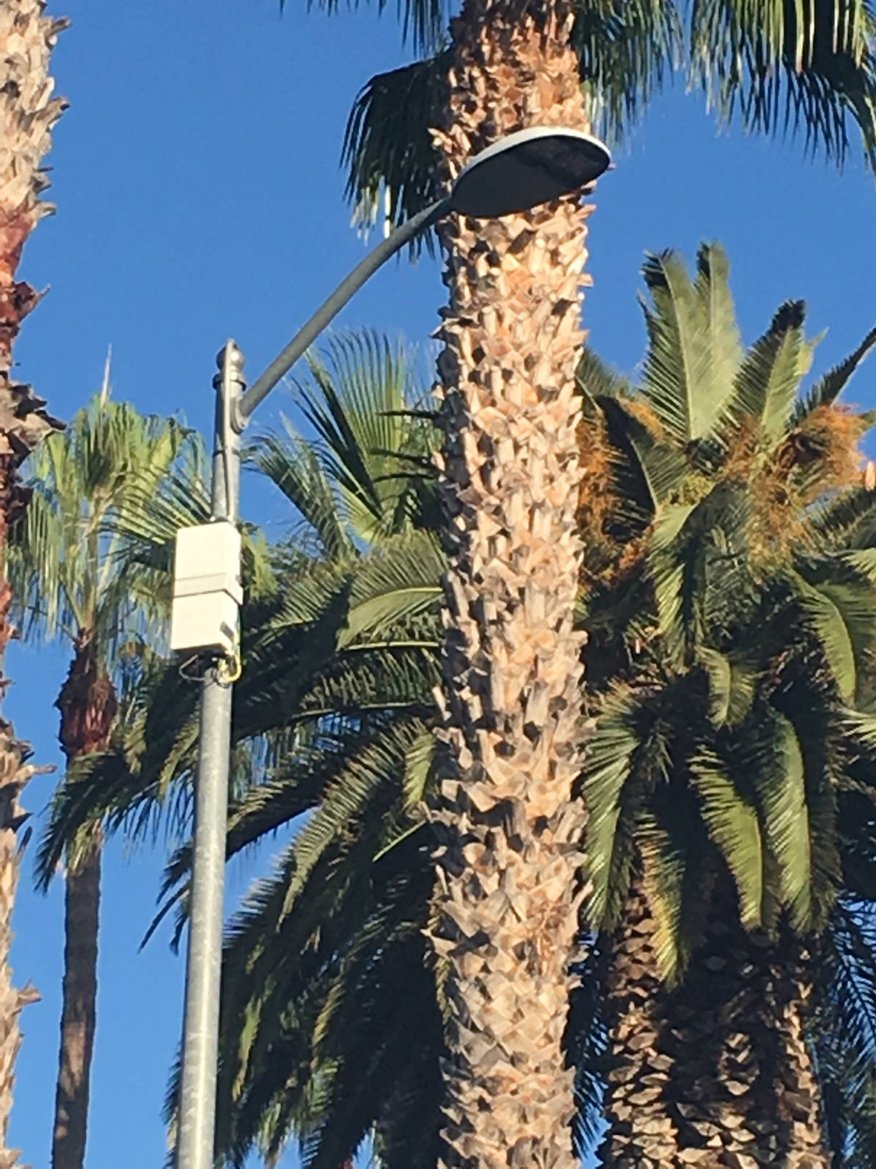
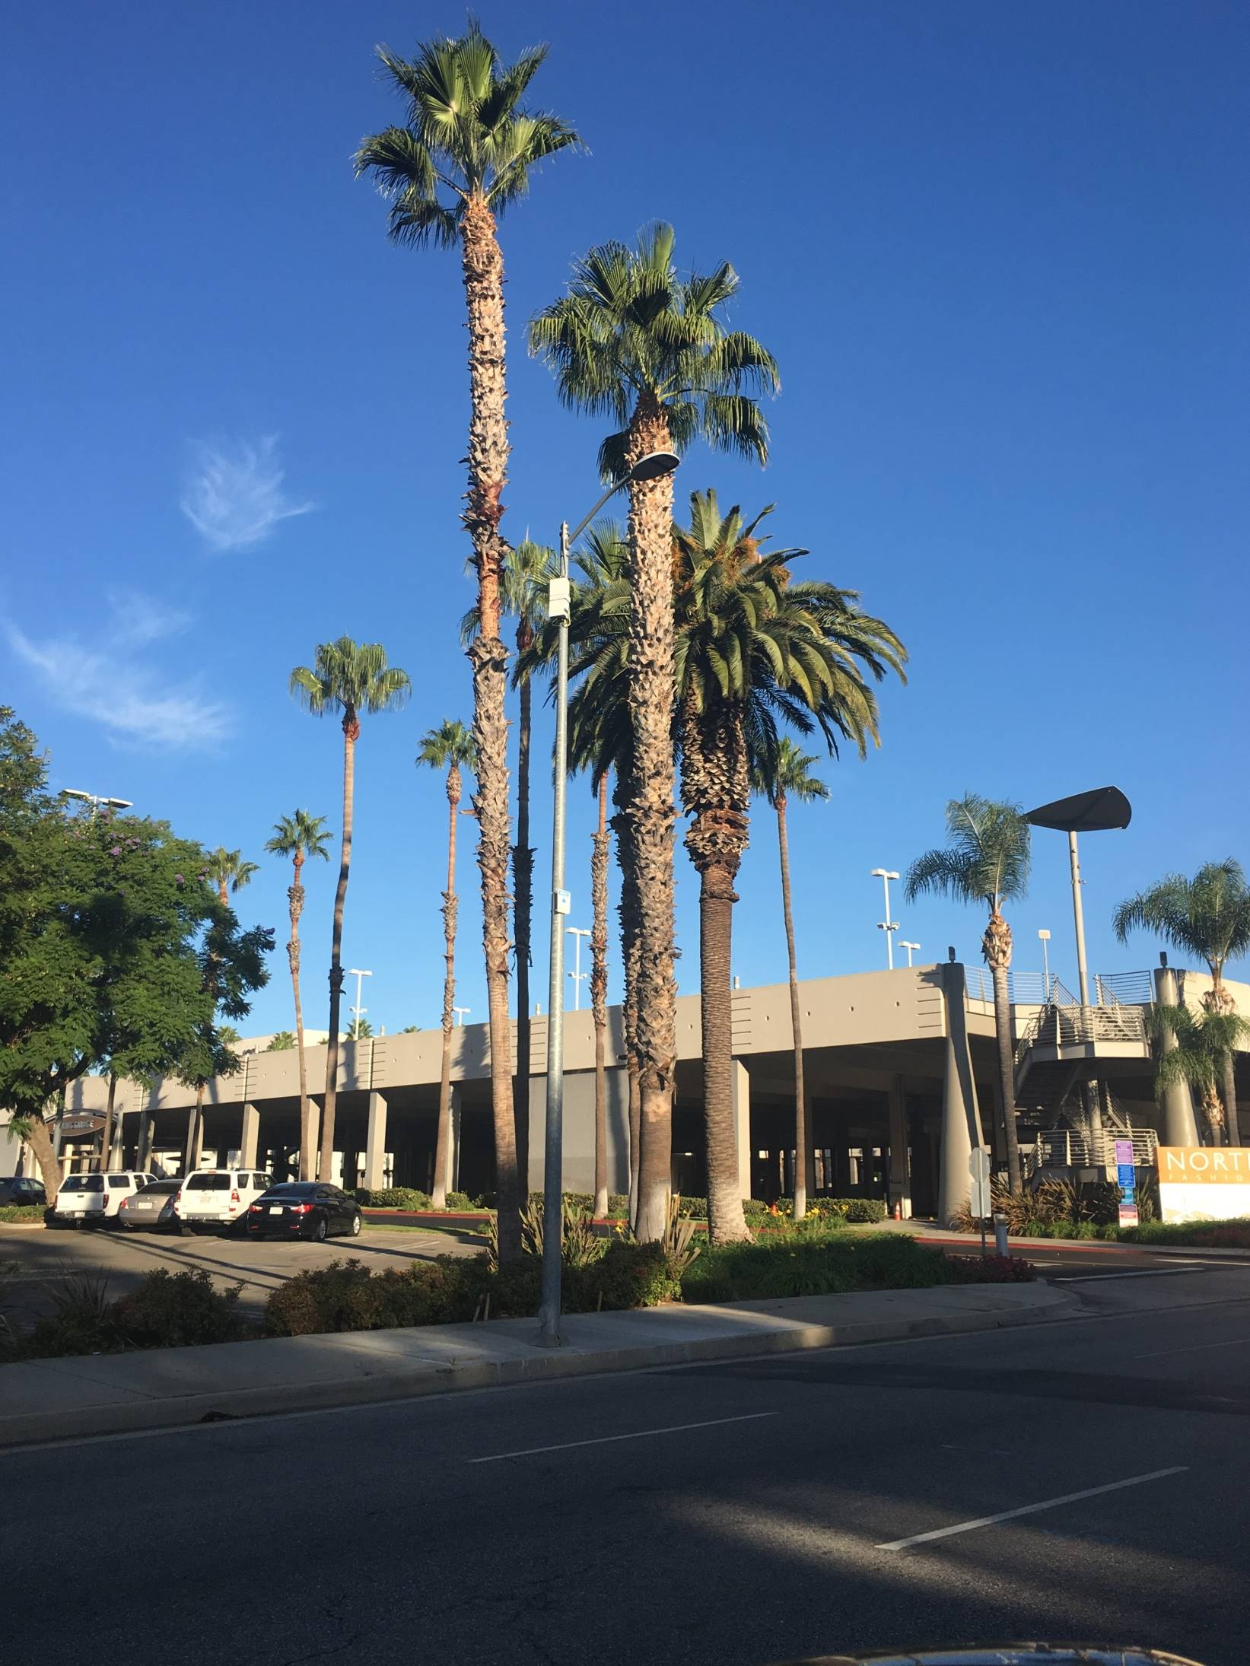
T-Mobile by Crown Castle
Los Angeles

Slide 19
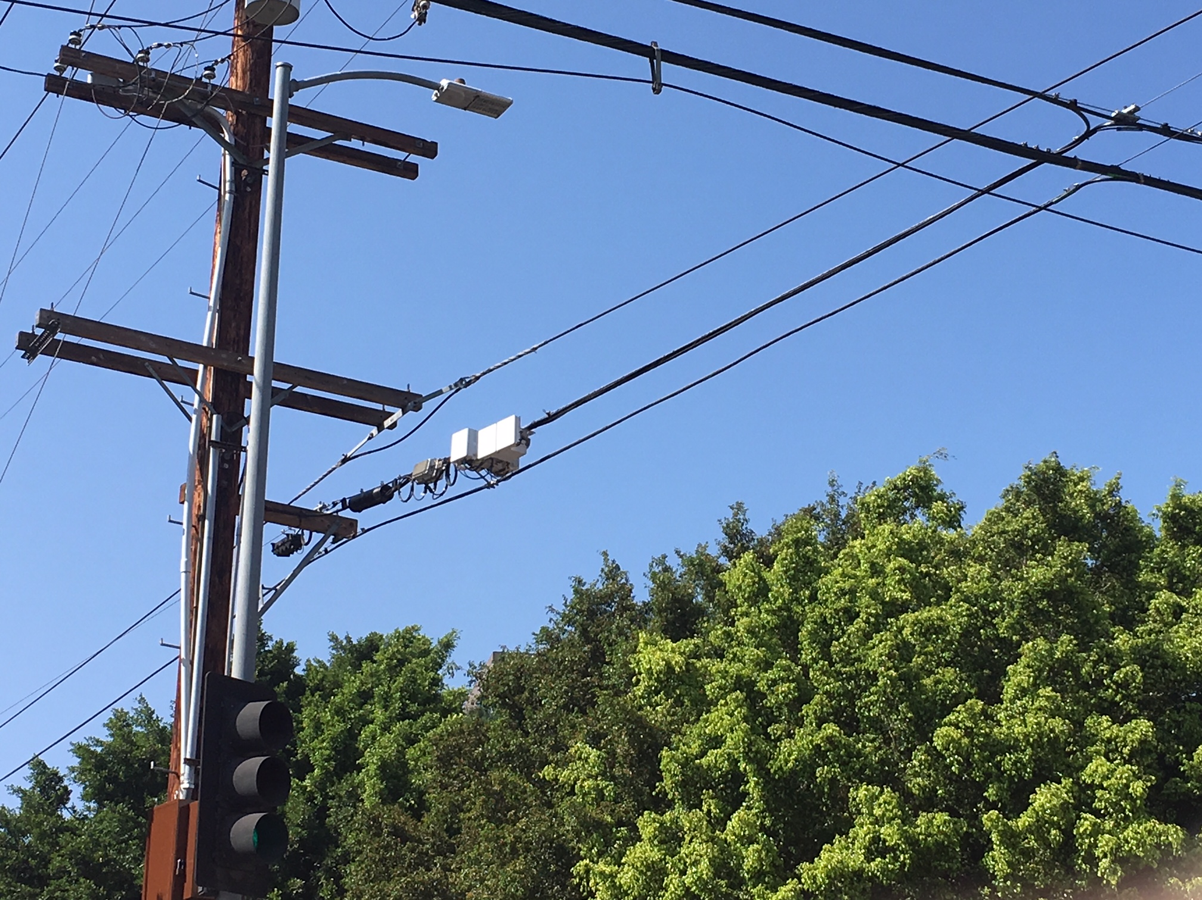
T-Mobile by Crown Castle
Los Angeles

Slide 20
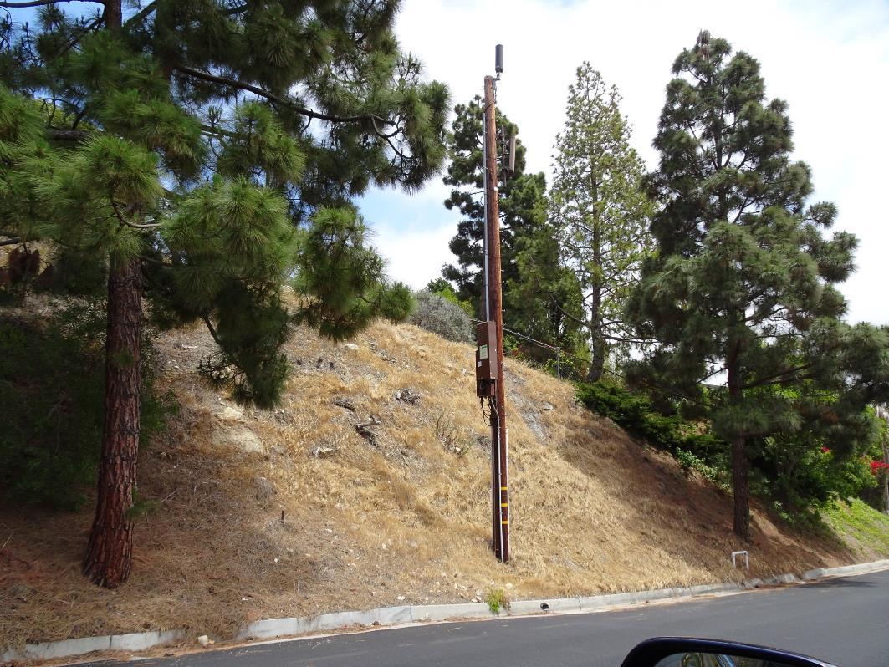
Sprint by Crown Castle
Palos Verdes Estates

Slide 21
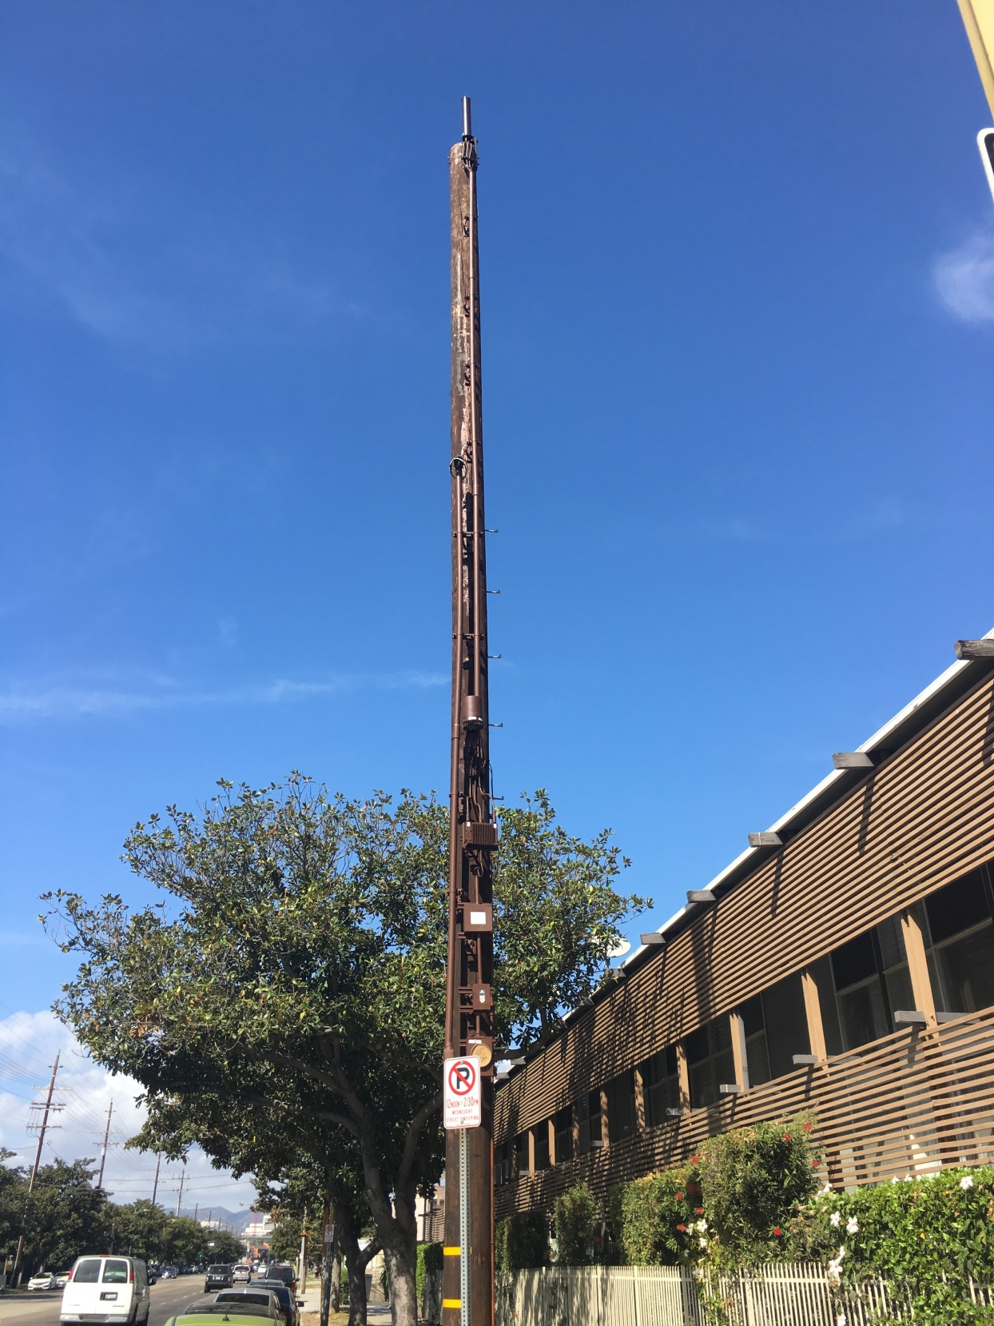
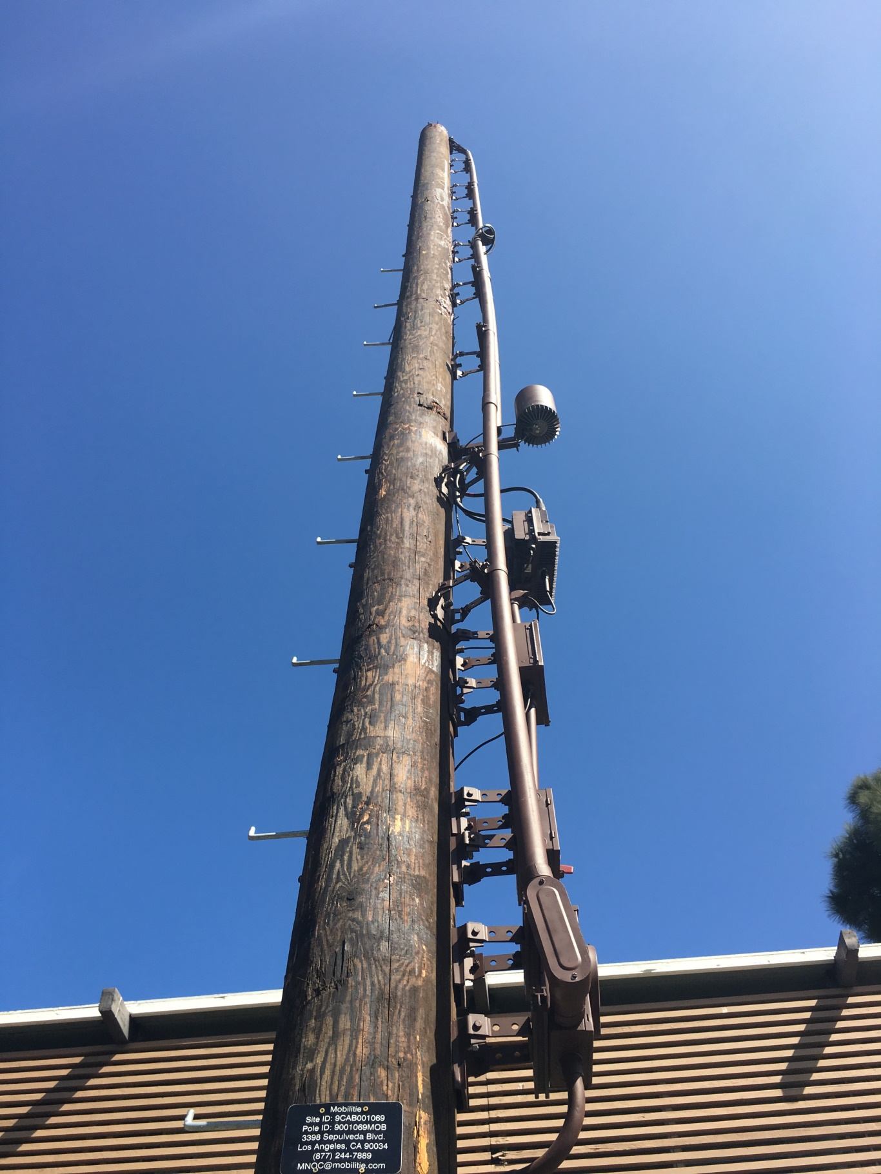
Pole installed by
Mobilitie; not
shared
Sprint by
Mobilitie

Slide 22
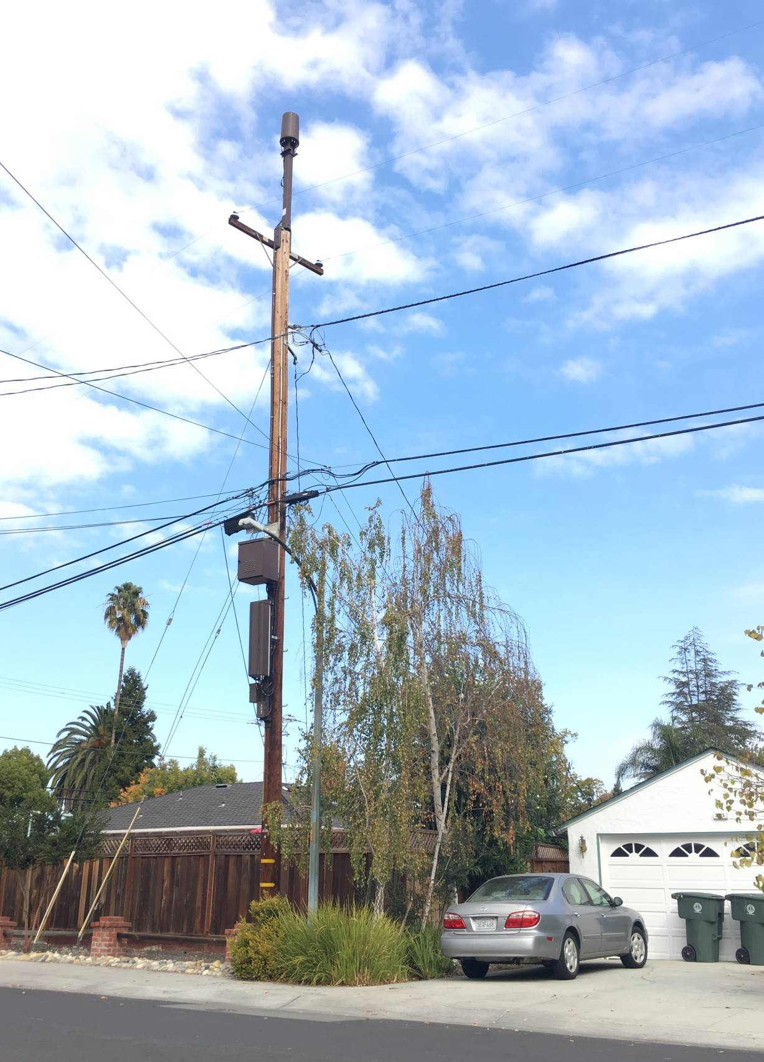
AT&T
Palo Alto

Slide 23
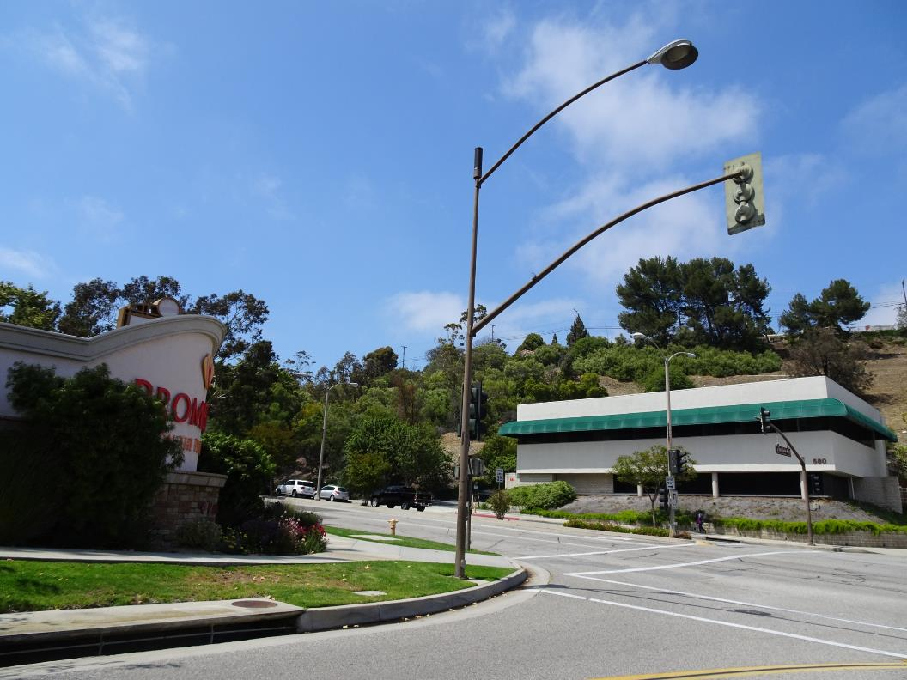
Antenna
Base station equipment in underground
Vault by the fire plug
Crown Castle
Rolling Hills Estates

Slide 24
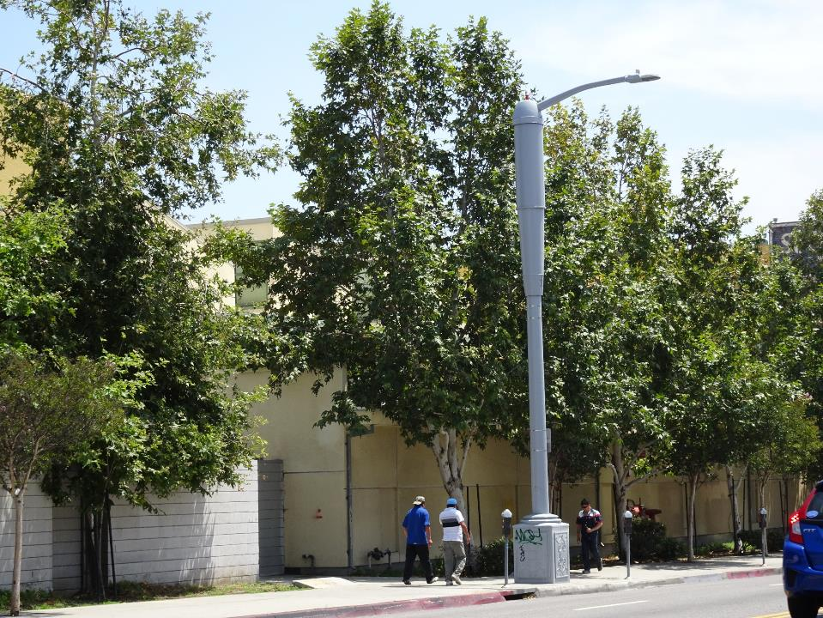
Verizon / Los Angeles

Slide 25
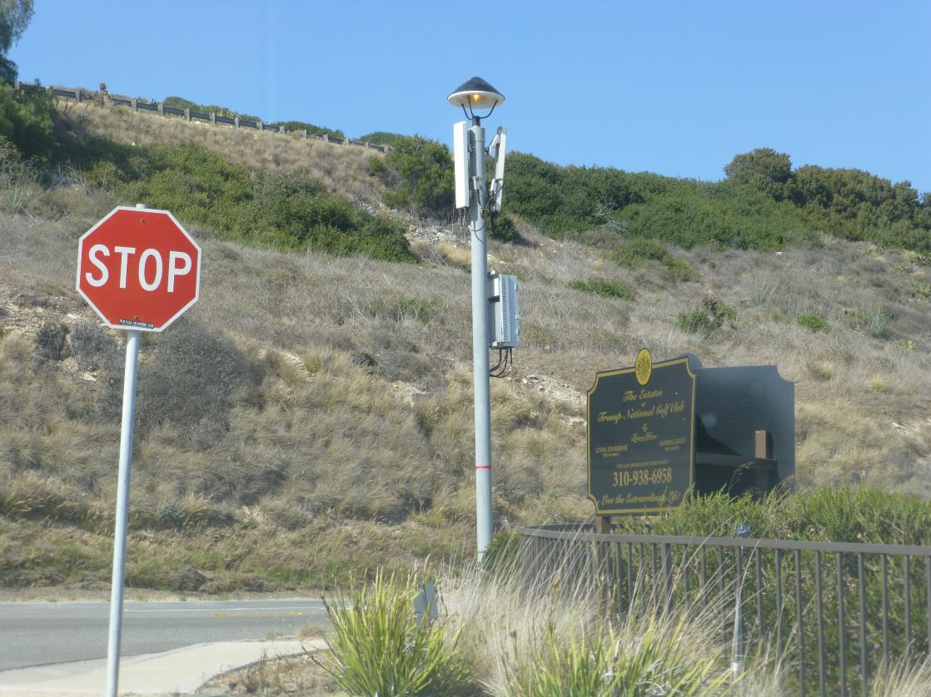
Crown Castle
Rancho Palos Verdes

Slide 26
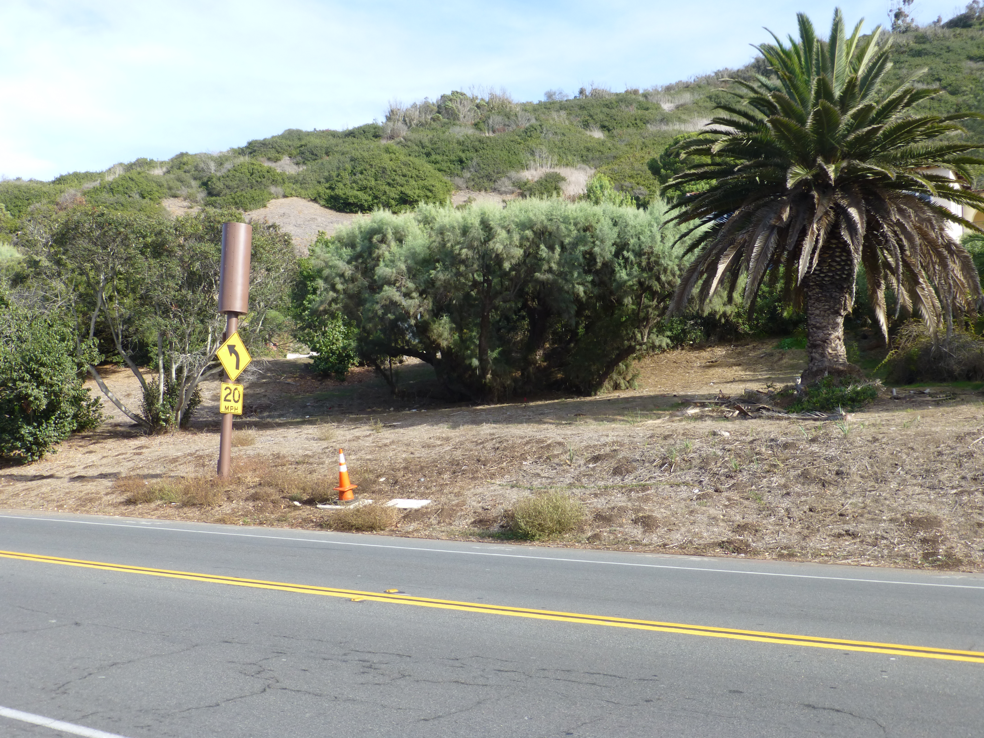
AT&T/Verizon Collocation
Crown Castle
Palos Verdes Estates

Slide 27
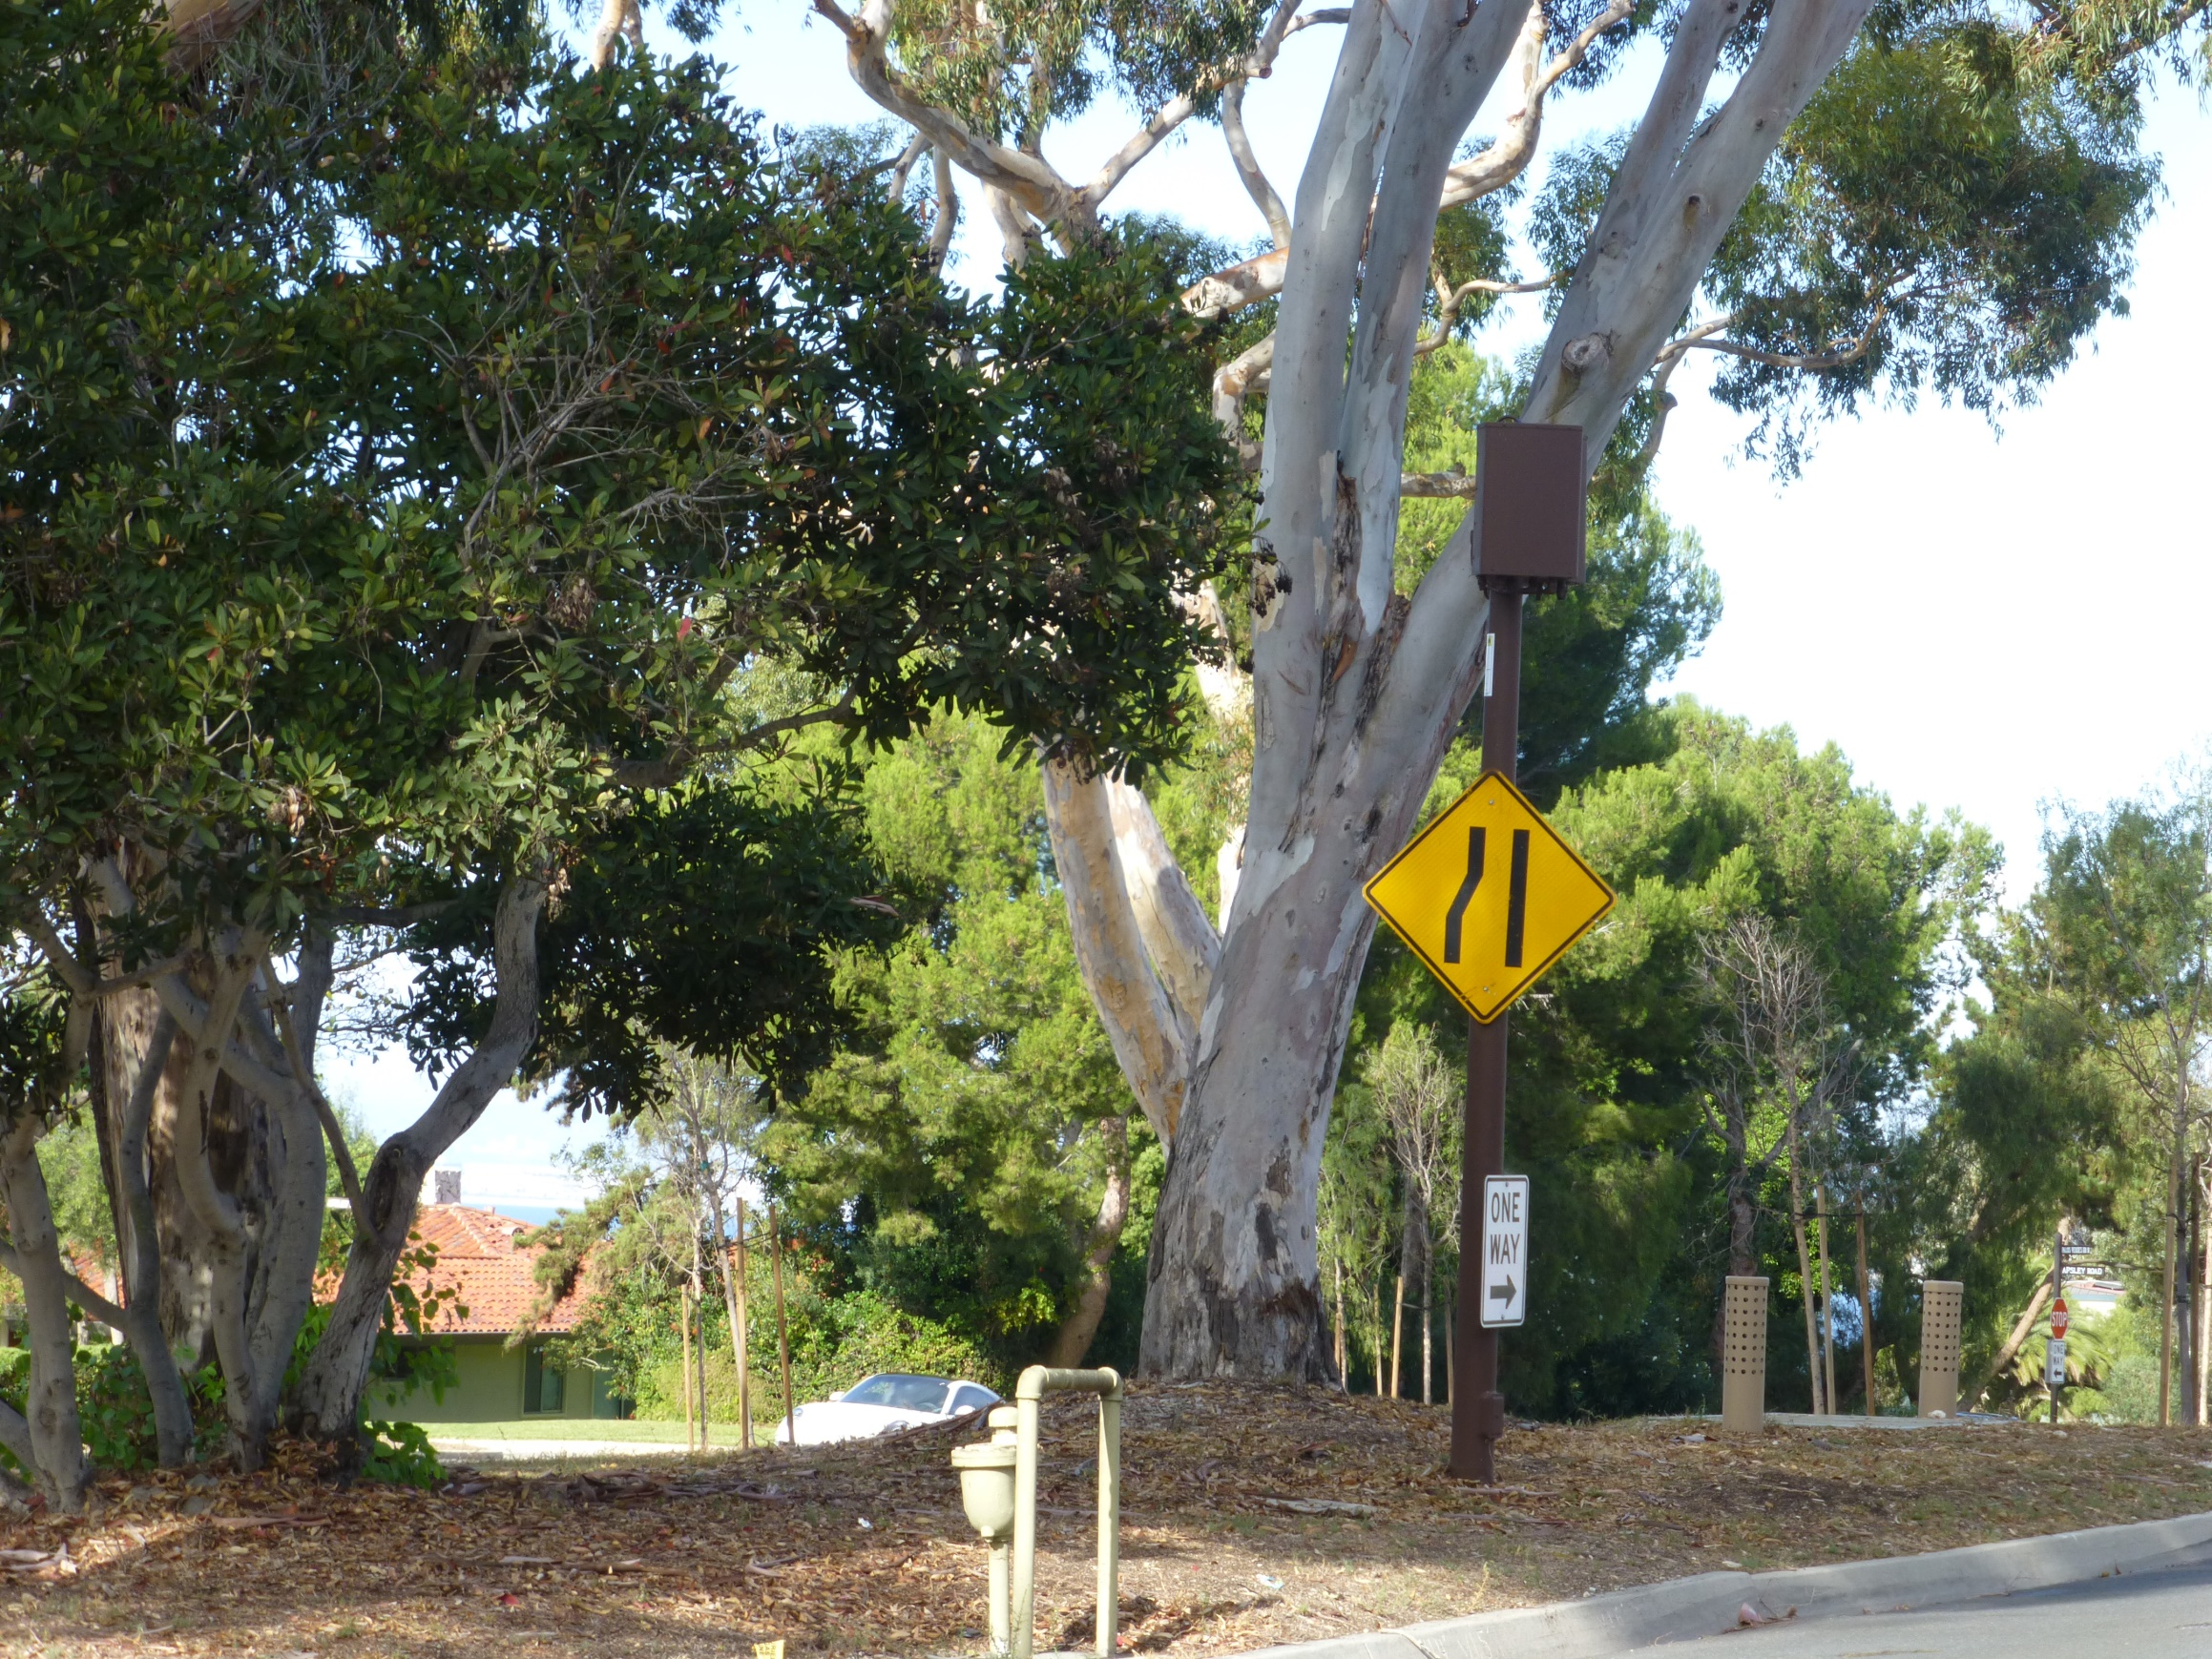
Crown Castle
Palos Verdes Estates

Slide 28
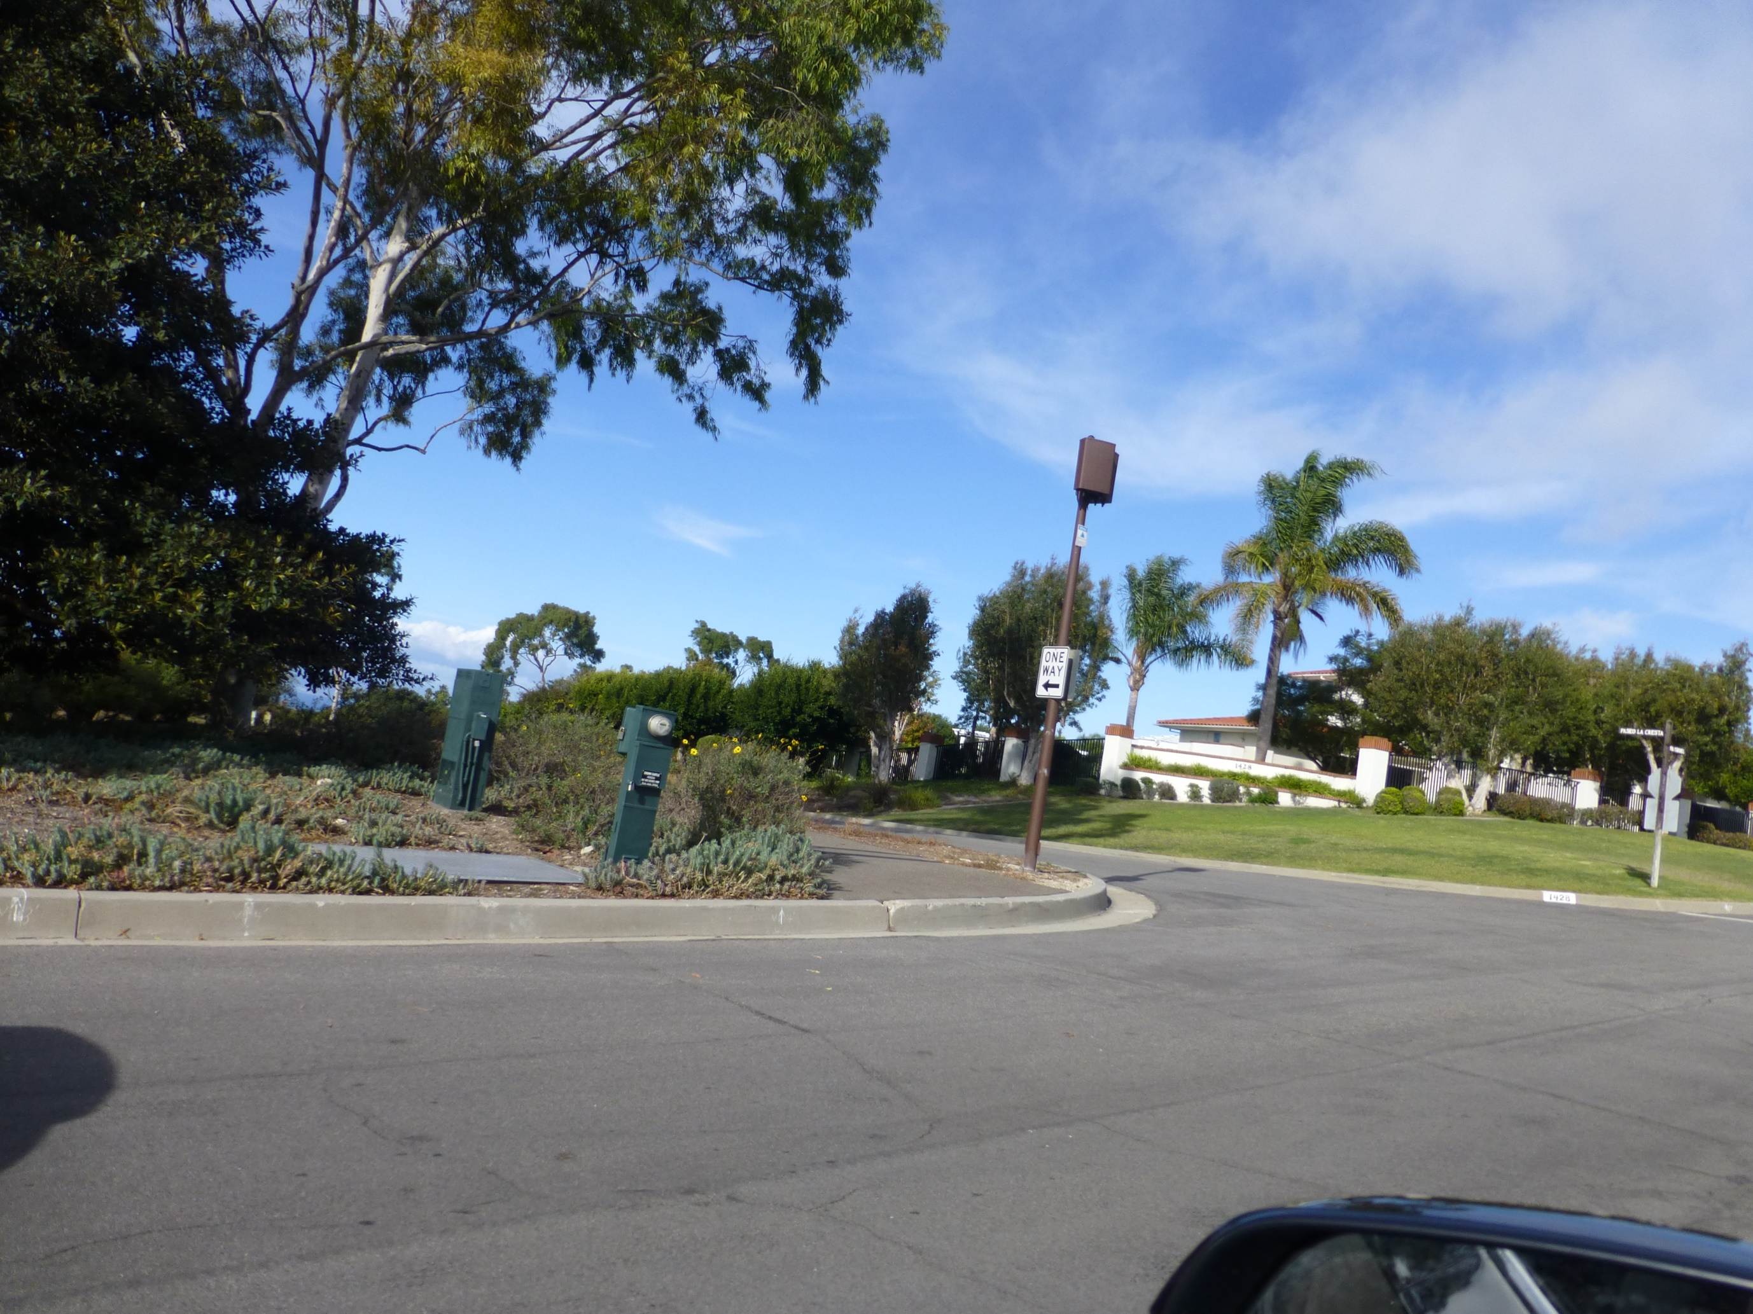
Crown Castle
Palos Verdes Estates

Slide 29
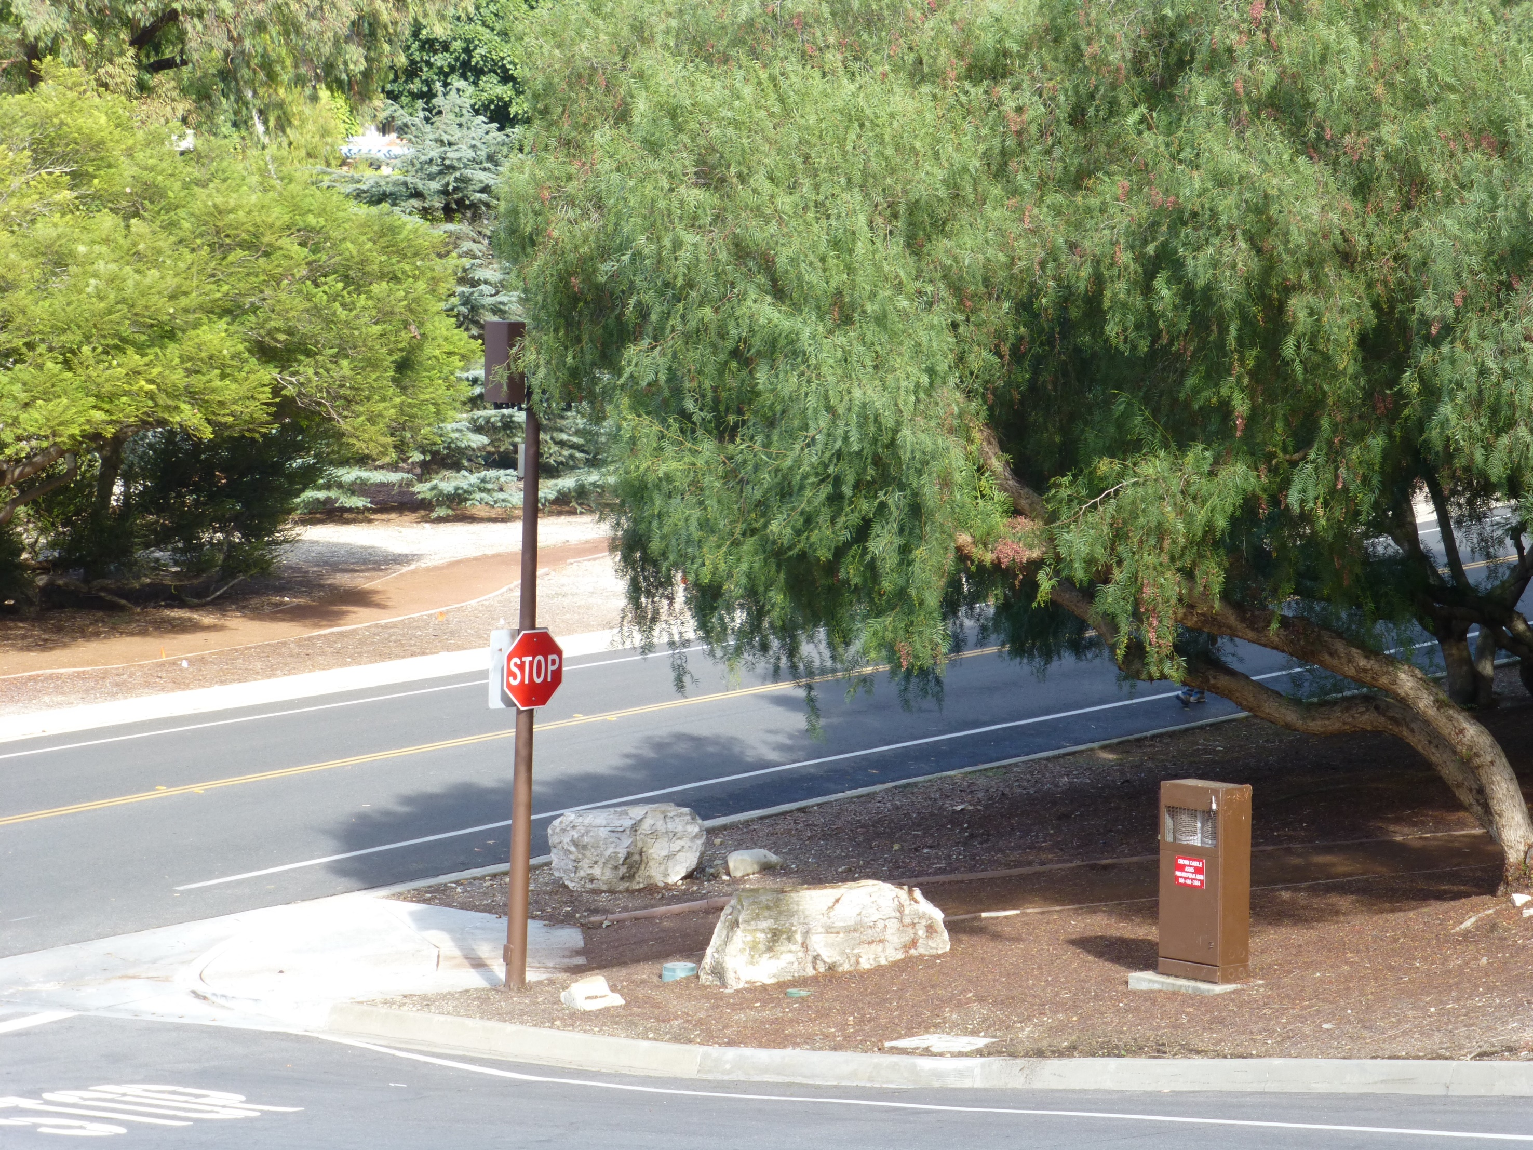
Crown Castle
Palos Verdes Estates

Slide 30
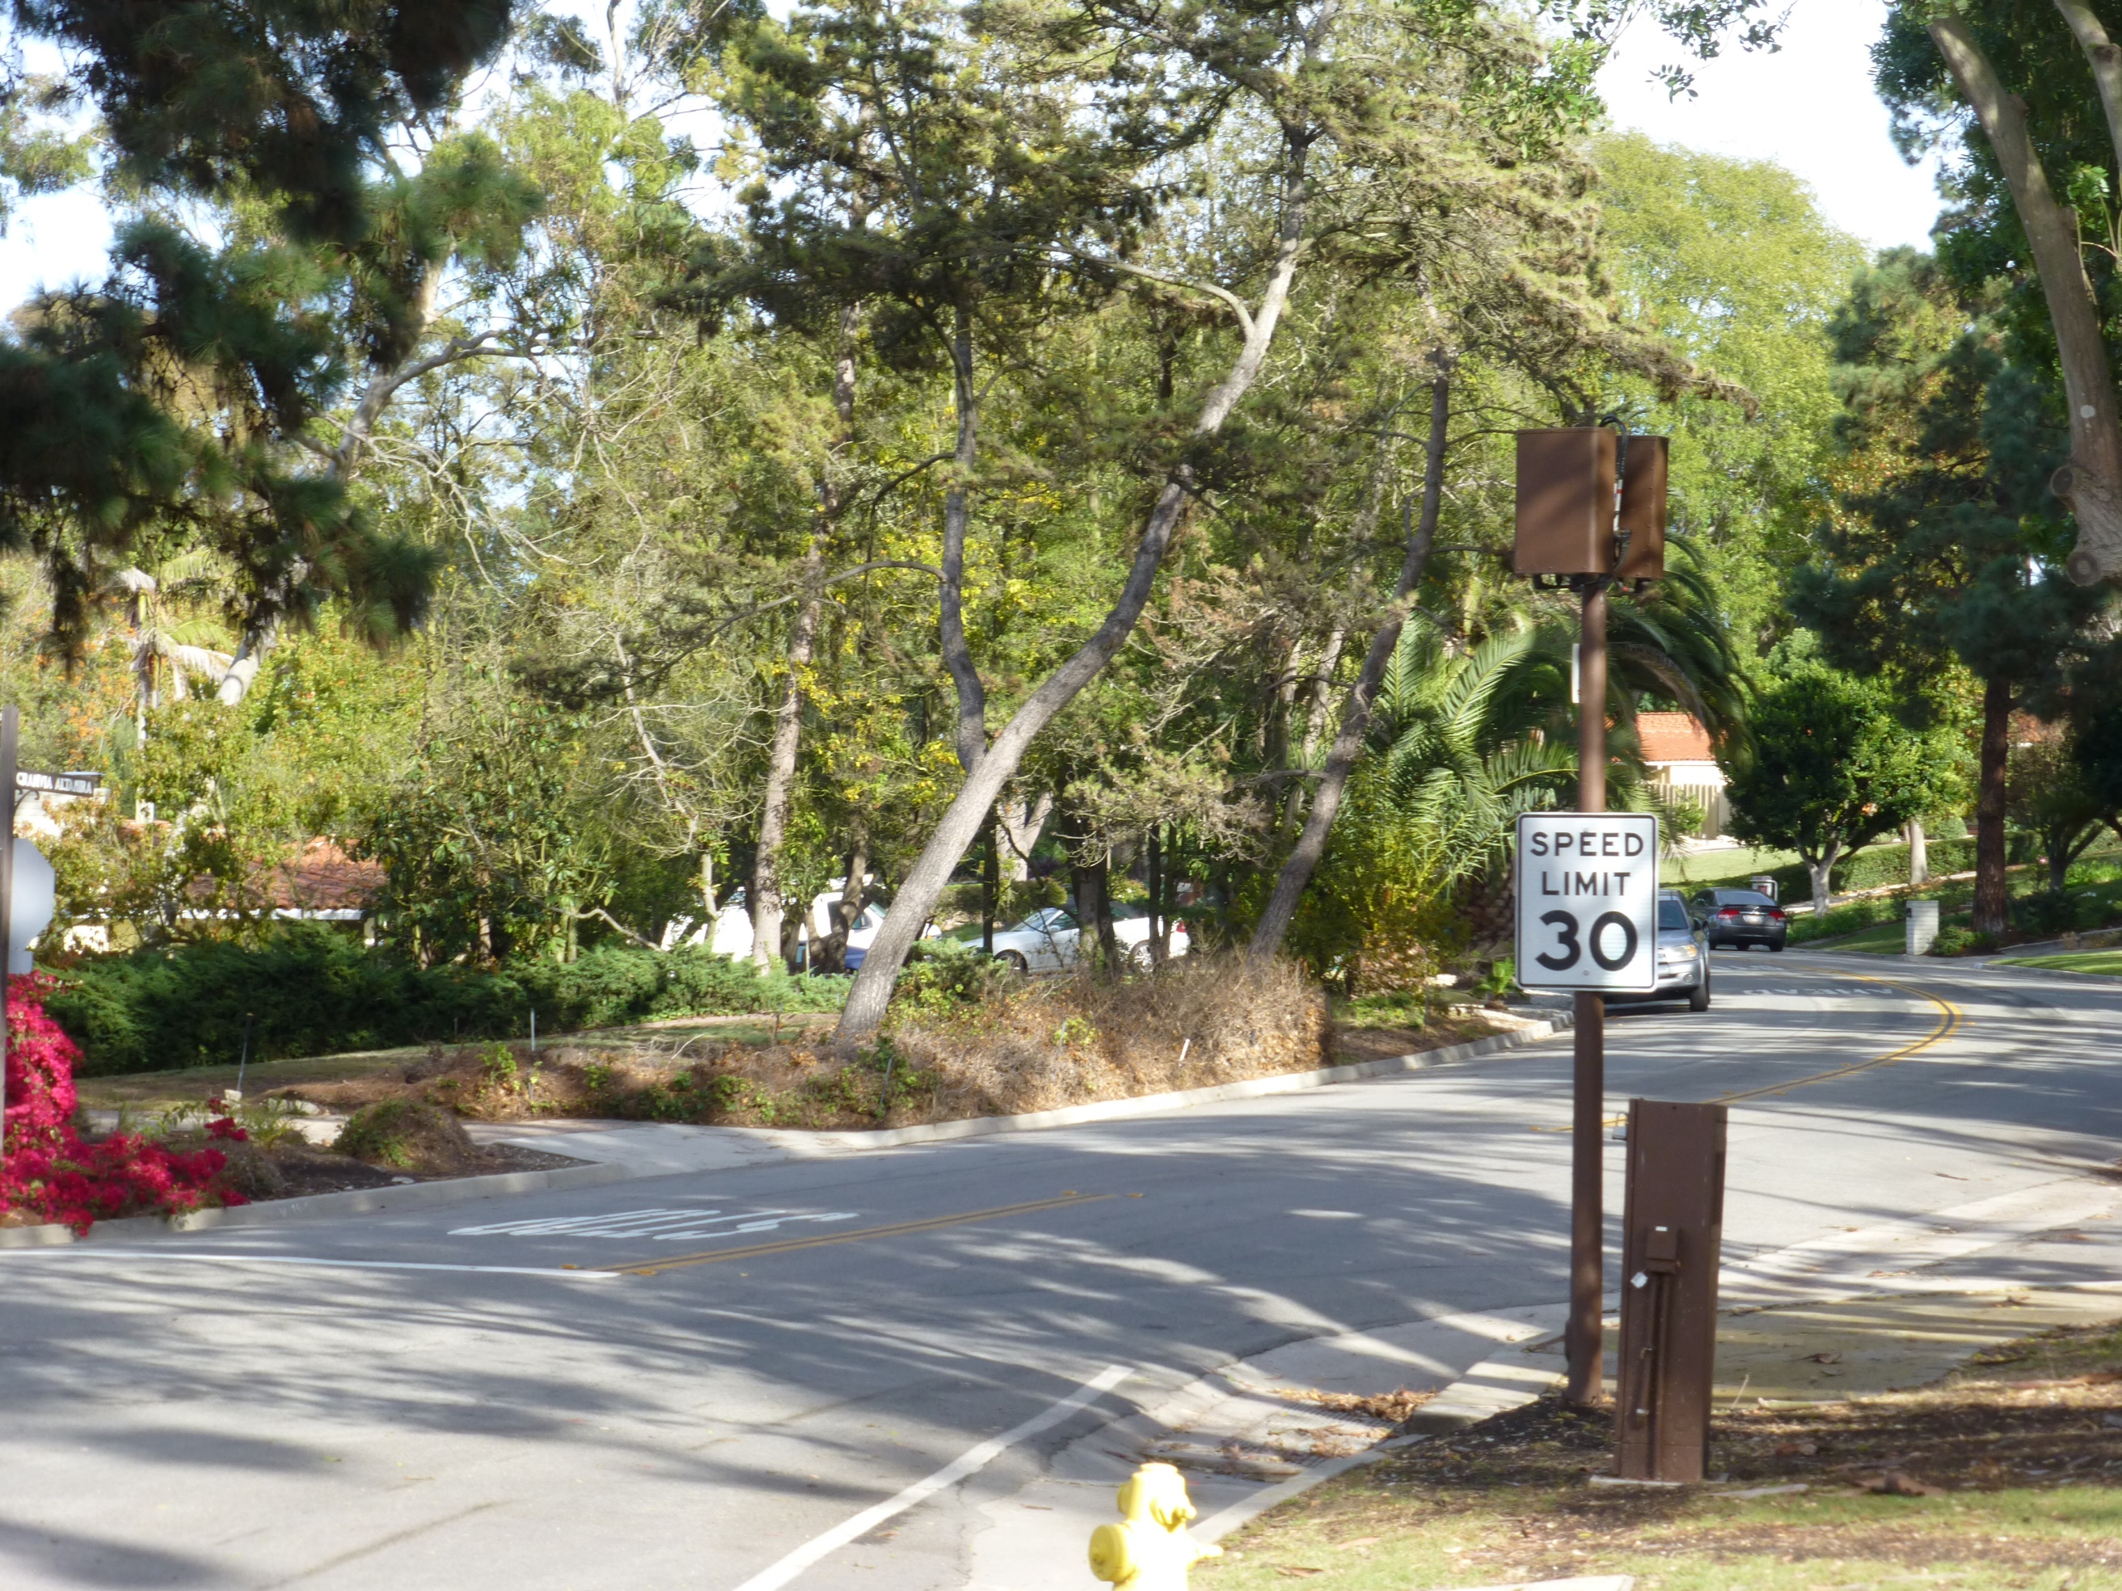
Crown Castle
Palos Verdes Estates

Slide 31
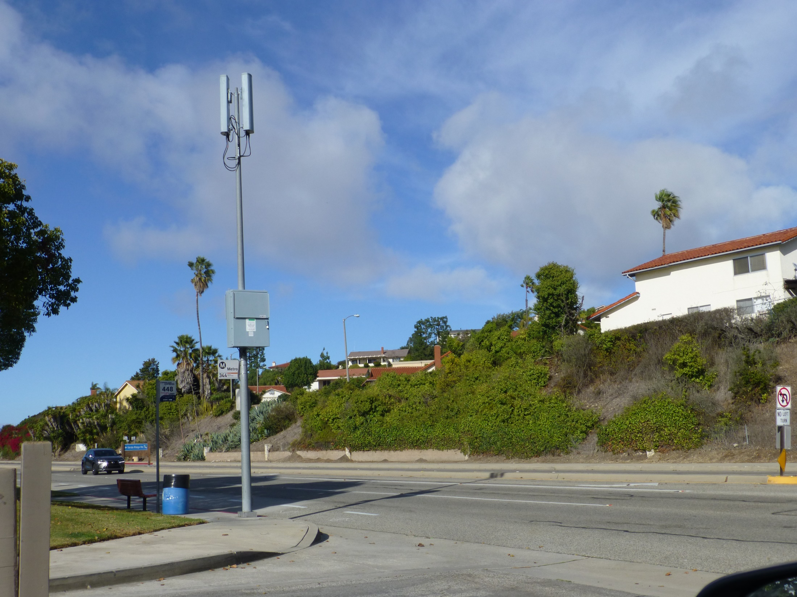
Crown Castle
Rancho Palos Verdes

Slide 32
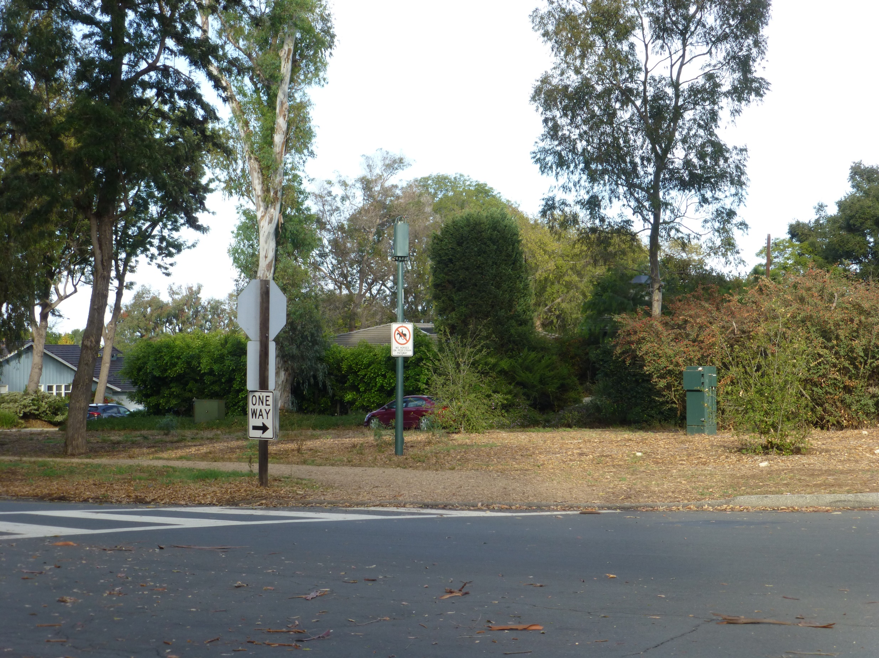
Crown Castle
Palos Verdes Estates

Slide 33
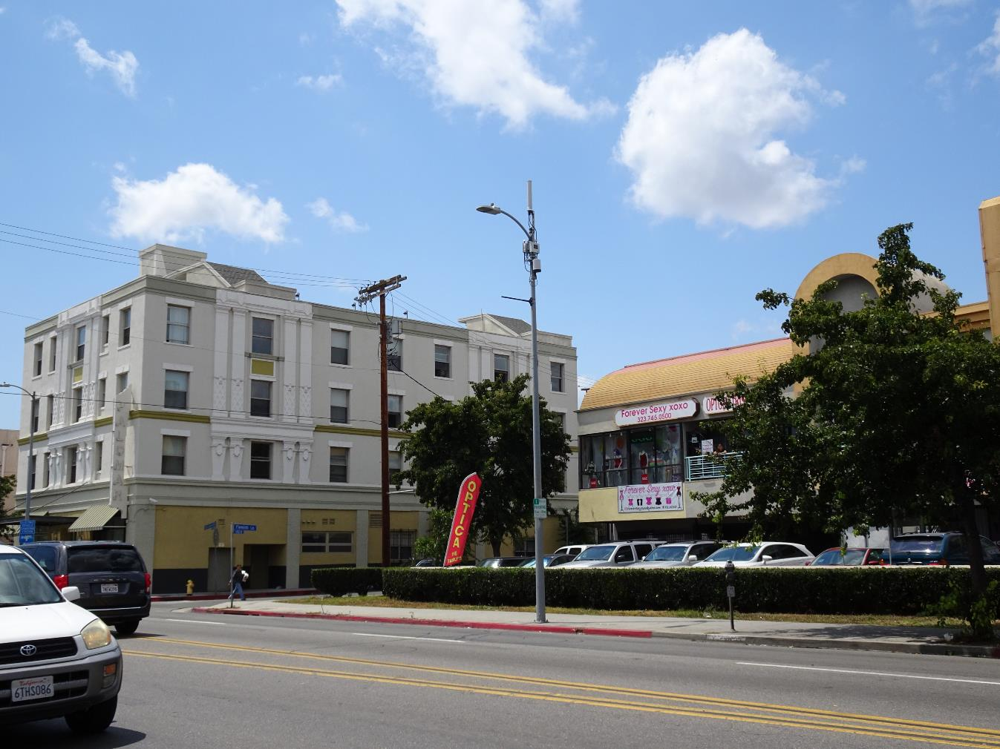
Sprint by
Mobilitie
Los Angeles

Slide 34
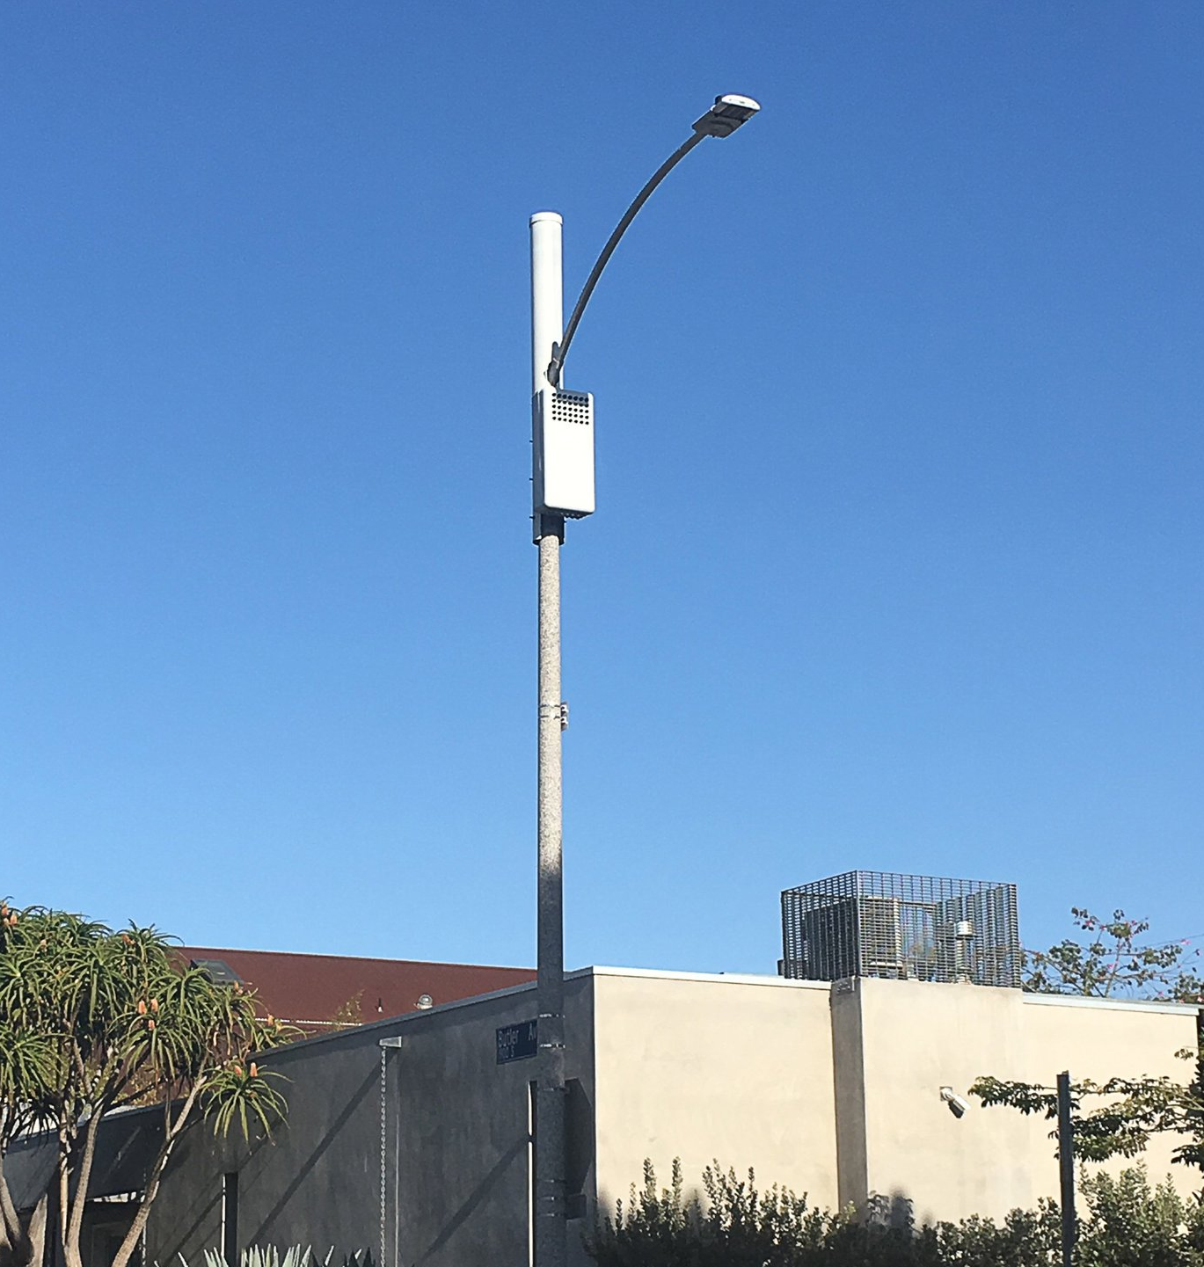
Sprint by
Mobilitie

Slide 35
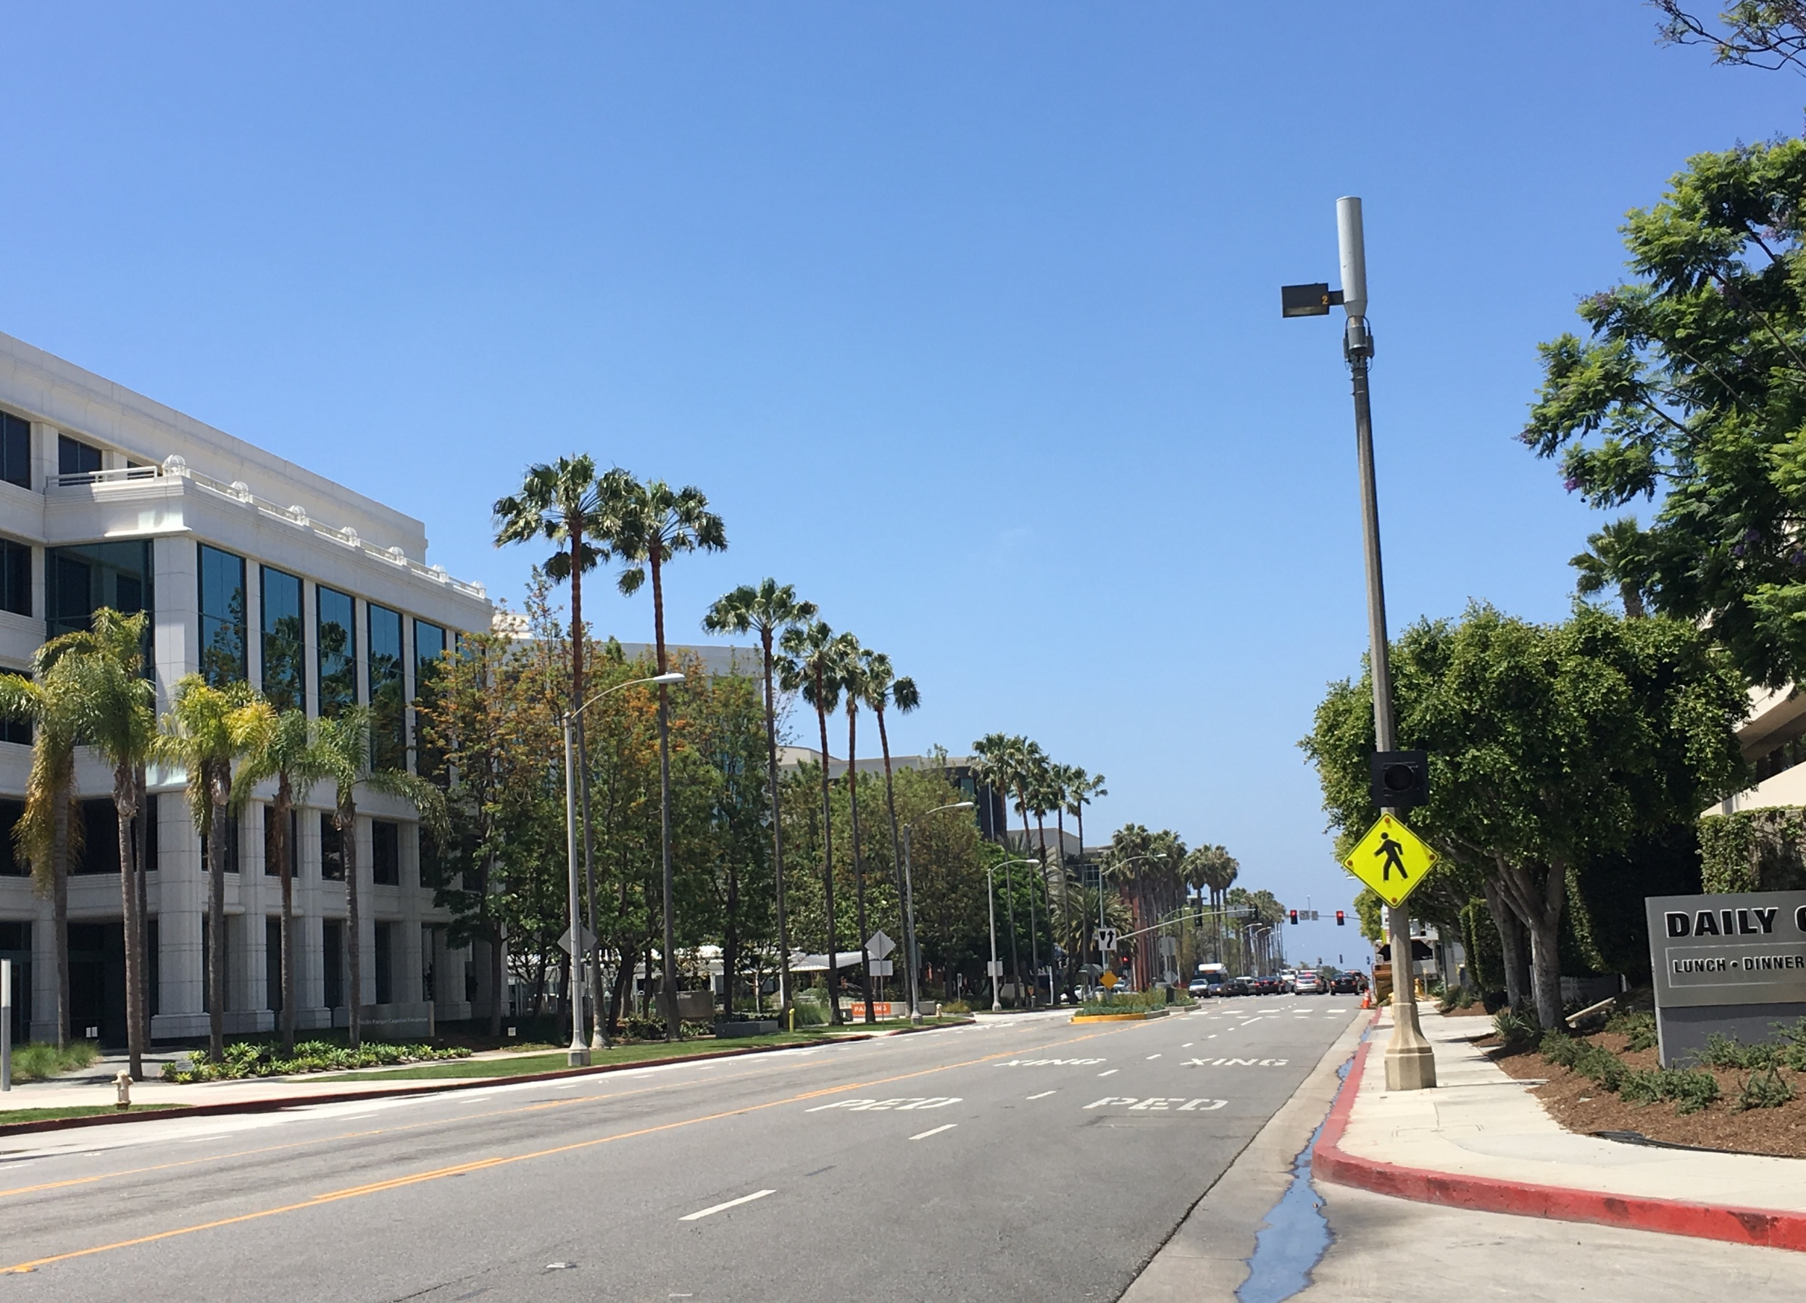
Sprint by
Mobilitie

Slide 36
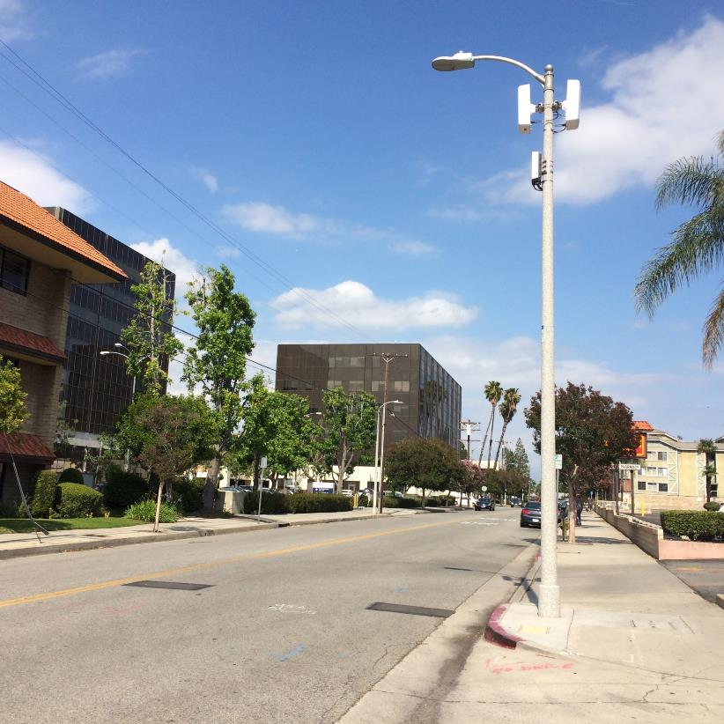
Verizon
Los Angeles

Slide 37
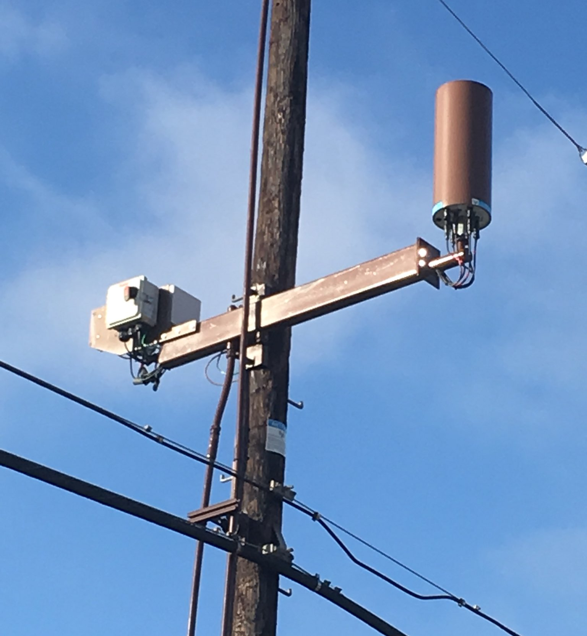
AT&T
Los Angeles
37

Slide 38
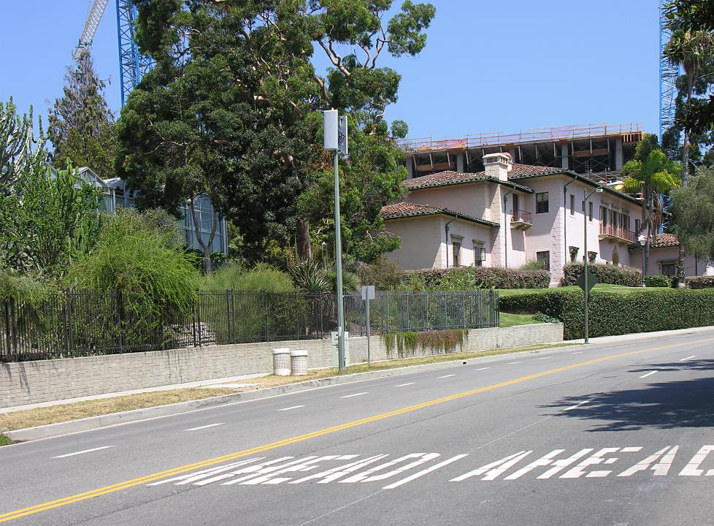
Sprint
Equipment in vault

Slide 39
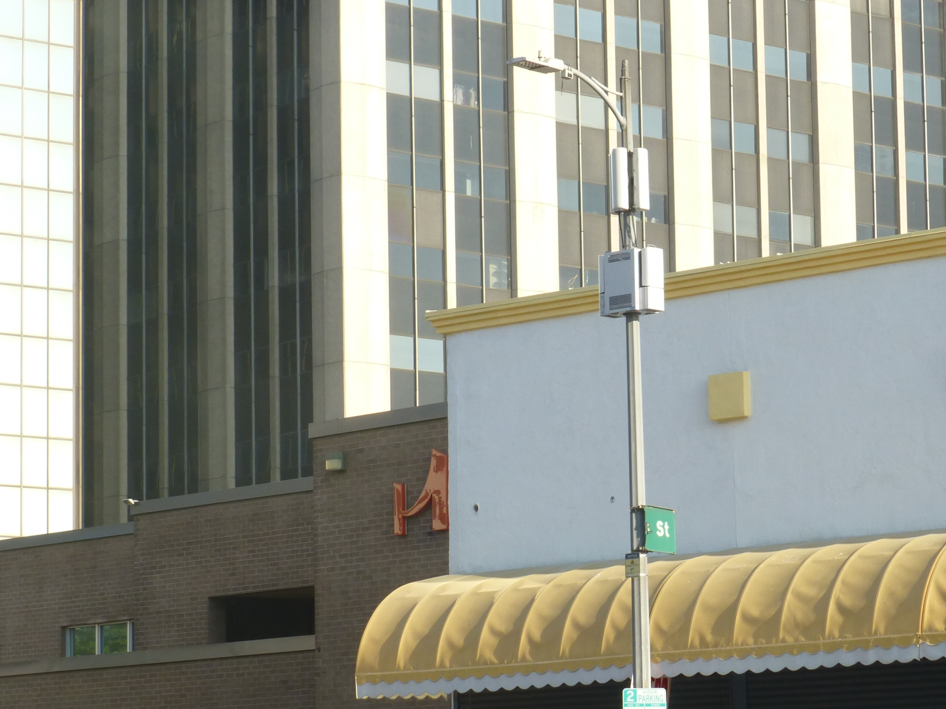
Verizon 4G+/Los Angeles

Slide 40
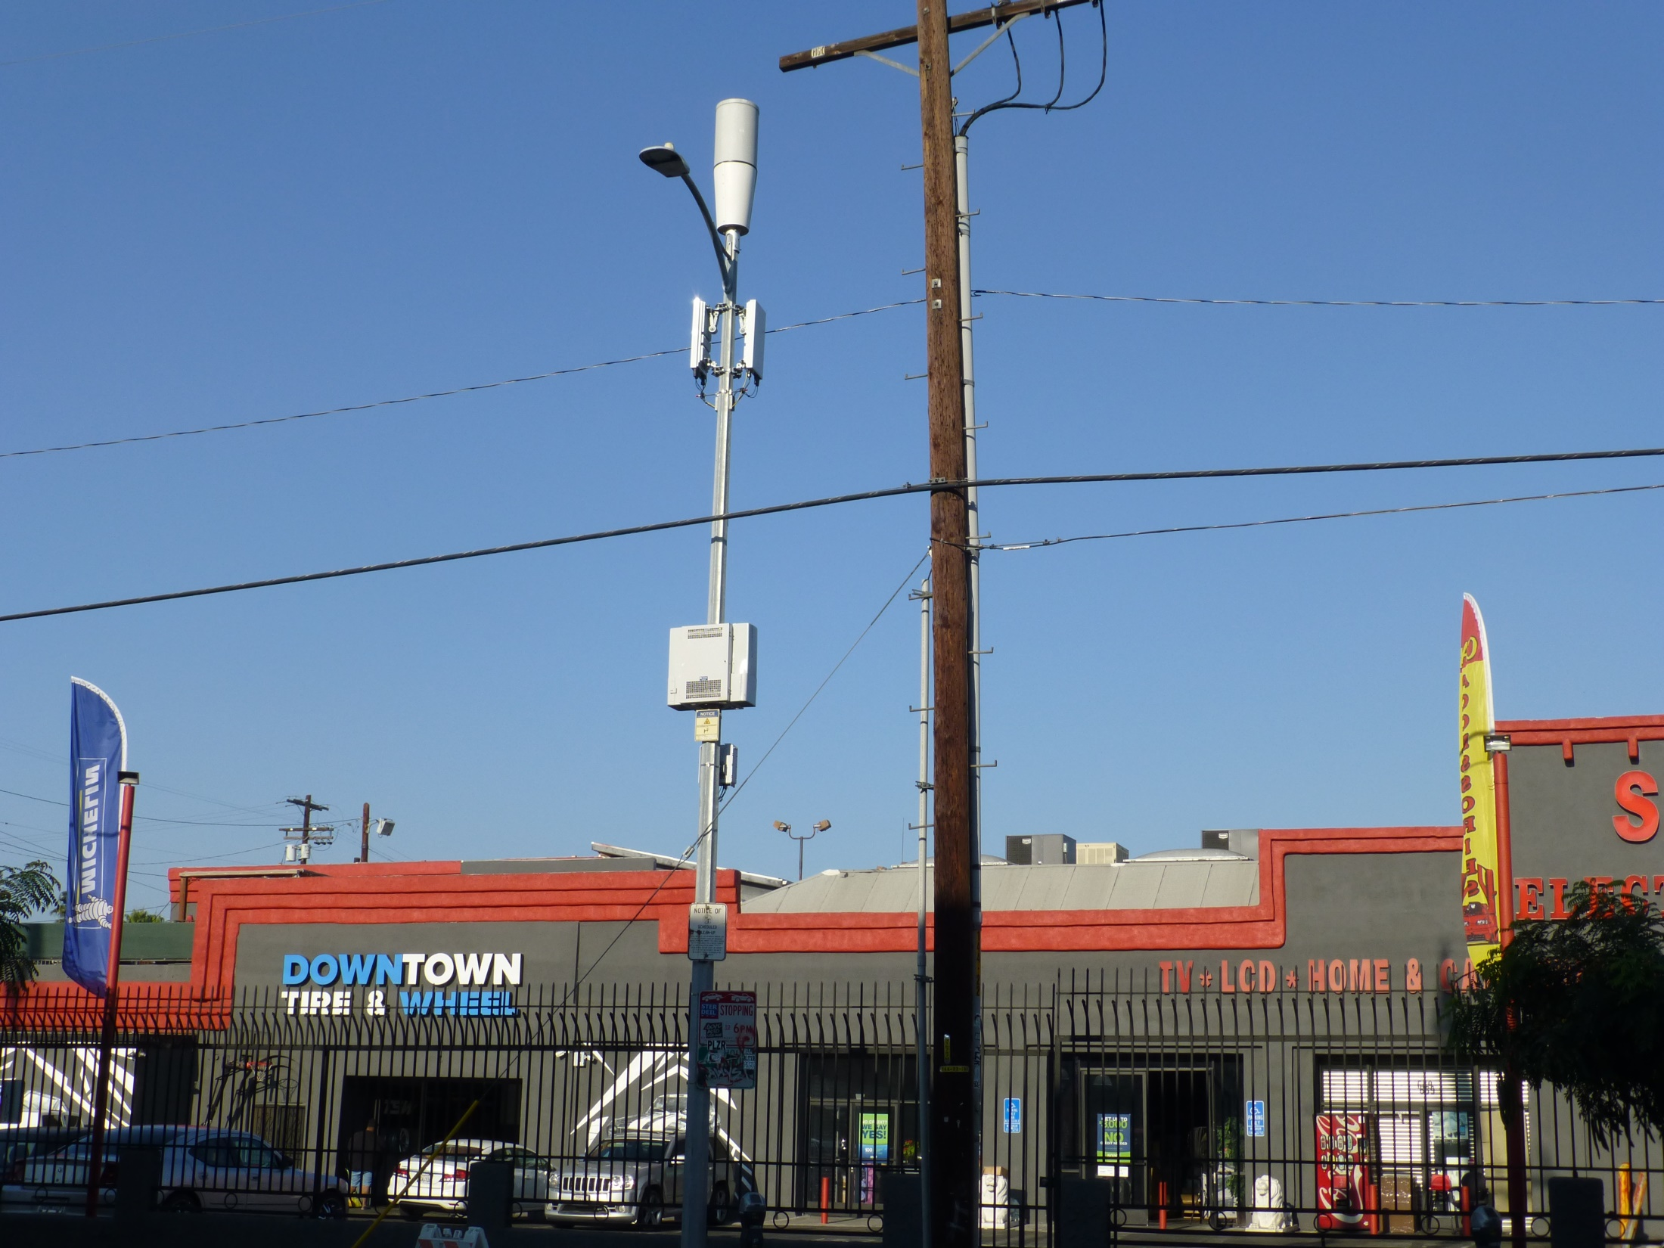
Verizon 4G+/Los Angeles

Slide 41
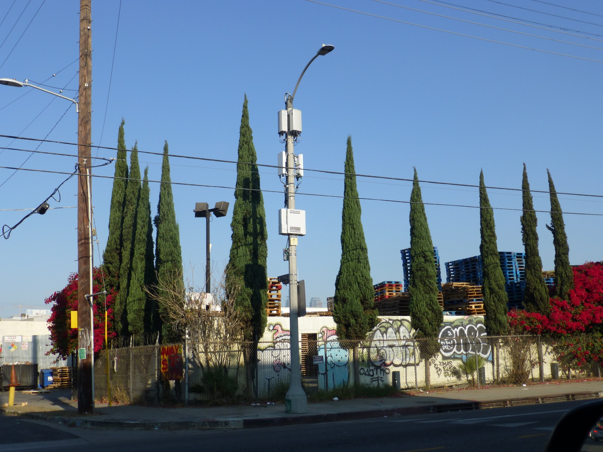
Verizon 4G+/Los Angeles

Slide 42
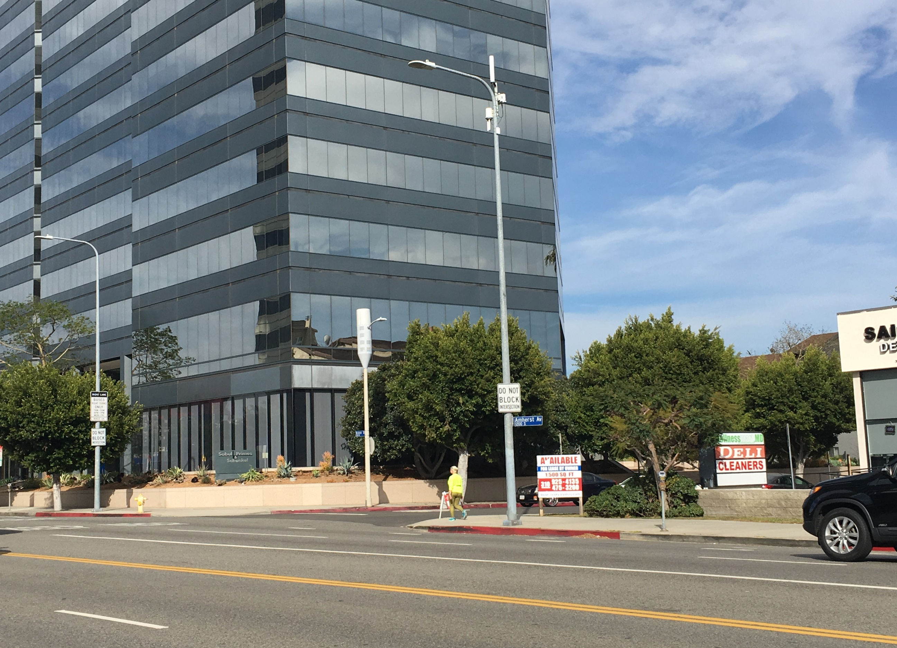
Sprint by
Mobilitie
AT&T.
Los Angeles, CA

Slide 43
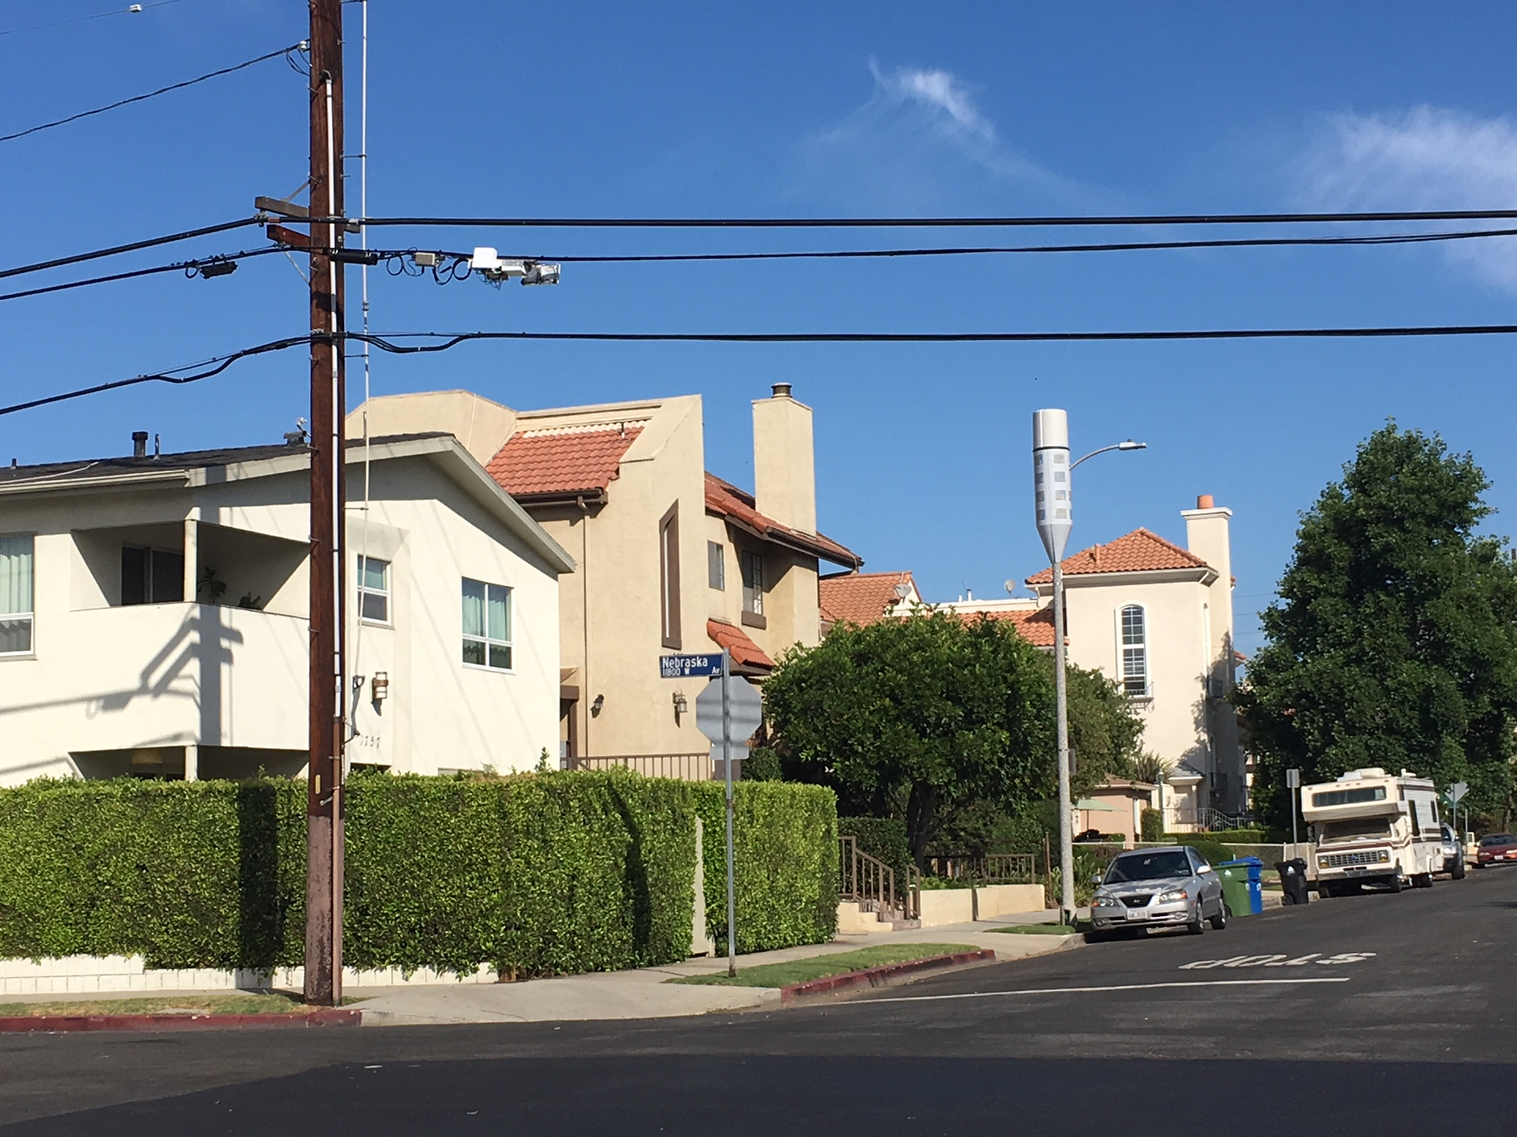
T-Mobile by Crown Castle
AT&T
Los Angeles, CA

Slide 44
Questions?

